Slide 1
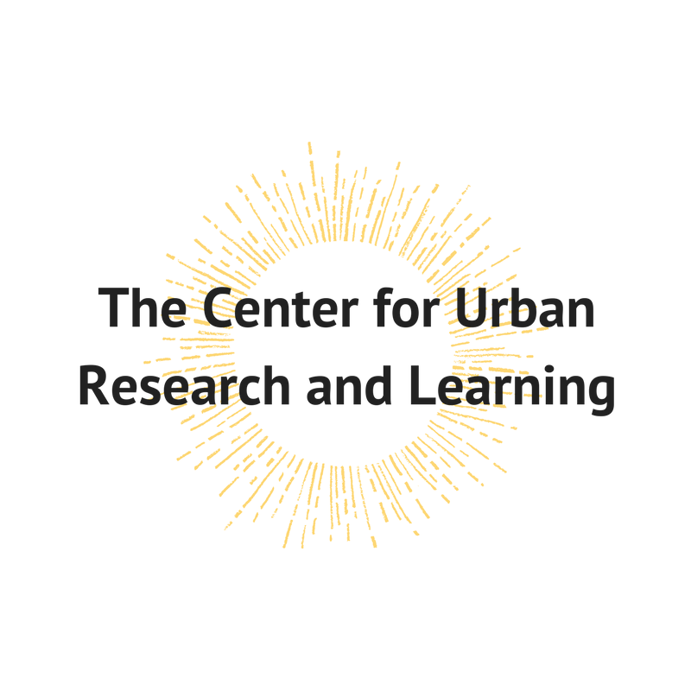
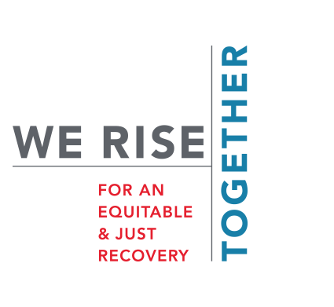
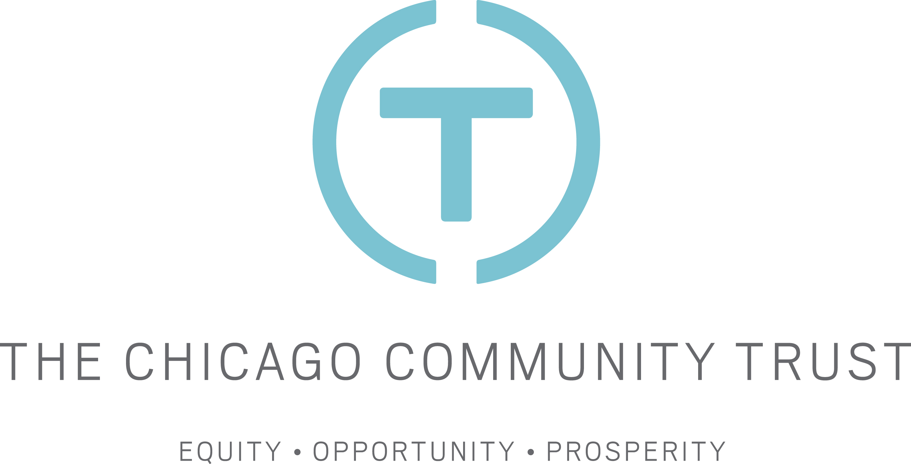

Assessing the Impact of Investments in Community-Based Organizations as a Method of Promoting Equitable Economic Recovery from the Covid-19 Pandemic in Chicago's South and West Sides
Gina Spitz, CURL; Brett Coleman, CURL; Sean Cunnane, CURL
Loyola University Chicago Center for Urban Research and Learning in collaboration with The Chicago Community Trust and MAPSCorps
Abstract
Findings and Analysis
The Covid-19 pandemic had a negative economic impact on many marginalized neighborhoods in Chicago which have already suffered from years of lack of investment. The Chicago Community Trust, aiming to help these communities not only recover to pre-pandemic economic levels, but to reach more equitable economic conditions, has begun investing through its We Rise Together initiative in neighborhood anchor sites. CURL, in collaboration with MAPSCorps, the Quinlan School of Business, and the Institute for Racial Justice, is assessing the impact of these investments using community-engaged evaluations, secondary economic data, and stakeholder engagement. Thus far in our research, it is increasingly clear that access to funding, opportunities for youth development, and ownership of businesses by community members are some of the major goals the We Rise Together Initiative should continue to strive for in its investments.
Findings thus far are preliminary, as this evaluation will continue through 2025. Secondary data collection is in the early stages, and resources such as the American Community Survey will not have recent enough data to evaluate the impact of We Rise Together investment sites for a few more years. All findings to this point come from the survey results and the focus groups.
Covid Impact
Community members in each of the five communities largely agreed that Covid-19 had an impact on their local economy. Overall, 161 of the 233 total local resident survey respondents said Covid-19 had a “very significant” impact on the local economy, with 40 respondents saying Covid-19 had a “significant” impact.
2 Year Future Economic Outlook
Survey respondents were largely optimistic about the 2 year economic outlook for their communities. Of 232 respondents, 120 said that they expected the neighborhood to be doing “better” economically in 2 years. Only 49 respondents said the neighborhood would be doing “worse,” while the rest said the neighborhood would be “about the same.”
Future Neighborhood Jobs
Residents were asked to rate on a scale of 1 to 5 how likely they thought good paying jobs were to come to the neighborhood in the next two years. Despite the majority of respondents reporting that they expect their neighborhood to be doing “better” economically in two years, only 88 of 230 respondents thought good paying jobs were either “very likely” or “somewhat” likely to come to the neighborhood. The most common response was that good paying jobs were “neither likely nor unlikely” to come to the neighborhood in the next two years.
Background and Introduction
Chicago’s growth and economic outlook has lagged since the Great Recession, and the economic divide between white communities and communities of color further deepened during the pandemic. The Chicago Community Trust’s We Rise Together initiative is focusing significant investments on long-disinvested Black and Latinx communities aiming to strengthen the entire Chicago region. CURL has partnered with MAPSCorps, the Quinlan School of Business, and the Institute for Racial Justice to evaluate the impact of We Rise Together investments. The goal of the We Rise Together initiative is to help communities of color to recover not just to pre-pandemic economic conditions, but to a more equitable economic level on par with the rest of Chicago.
Our goal is to understand the local impact of We Rise Together investment sites. Using both primary data from resident surveys and secondary economic data, we aim to understand the intersection of what these communities want and need in order to develop economically in an equitable way. With our findings, we will be able to advise the Chicago Community Trust on what sort of sites they should receive future funding in order to maximize the impact of the We Rise Together initiative.
Focus Group Themes
Accessible Funding
Access to funding was a commonly cited concern among focus group participants. Residents discussed the difficulty that many community members have in accessing funding, whether due to confusing language surrounding loans or a simple lack of funding for the area.
Community Ownership of Local Businesses
In connection with funding, focus group participants expressed an interest in future We Rise Together investments going toward businesses in their communities which are owned by community residents. Participants highlighted a need for self-sufficiency in their community, and many agreed that community members owning local businesses is an important part of achieving this goal.
Youth Development, Not Just Jobs
Some participants felt that We Rise Together investments should not go to restaurants. They expressed that although job opportunities for youth (such as jobs at restaurants) are generally good, it is more important that there are places in the community where youth can go to develop skills for future jobs, rather than places that simply offer minimum wage for part-time jobs. Interestingly, some participants expressed that restaurants could be good community anchor sites, as they serve as gathering places for community members. Generally, participants agreed that youth training and development is more important than just getting youths part time jobs.
Design and Methods
This study focused on five neighborhood anchor investment sites. They were Esperanza Health Center in West Lawn, ChiFresh Café & Kitchen in Greater Grand Crossing, Urban Core Wellness Hub in South Shore, Ogden Commons in North Lawndale, and North Lawndale Employment Network Headquarters, also in North Lawndale. The first phase of our research involved surveys with local residents and small businesses near the investment sites to assess the following: the economic state of the neighborhood before and during the pandemic; the neighborhood’s economic future; and future investments that could help the neighborhood.
We also examined secondary data related to local foot traffic and spending in the different neighborhoods. In collaboration with the Quinlan School of Business, we partnered with MasterCard to measure changes in spending patterns at small businesses in the 15-minute walking distance radius. We also made use of SafeGraph cell phone data to measure changes in foot traffic near the investment sites.
Finally, CURL has collaborated with MAPSCorps to conduct focus groups with community members. Those eligible for participation in these focus groups must either live or work in the neighborhood. Thus far, we have conducted 2 in-person focus groups in South Shore and North Lawndale. In these focus groups, we discuss with residents how they view the economic conditions in their neighborhood. We provide participants with a summation of the local resident survey results from the neighborhood and discuss their opinions on why local residents responded the way they did. The focus groups are recorded and coded for thematic patterns. Both the conducting and coding of focus groups is an ongoing aspect of the We Rise Together evaluation.
References
“We Rise Together: For an Equitable and Just Recovery.” We Rise Together, Chicago Community Trust, 7 Dec. 2022, https://wrtogether.org/.

