Slide 1
Gene Annotation of Akt in Drosophila persimilis
Authors: Julia Kaniuk, Chinmay P. Rele, Katie M. Sandlin, Laura K. Reed, Dr. Jennifer Mierisch
Notes:
Double check author list
1 - me
5- Dr. M

Slide 2
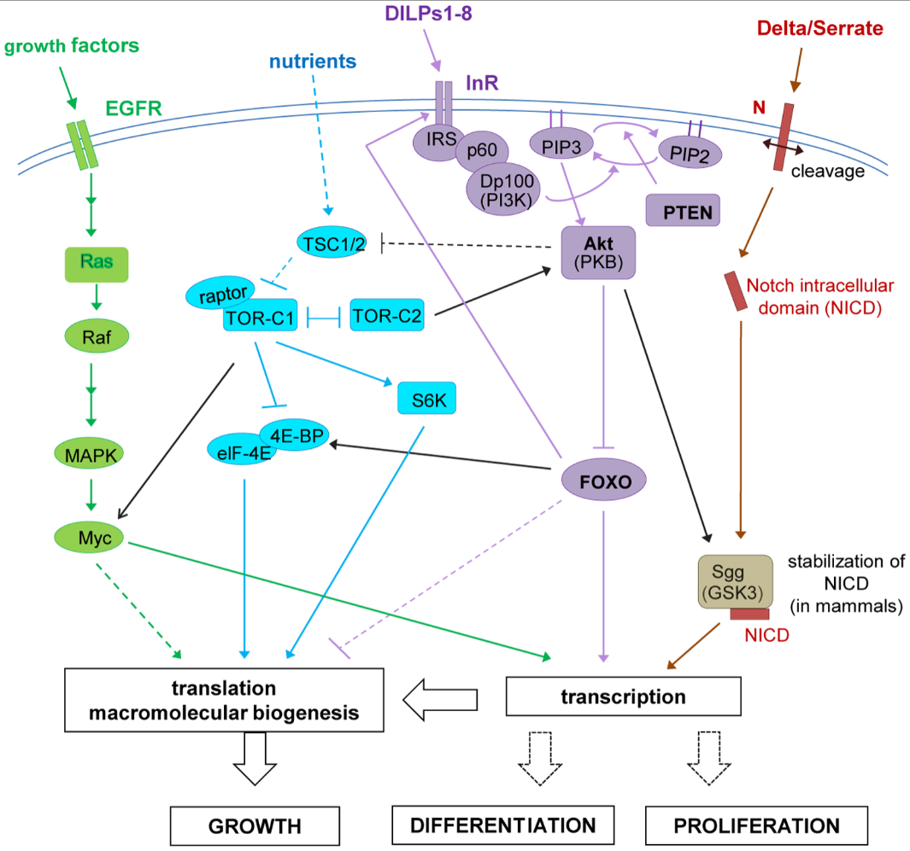
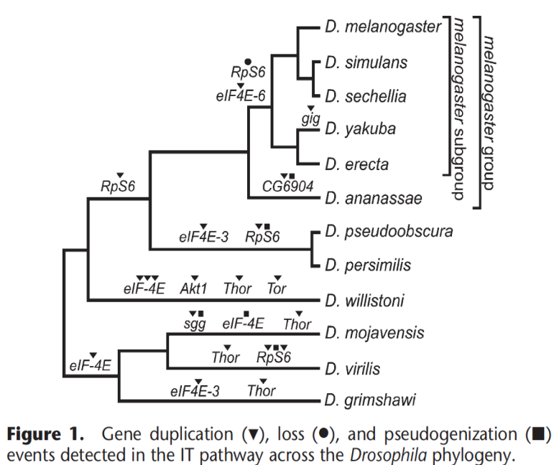
Insulin Pathway
Alvarez-Ponce et al. (2009)
Dutriaux et al. (2013)
Notes:
The main focus of this GEP project overall is examining insulin pathway which is a very important metabolic pathway for processing sugar and is found in all Drosophila species. The main goal of this project is to determine “How much of the pathway is conserved as compared to what is characterized in D. melanogaster?” and “If a change occurred, where is it and how consistent is the change among other species?”
Existing evidence suggests that molecules earlier in insulin signaling pathways evolve more quickly than later molecules. The phylogenetic tree on the left from a paper characterizing the insulin/ TOR signal transduction pathway shows an increased amount of changes in more diverged species. Akt is seen to be affected, specifically duplicated, in the divergence of Drosophila willistoni which could be a clue for potential divergence in species closely related to D. willistoni.
We will be focusing on the enzyme Akt …

Slide 3
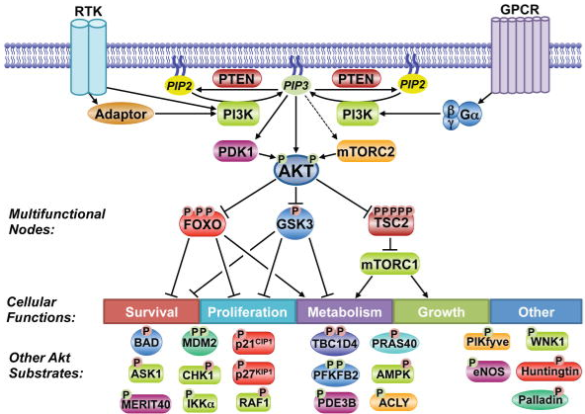
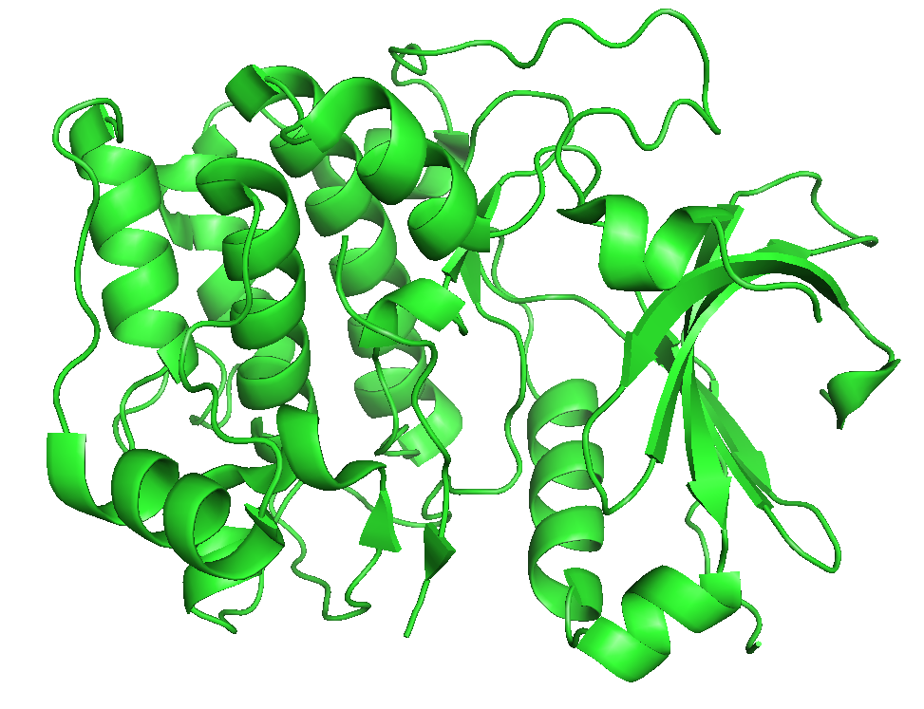
Akt Kinase
PKB (protein kinase B)
Serine/ threonine kinase family
Involved in insulin-mediated cell proliferation
Freeman-Cook et al. (2010)
Manning et al. (2017)
Notes:
Akt plays a role in many key systems but our focus will be on the metabolism pathway

Slide 4
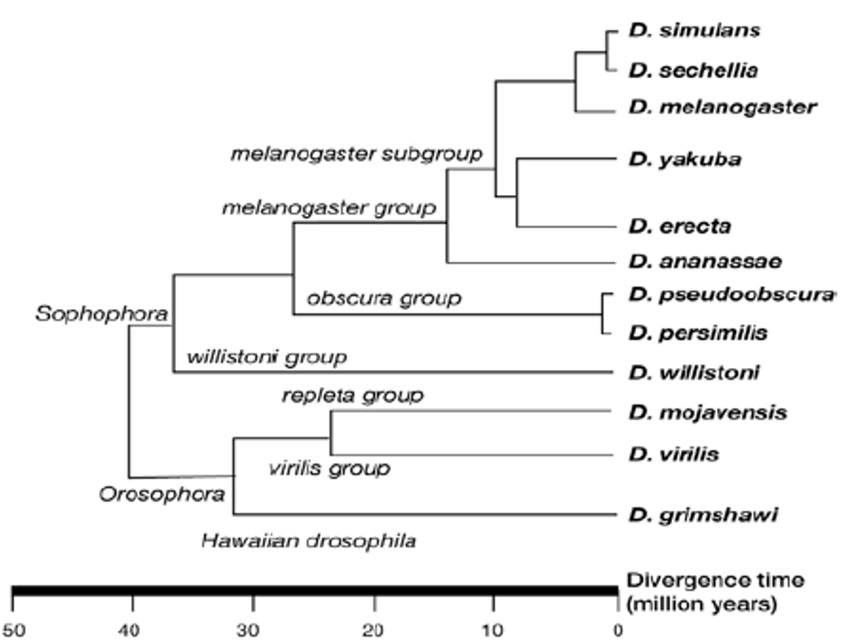
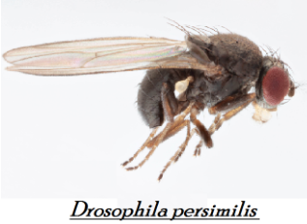
Phylogenetic Background
Mousumi Sepai (2019)
Martignetti et al. (2007)
Notes:
Drosophila persimilis is a sister species of Drosophila pseudoobscura within the “obscura group” which is predominantly found in North America. The divergence of the obscura and melanogaster groups began about 25 million years ago which may imply increased gene evolution between the 2 species. D. persimilis and D. willistoni are phylogenetic neighbors which could indicate a similar pattern of divergence patterns in Akt in Drosophila persimilis. D. willistoni is more diverged than D. persimilis.

Slide 5
Annotation Process
Examine the genomic neighborhood surrounding Akt in D. melanogaster (Genome Browser)
Identify the genomic location of ortholog in D. persimilis (tblastn)
Determine conservation of the local environment (blastp)
Determine Akt structure in D. melanogaster (Gene Record Finder)
Map all coding exons to Akt ortholog (tblastn)
Verify model (Gene Model Checker)
Repeat process each uniquely coded isoform
Notes:
General analysis of tools used:
Tblastn uses amino acid data from the known D. melanogaster gene and finds likely matches within the D. persimilis genome
Blastp identifies the proteins formed by local genes therefore we can observe conservation of the local region, even if the orientation of the genes is flipped onto the opposite strand
Gene Record Finder helps us have an approximation of what we are looking for in terms of CDS length, amount as well as any possible coding isoforms
Tblastn can be also used to approximate the location of coding exons once we have confirmed that we are looking in the correct region (based on synteny). Tblastn is limited in its accuracy of base pair-by-base pair prediction so the coding exons will most likely take manual adjustment by looking at the location of start and stop codons between all 3 phases.
Gene Model Checker checks the model for having the correct number of exons, canonical start and stop codons, and correct splice donor/ acceptor sites based on the lack of intrastrand stop codons.

Slide 6
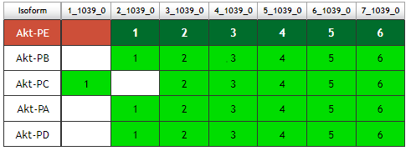
Akt structure in D. melanogaster
GEP Gene Record Finder
Notes:
Here we can see the known structure of Akt in D. melanogaster from the Gene Record Finder. The thinner blue bars indicated the UTRs, which were not the focus of this project, and the wider blue bars indicate the coding regions. As seen on the diagram as well as the chart, there are 2 unique coding isoforms with Akt- PA, PD, PB, PE as identical exons and Akt-PC being unique with a slightly longer CDS 1. This is something to keep in mind when annotating Akt in D. persimilis.
2 unique coding isoforms

Slide 7
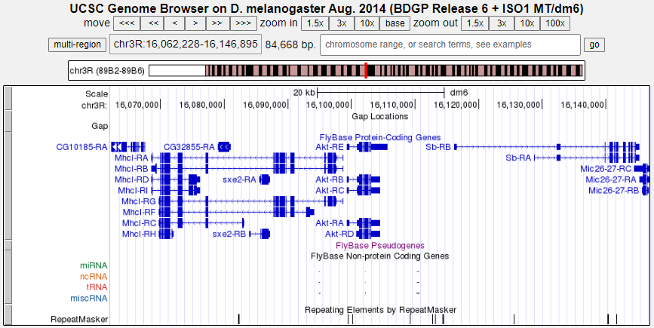
Akt in D. melanogaster
GEP UCSC Genome Browser Gateway
Notes:
Here is the known location of Akt in D. melanogaster along with its neighboring genes. Here we see Akt on the + strand surrounded by sxe2, Mhcl, Sb, and Mic26-27. The organization of these genes relative to one another, known as synteny, will be an important principle in locating the ortholog in D. persimilis. The directionality of the genes should be noted as well as the relative distances between them, such as the ~15000 base pair gap between Akt and Sb.

Slide 8
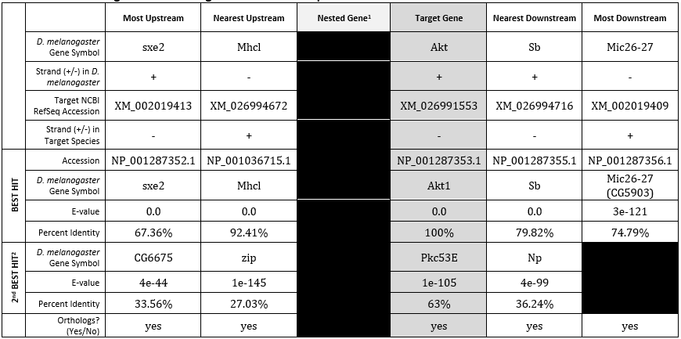
Akt in D. melanogaster
Notes:
Here is a neater chart representation of the previous diagram. The green box indicates all information relevant to Akt in D. melanogaster.
Confirmed location with tblastn

Slide 9
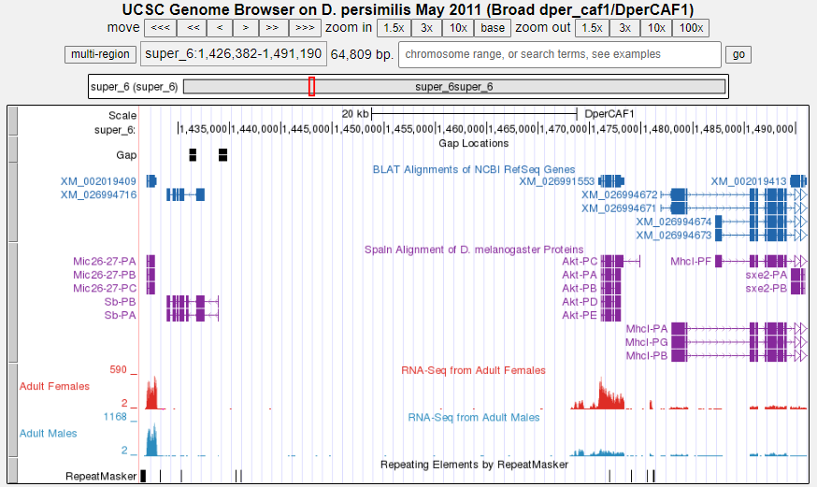
Akt in D. persimilis
GEP UCSC Genome Browser Gateway
Notes:
Here is the genome browser view of the predicted Akt ortholog in D. persimilis using tblastn data. The blue markings indicate so far unnamed genes in D. persimilis while the purple boxes are computer predictions comparing the genomes of D. melanogaster and D. persimilis. This is where blastp will be used to characterize genes in D. persimilis. We can also see here that the orientation appears to be flipped onto the opposite strand in comparison to D. melanogaster so we will want to note of whether the orthologs neighboring genes have followed a similar pattern of divergence. Another interesting thing to note is the greatly increased distance of ~40000 pair gap between Akt and Sb compared the ~15000 base pairs in D. melanogaster.
Talk about blastp confirmation to transition
Flipped strand
~40000 pair gap between Akt and Sb → NOTED EXPANSION?

Slide 10
Akt in D. persimilis
Notes:
Explain the logic of using Target NCBI RefSeq Accession → Accession → best hit vs second best hit → conclusions about genomic neighborhood
E-value and percent identity are both measures of accuracy where an e-value of 0.0 is the best and the greater the percentage identity, the better the hit is. Talk about orthologs

Slide 11
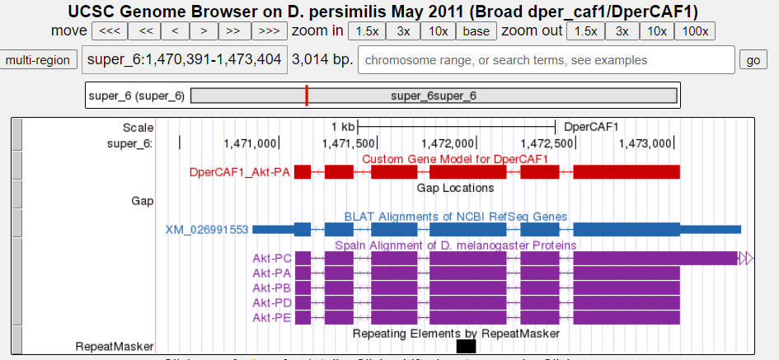
Akt-PA, PB, PD, PE Gene Model
GEP Gene Model Checker

Slide 12
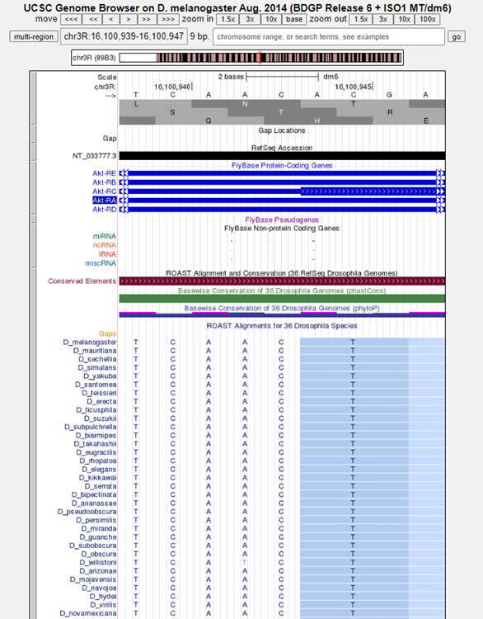
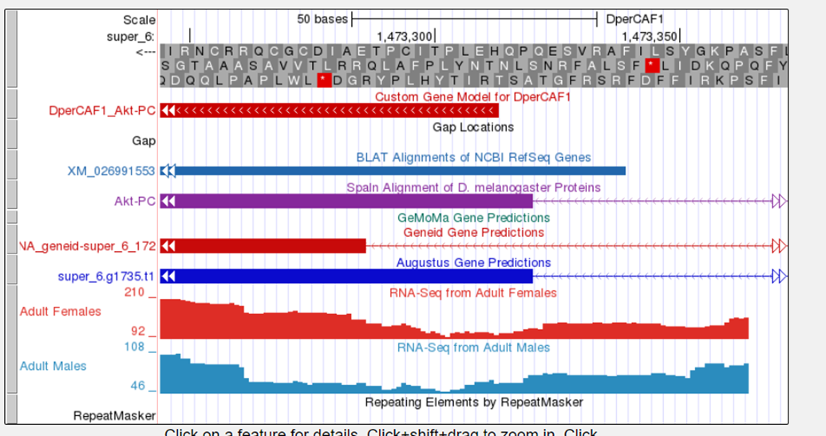
Akt-PC Gene Model
GEP Genome Browser; GEP Flybase
Notes:
tblastn did not yield good results for the first coding exon of Akt-PC so we decided to look in Flybase to see if there were any indications
Emphasize the adjusted first coding exon in Akt-PC
Mention the fail in “check for start codon” and rationale for using a non canonical start codon according to GEP Flybase data

Slide 13
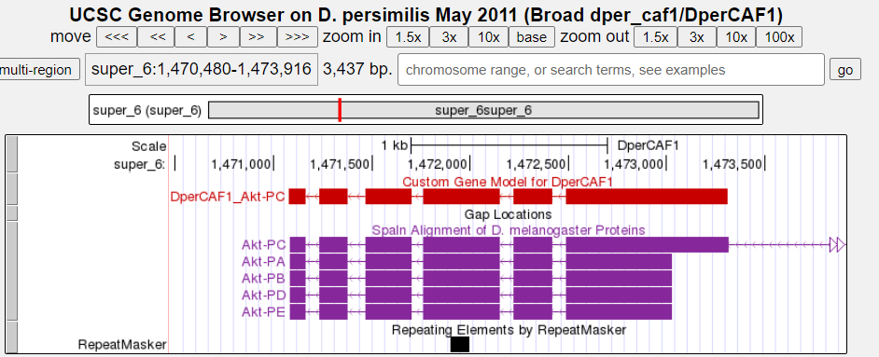
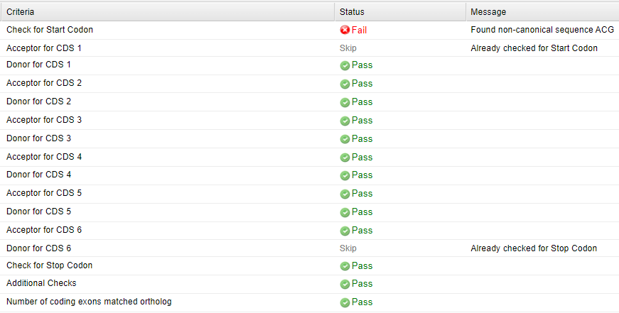
Akt-PC Gene Model
GEP Gene Model Checker; GEP Flybase
Notes:
Blastp did not yield good results for the first coding exon of Akt-PC so we decided to look in Flybase to see if there were any indications
Emphasize the adjusted first coding exon in Akt-PC
Mention the fail in “check for start codon” and rationale for using a non canonical start codon according to GEP Flybase data

Slide 14
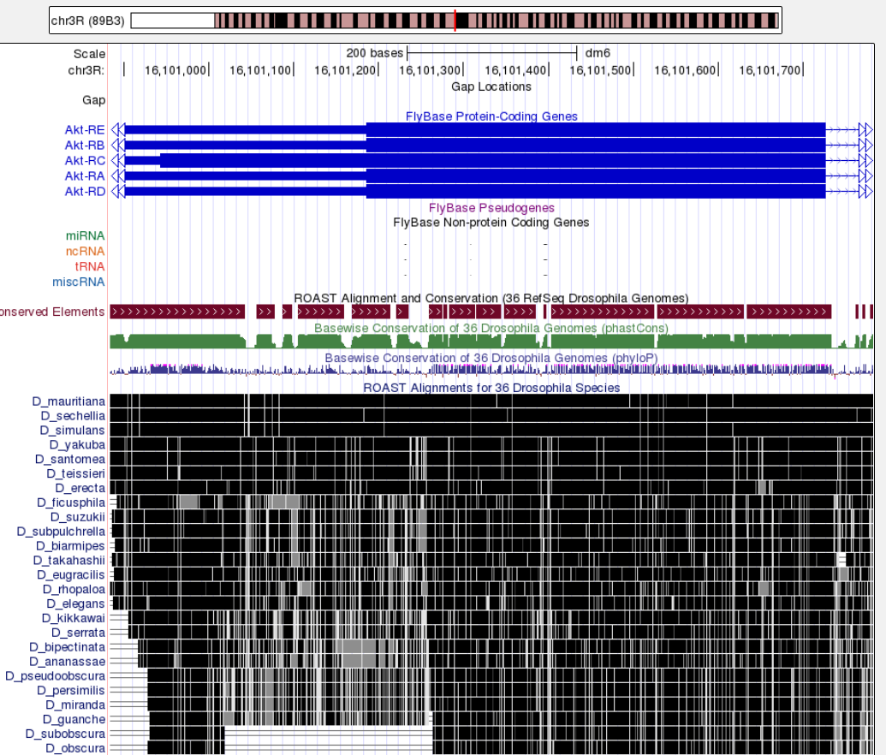
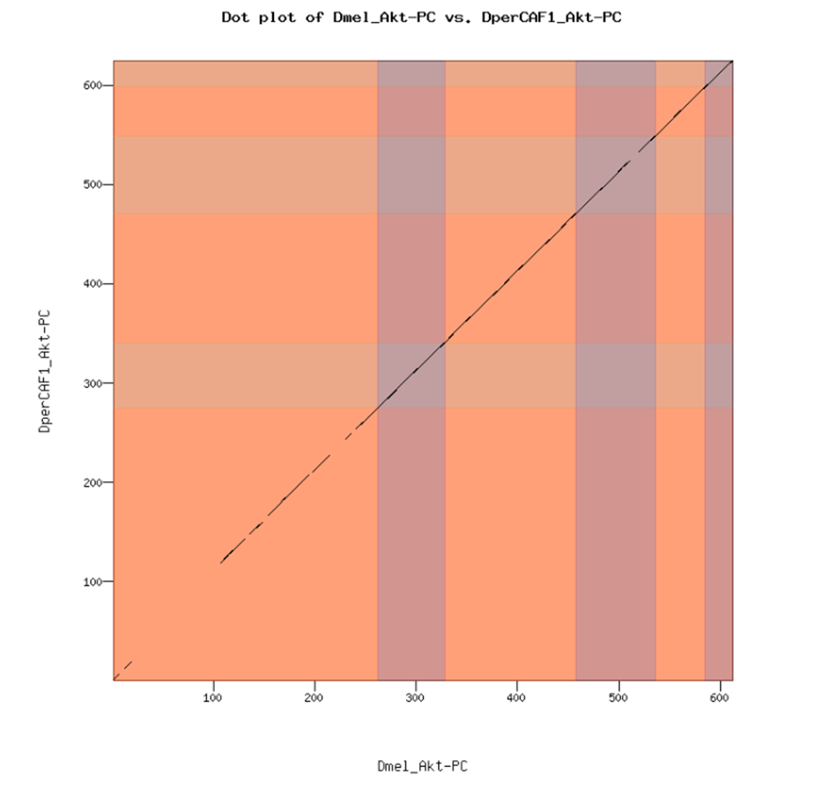
Poor conservation of CDS 1 in Akt-PC
GEP Gene Model Checker
Notes:
Poor conservation is seen in CDS 1 which is consistent with further divergence from Akt in D. melanogaster as the species become more diverged.
Explain that the dot plot plots a point based on perfect matches on the amino acid level therefore we don’t know if an amino acid has been completely changed to another with different properties or if the switch was made within the same amino acid group.
Mention the pattern of divergence and what that tells us about the expected conservation of Akt in D. persimilis

Slide 15
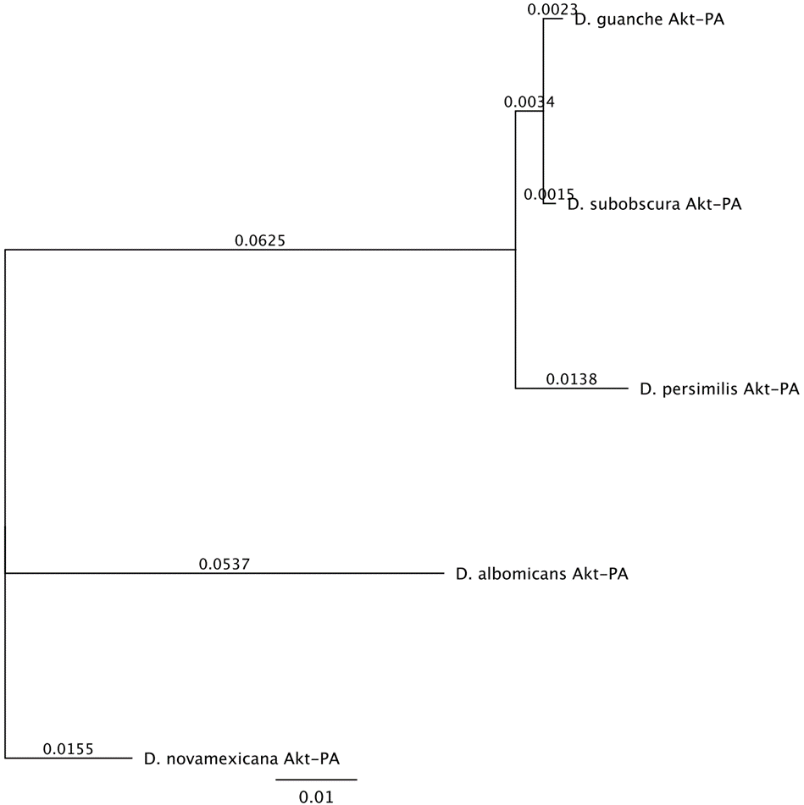
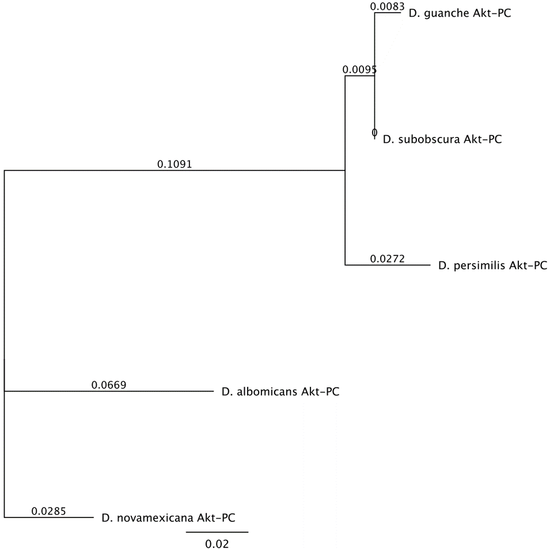
Synteny Across Multiple Species
Notes:
How do I explain these charts?

Slide 16
Acknowledgements
Notes:
Thank LUC for Biology Fellowship funding and Dr. Mierisch for her guidance
Thank GEP for the opportunity to present this project

Slide 17
Questions?

Slide 18
Works Cited
Dutriaux A, Godart A, Brachet A, Silber J (2013) The Insulin Receptor Is Required for the Development of the Drosophila Peripheral Nervous System. PLoS ONE 8(9): e71857. https://doi.org/10.1371/journal.pone.0071857 https://journals.plos.org/plosone/article?id=10.1371/journal.pone.0071857
Alvarez-Ponce et al. (2009) Network-level molecular evolutionary analysis of the insulin/TOR signal transduction pathway across 12 Drosophila genomes. Genome Res. 19(2):234-242.
J. Med. Chem. 2010, 53, 12, 4615–4622 Publication Date:May 19, 2010 https://doi.org/10.1021/jm1003842
Manning BD, Toker A. AKT/PKB Signaling: Navigating the Network. Cell. 2017 Apr 20;169(3):381-405. doi: 10.1016/j.cell.2017.04.001. PMID: 28431241; PMCID: PMC5546324.
Martignetti, Loredana & Caselle, Michele & Jacq, Bernard & Herrmann, Carl. (2007). DrosOCB: a high resolution map of conserved non coding sequences in Drosophila. https://www.researchgate.net/figure/The-evolutionary-tree-of-Drosophila-genus-according-to-the-12-drosophila-genomes_fig1_1769063
GEP Gene Record Finder https://gander.wustl.edu/~wilson/dmelgenerecord/index.html
GEP UCSC Genome Browser Gateway https://gander.wustl.edu/cgi-bin/hgGateway
GEP Flybase https://flybase.org/
GEP Gene Model Checker https://gander.wustl.edu/~wilson/genechecker/index.html

