Slide 1
Insight into the regulation of
ADP-glucose pyrophosphorylase:
Importance of homologous serines/threonines in the allosteric site
Thomas Bennett
April 22, 2023
2023 Undergraduate Research & Engagement Symposium

Slide 2




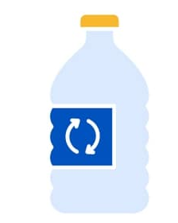

Importance of Starch
Recycled Plastics
Cosmetics
Biofuels
Marques, Susana, et al. “Starch Biomass for Biofuels, Biomaterials, and Chemicals.” Biomass and Green Chemistry, 2017, pp. 69–94., https://doi.org/10.1007/978-3-319-66736-2_4.

Slide 3
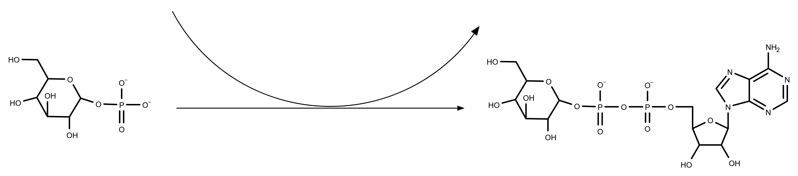
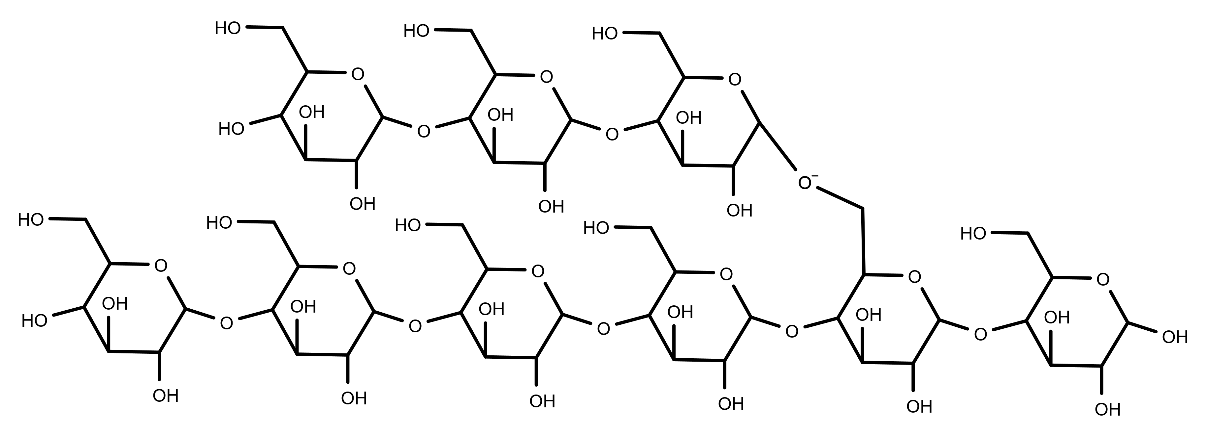
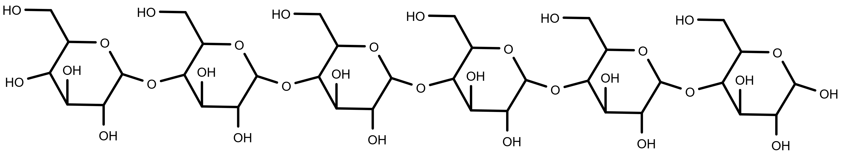
Regulation of starch and glycogen synthesis
ATP
PPi
Mg²⁺
ADP-Glc PPase
Glucose 1-Phosphate
ADP-glucose
Glycogen/starch Synthase
ADP
Branching Enzyme
α-1,4 glucan molecule
Starch/Glycogen
Ballicora, M. A., Iglesias, A. A., and Preiss, J. (2004), Photosynth Res 79, 1-24

Slide 4
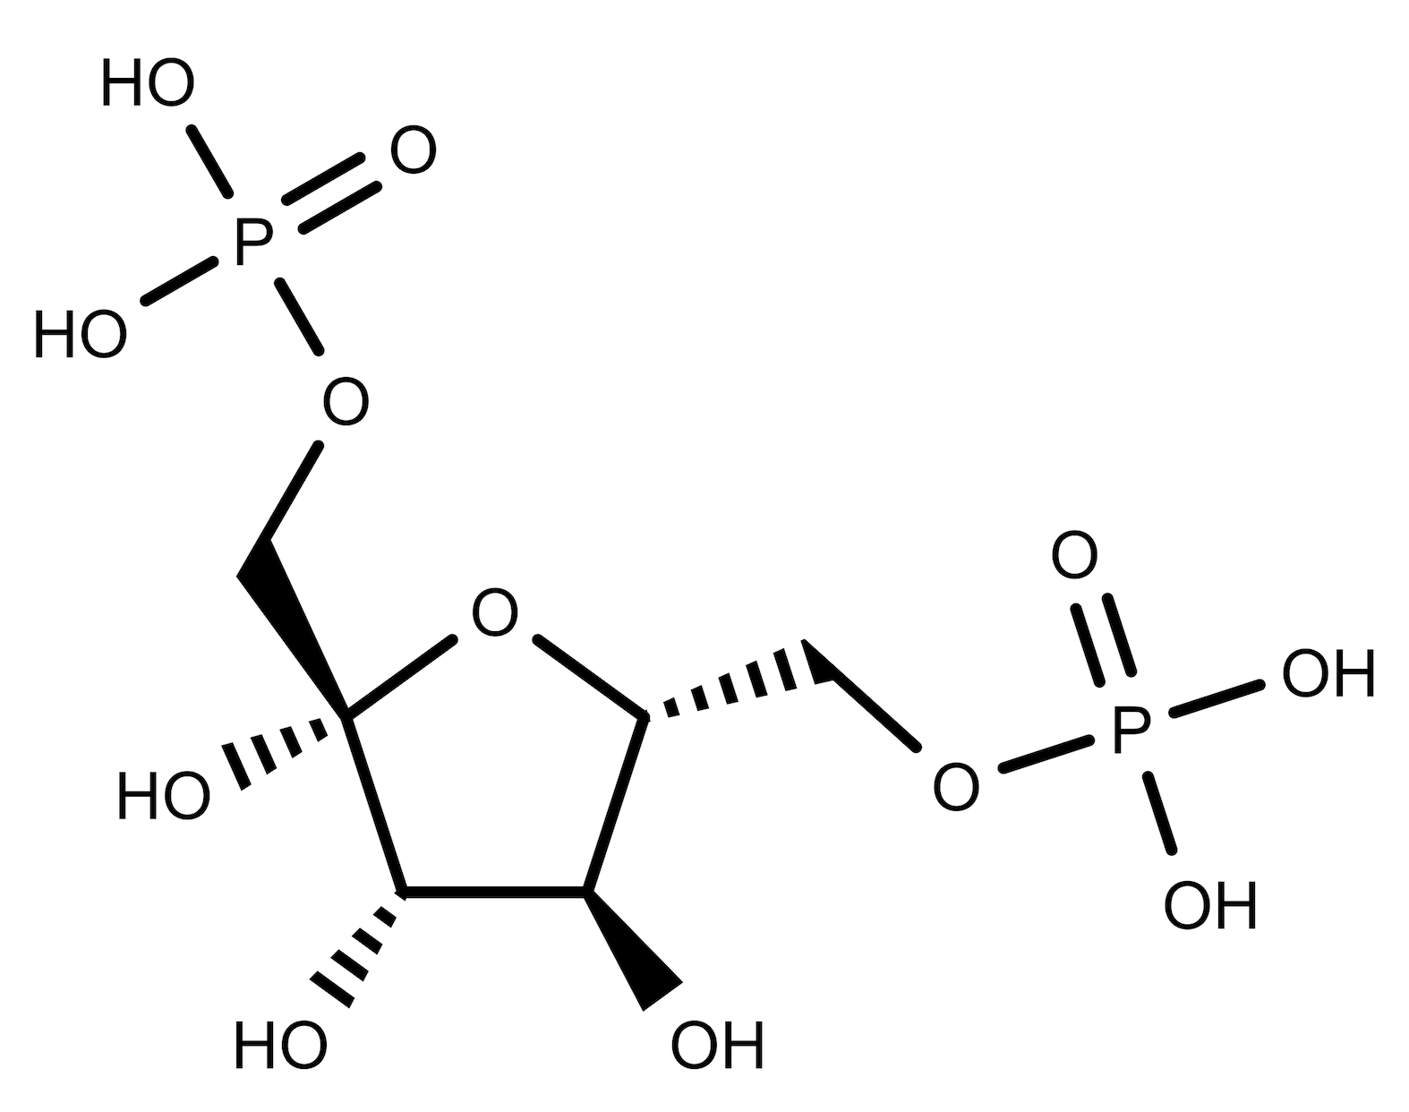
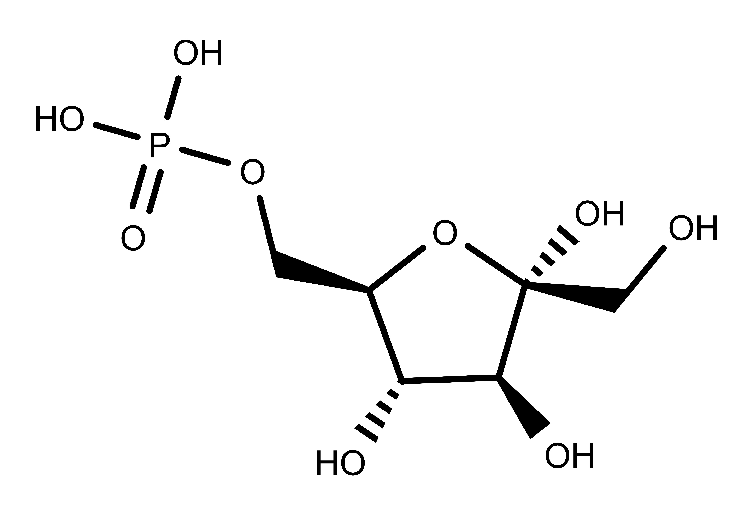
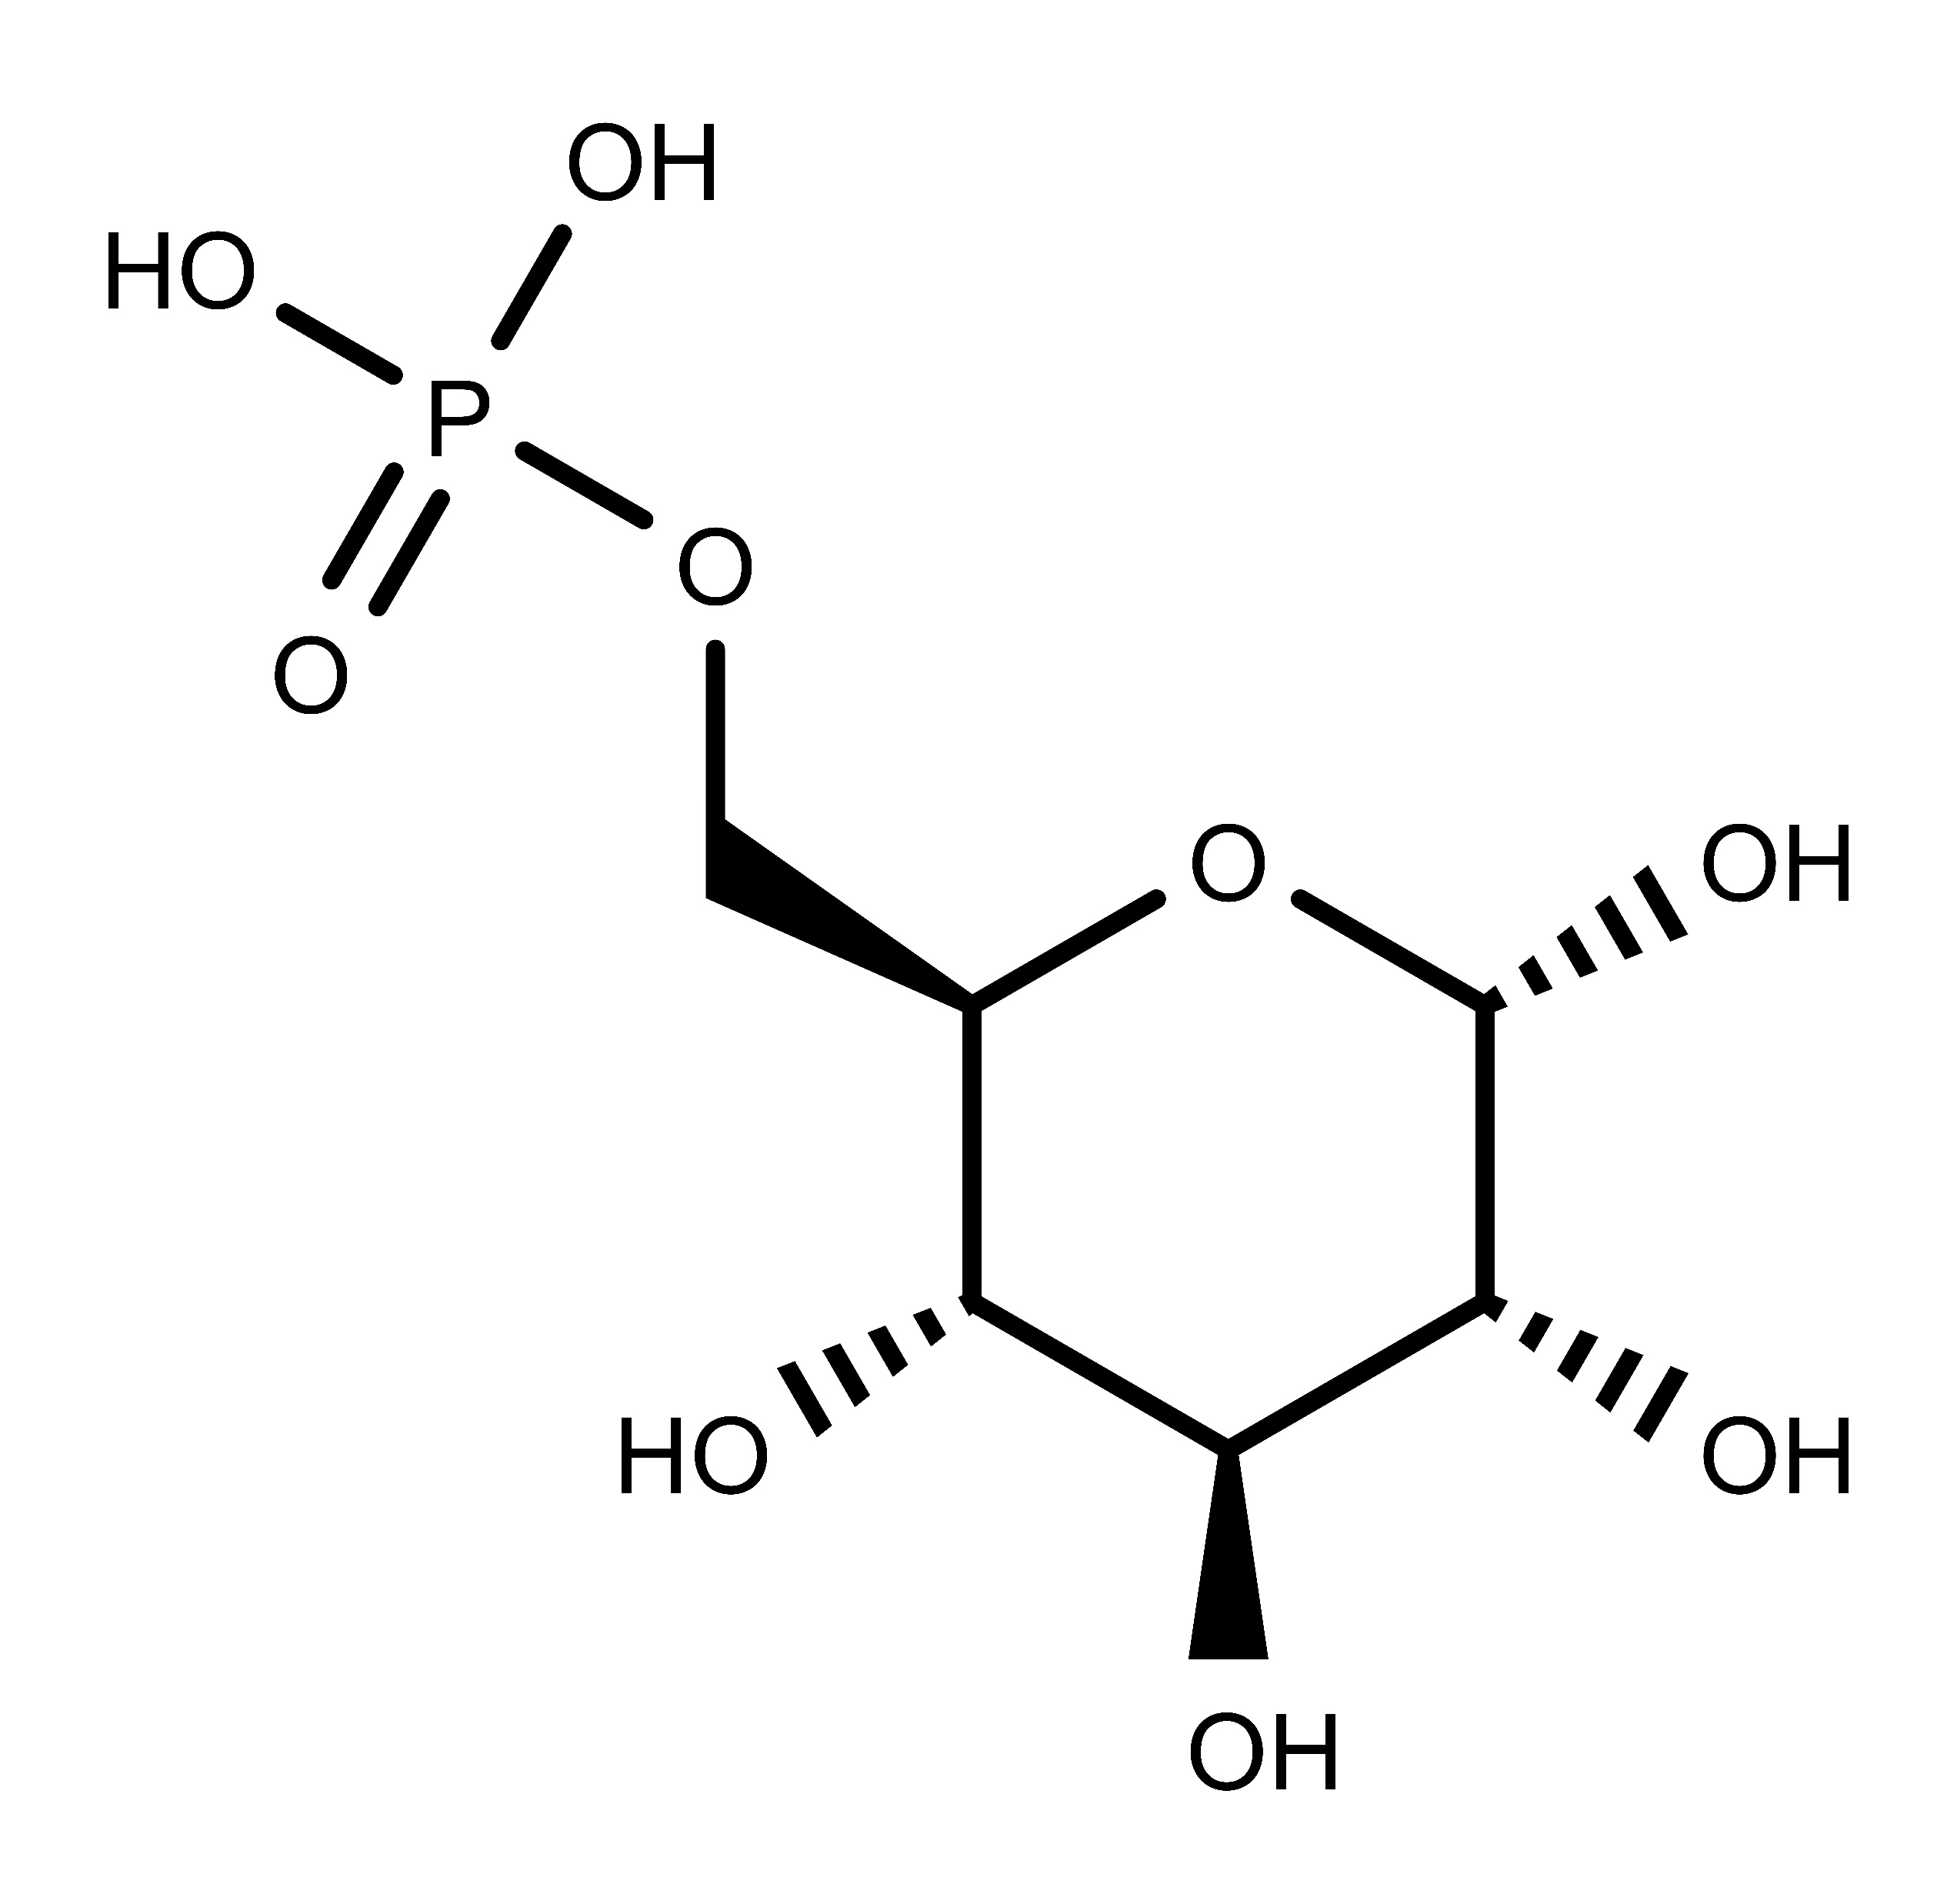
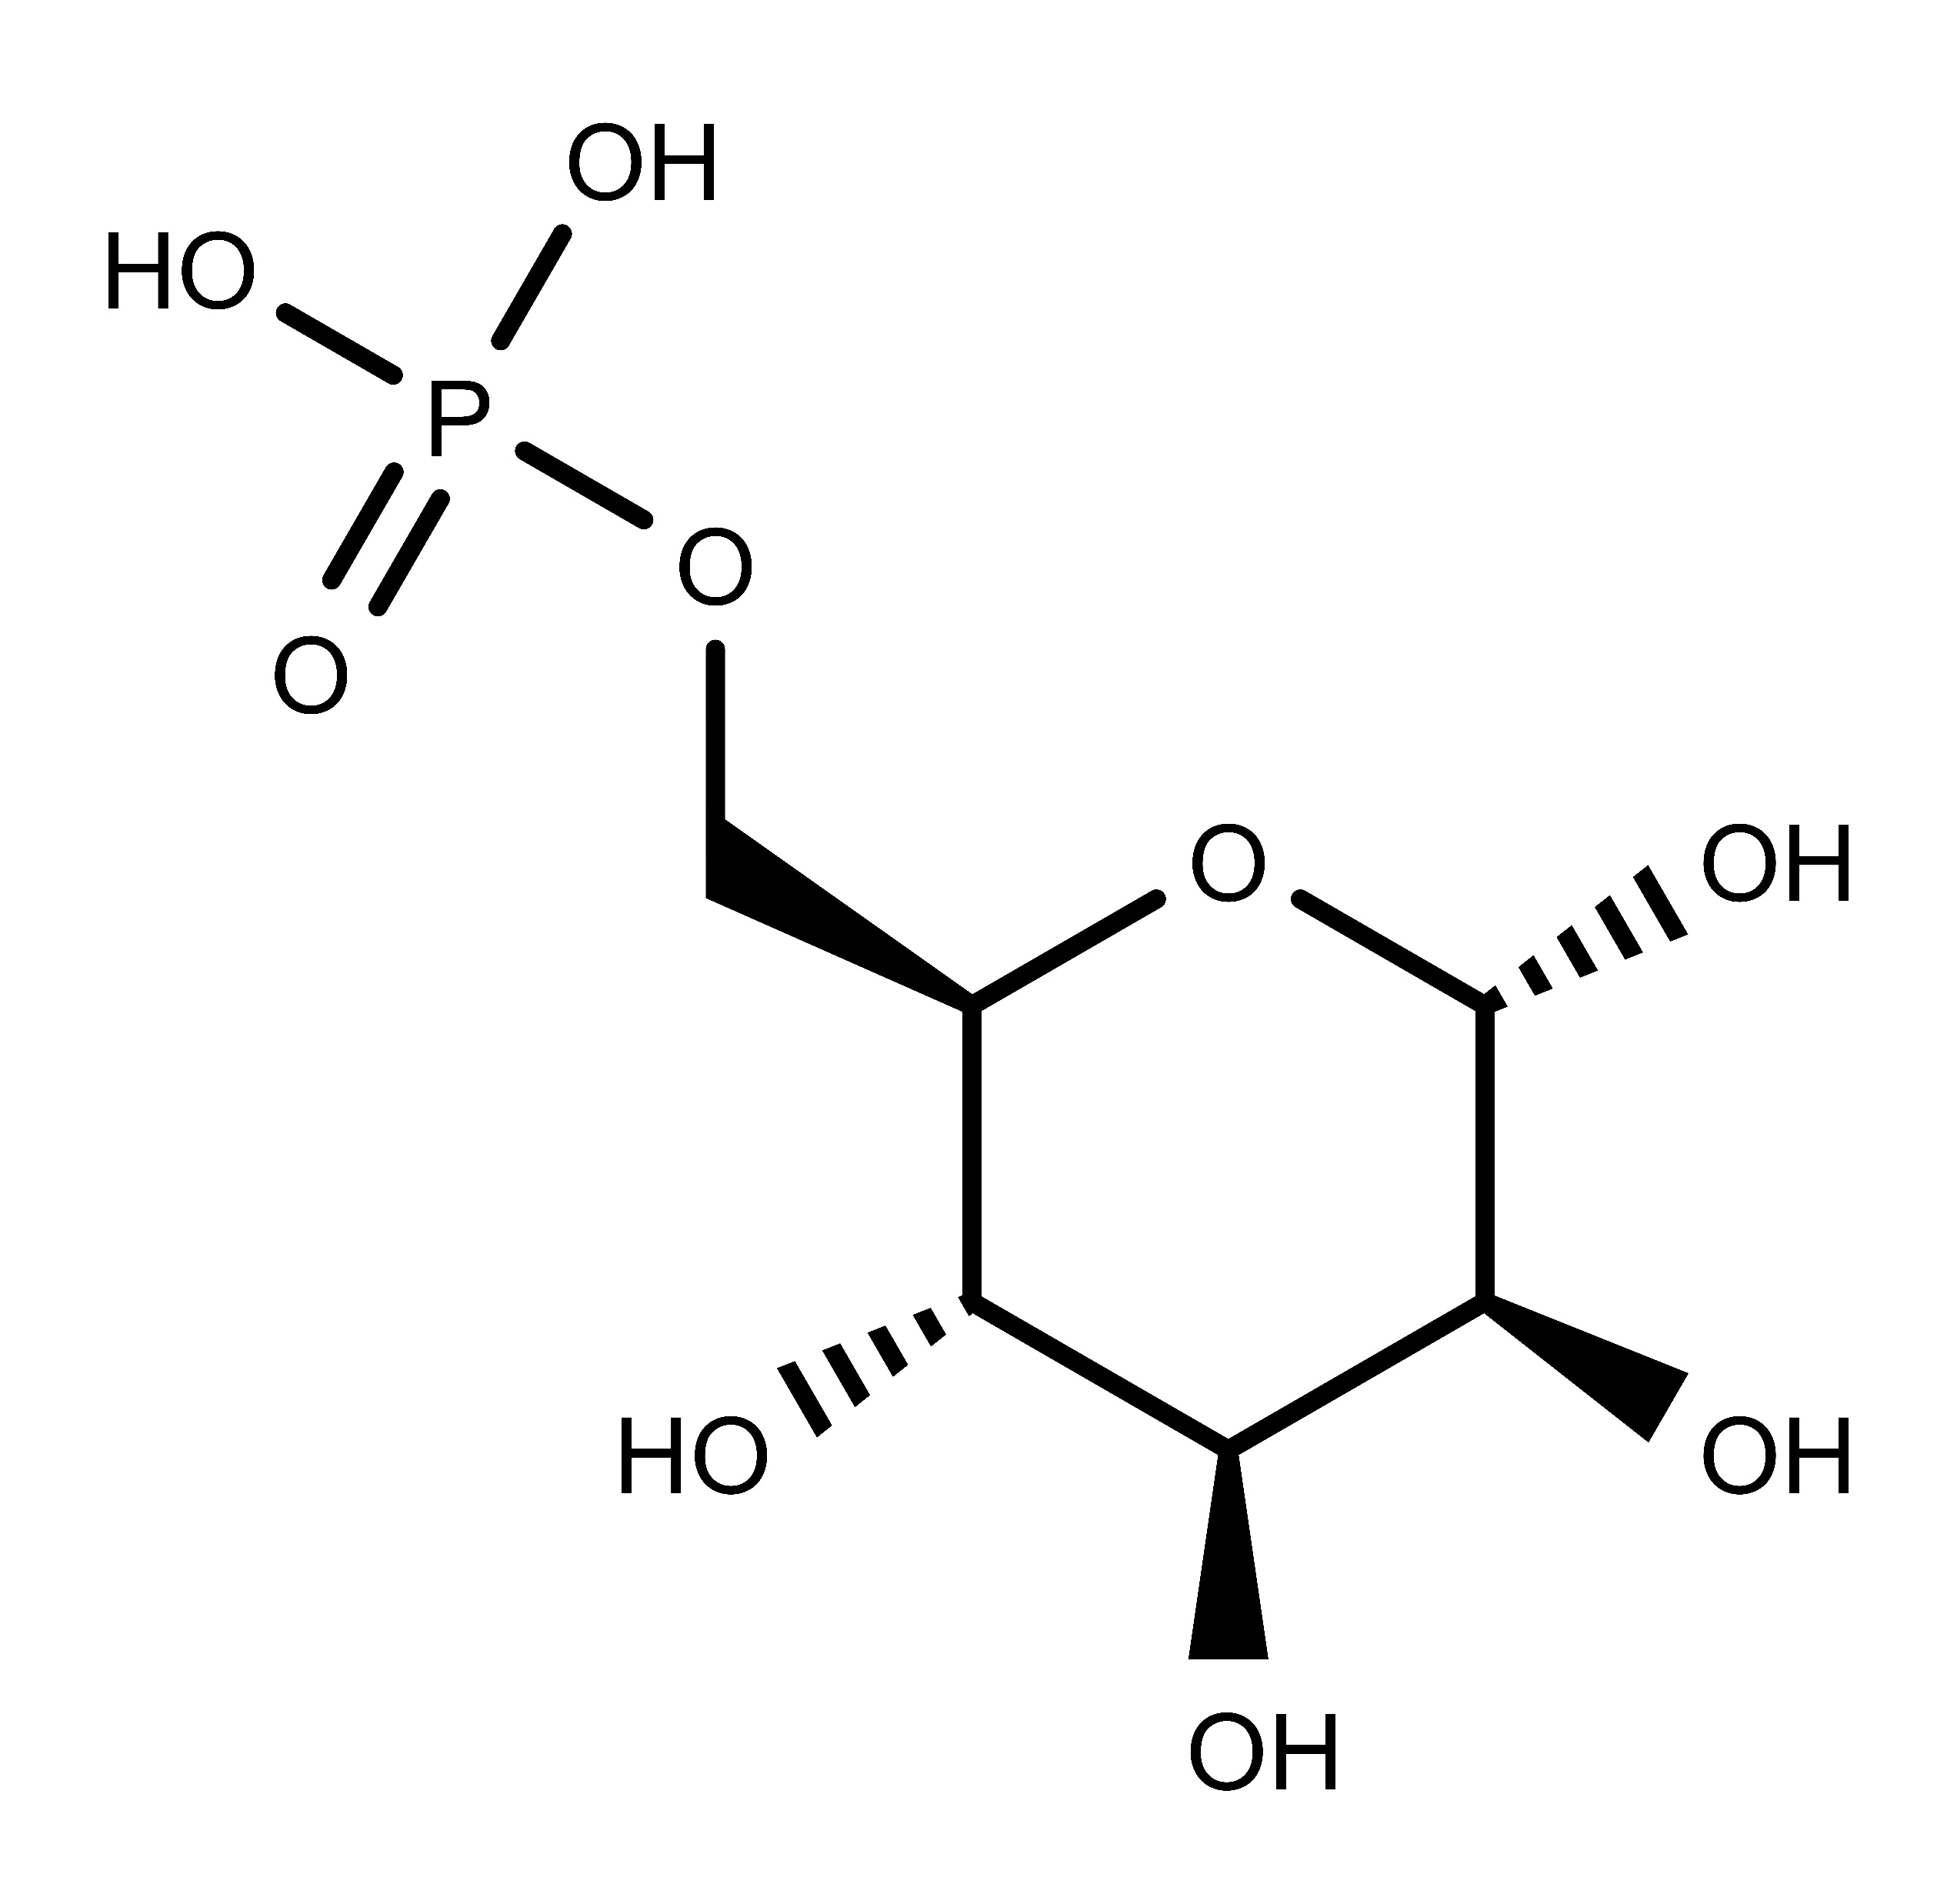
Allosteric regulation in detail
ATP
PPi
Glc1P
Mg⁺²
ADP-Glc
ADP-Glc PPase
Fru6P
Glc6P
Man6P
FBP

Slide 5
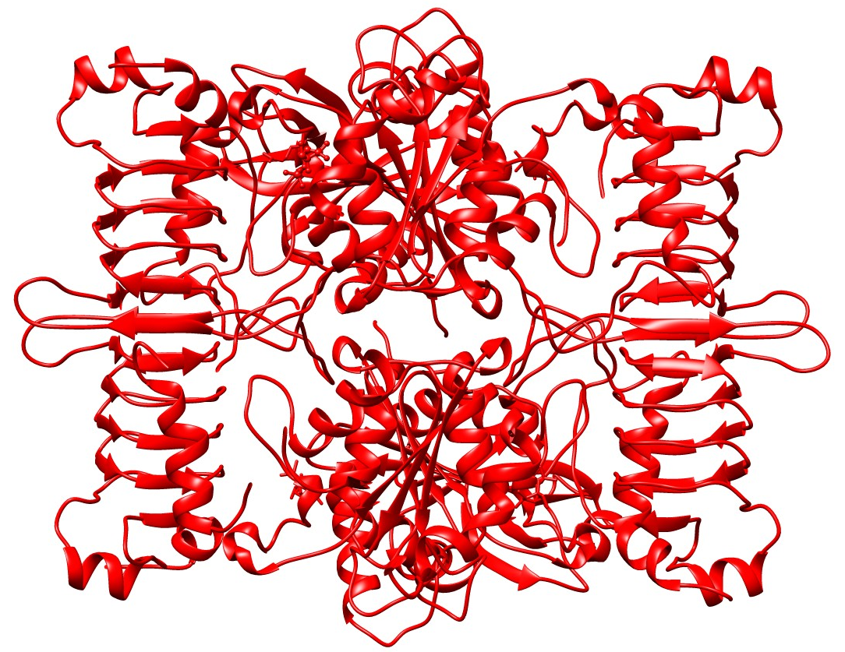
Structure of Agrobacterium tumefaciens
α₁
α₂
α₃
α₄
Hussien, R., Zheng, Y. et al., Unpublished

Slide 6
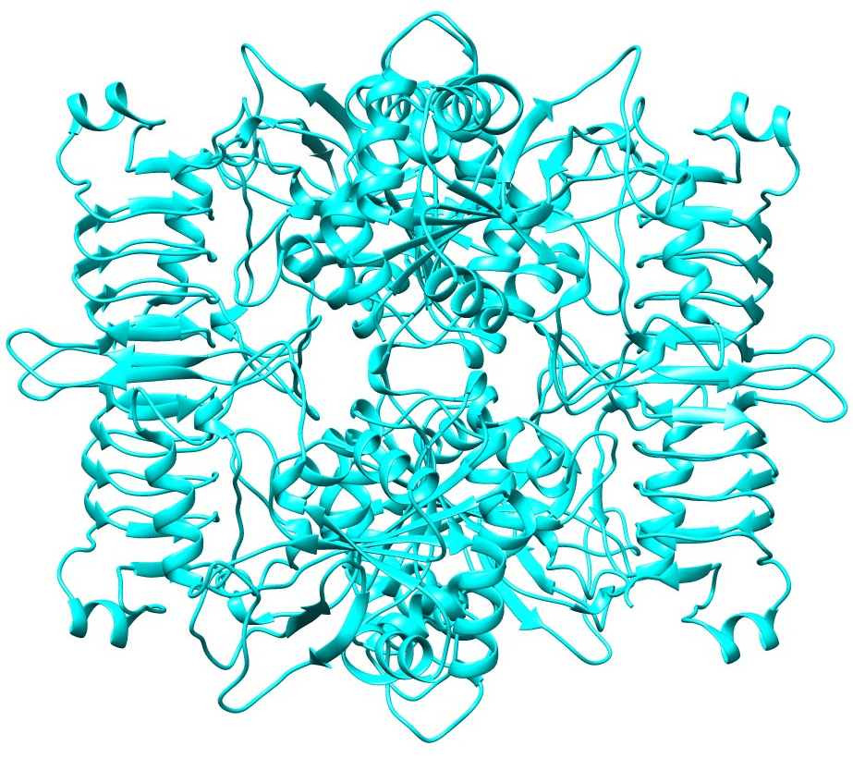
Structure of Melainabacteria
α₁
α₂
α₃
α₄
Hussien, R., Zheng, Y., Bhayani, j., et al., Unpublished

Slide 7
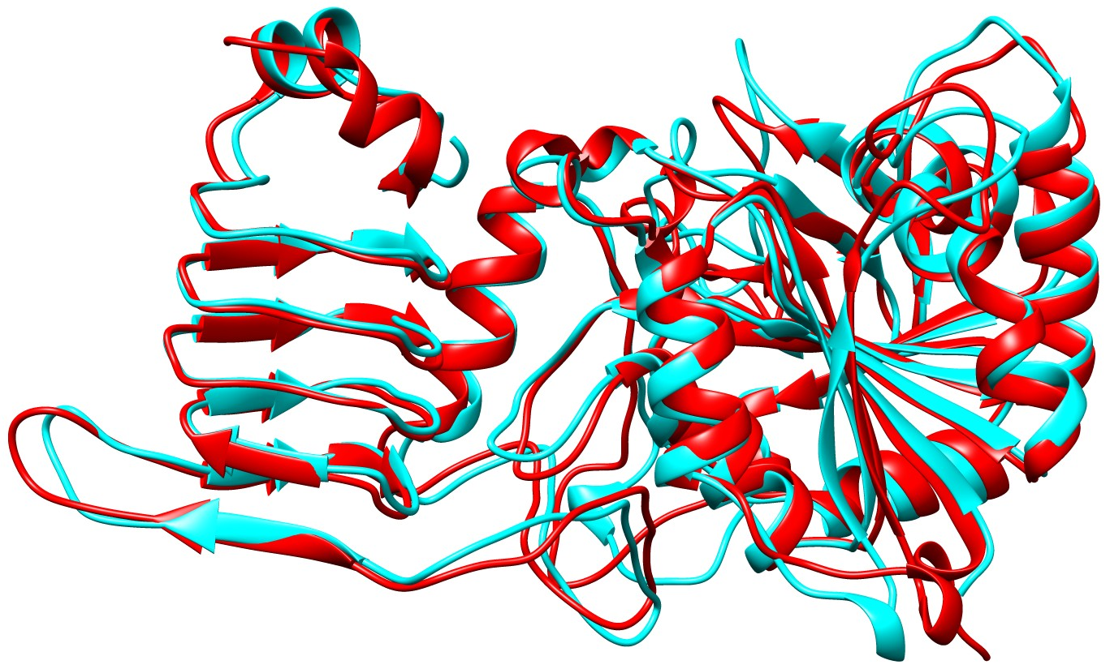
Structure Comparison
Hussien, R., Zheng, Y. et al., Unpublished

Slide 8
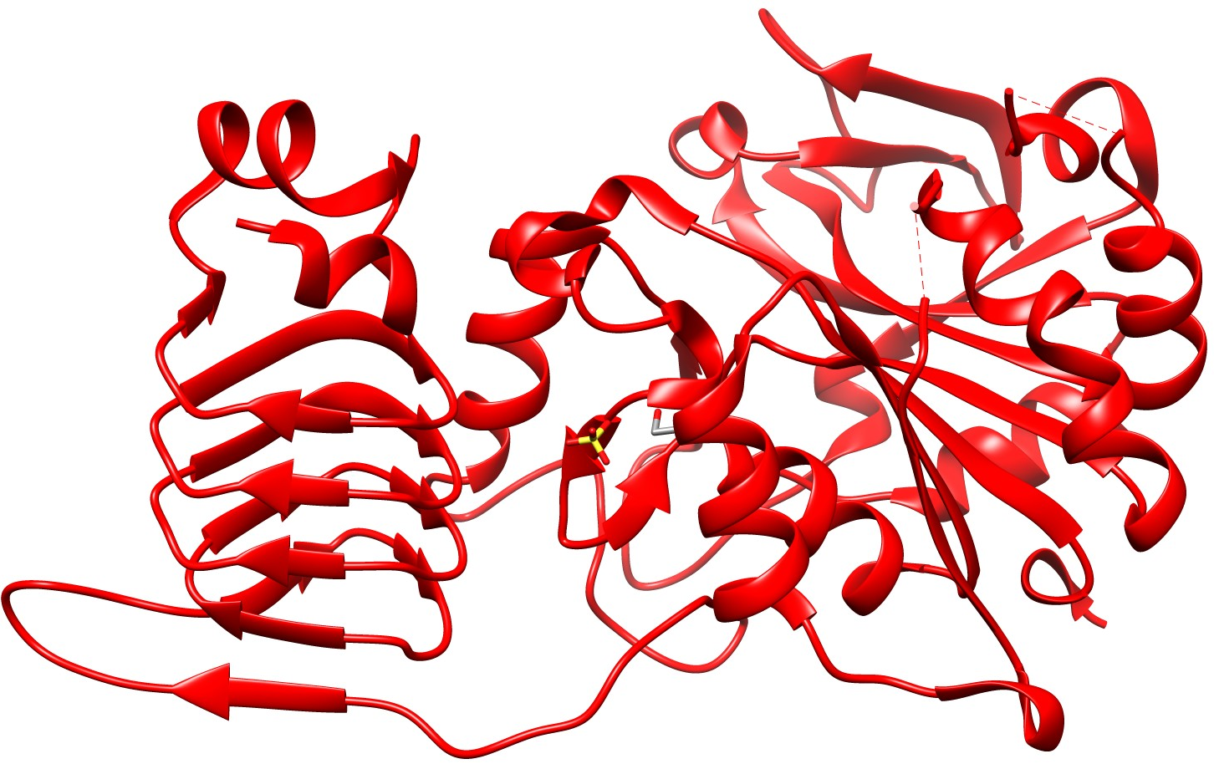
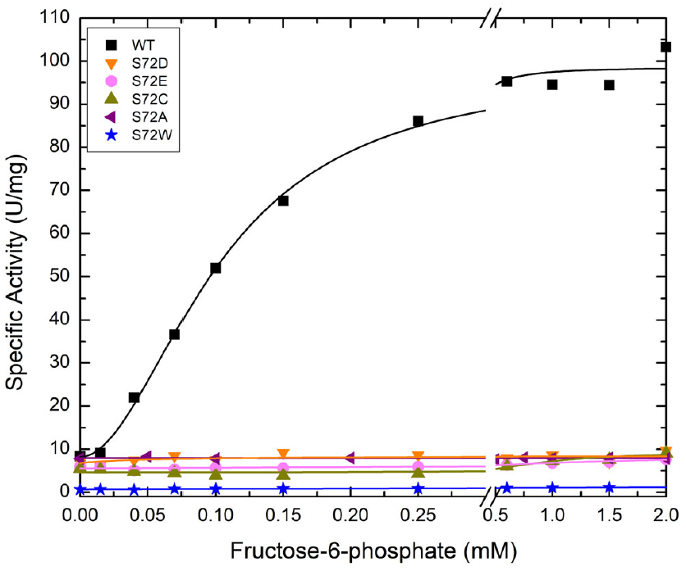
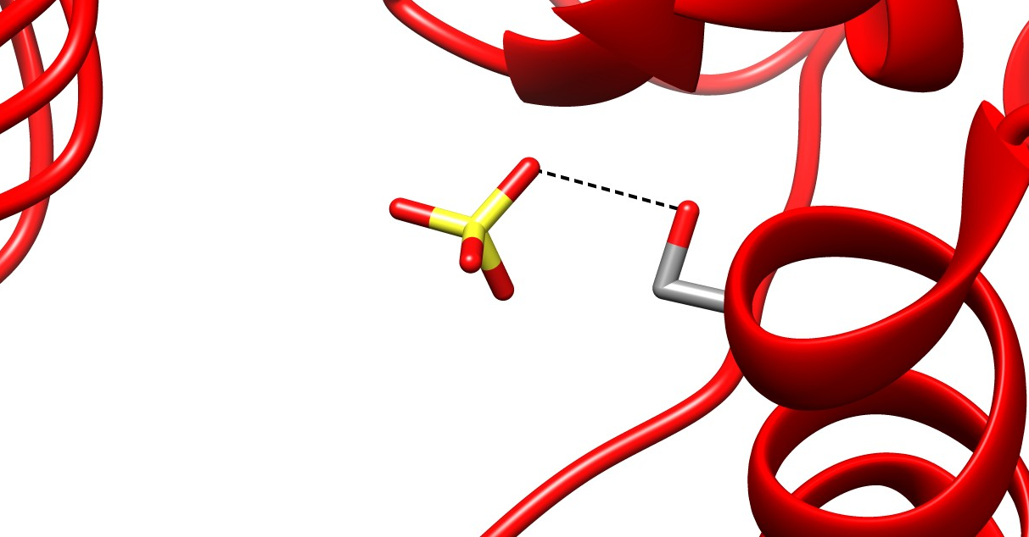
Serine 72 in A. tumefaciens
3.13 Å
Alghamdi, Mashael A., et al. “Site‐Directed Mutagenesis of Serine‐72 Reveals the Location of the Fructose 6‐Phosphate Regulatory Site of the Agrobacterium Tumefaciens Adp ‐Glucose Pyrophosphorylase.” Protein Science, vol. 31, no. 7, 2022, https://doi.org/10.1002/pro.4376.

Slide 9
Homologous residues
Homologous residues, all polar uncharged side chains
  Ser72
  Thr79
  Ser65

Slide 10
Objectives
Mutate Serine at position 65 to an Alanine in Melainabacteria
  Determine kinetic data
  Determine activator binding
Mutate Threonine at position 79 to Alanine and Serine in E. coli
  Determine kinetic data
  Determine activator binding
Serine
Threonine
Alanine

Slide 11
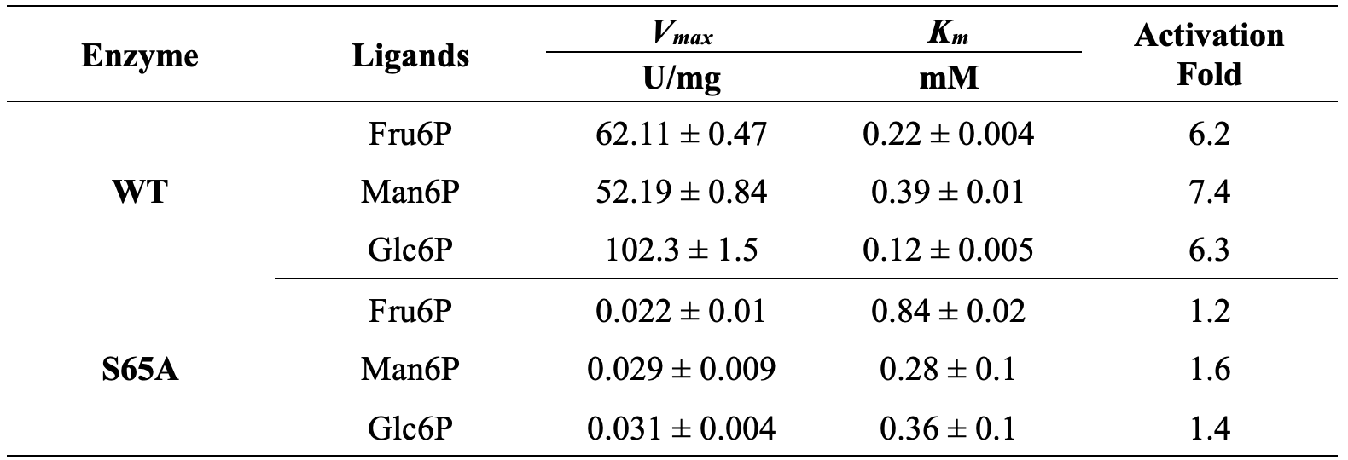
S65A mutant in Melainabacteria
Fru6P
Man6P
Glc6P

Slide 12
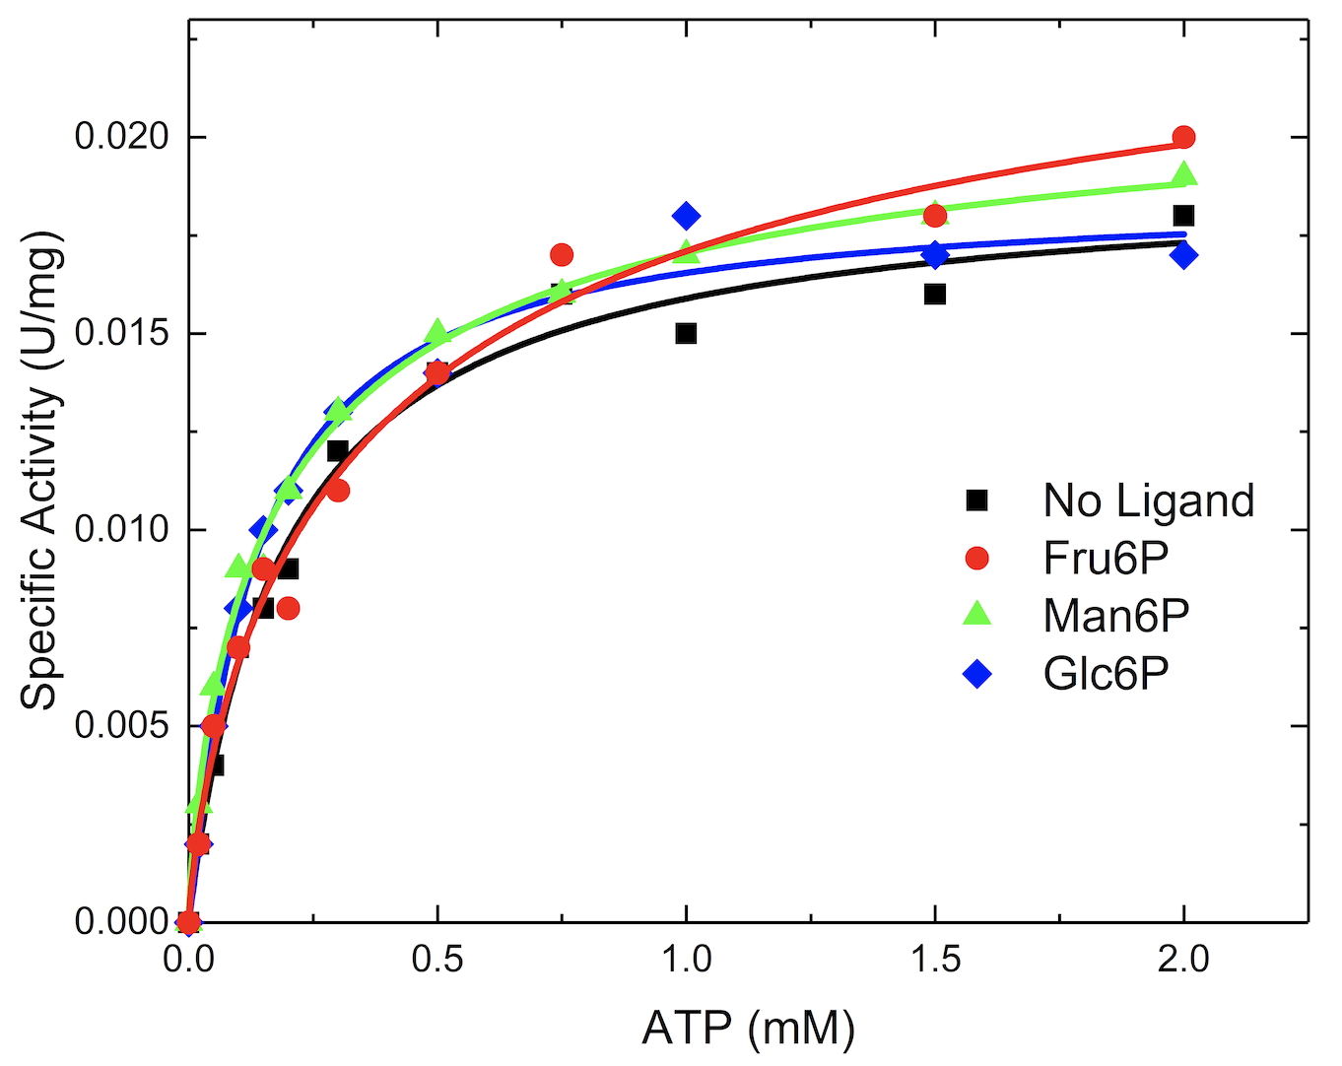
S65A ATP Saturation Curves
WT
S65A

Slide 13
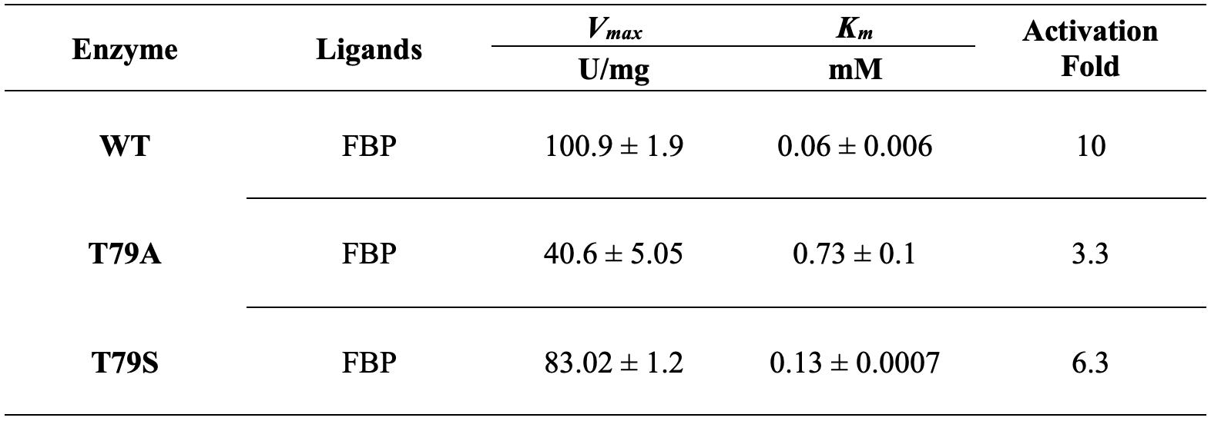
E. Coli Mutants
FBP

Slide 14
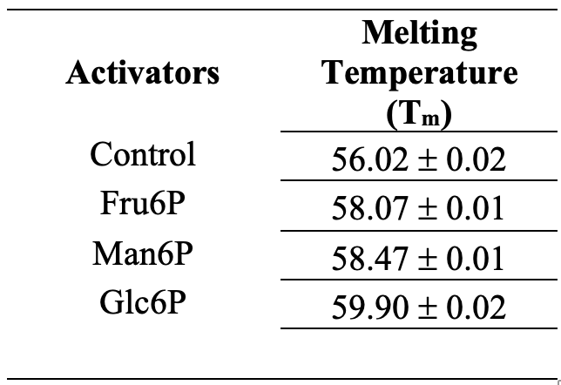
Thermal Shift Data of WT Melainabacteria
Fru6P
Man6P
Glc6P

Slide 15
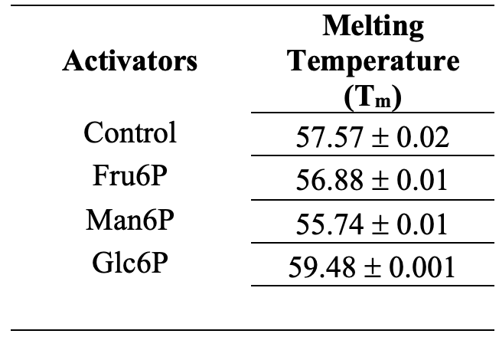
Thermal Shift Data of S65A from Melainabacteria
Fru6P
Man6P
Glc6P

Slide 16
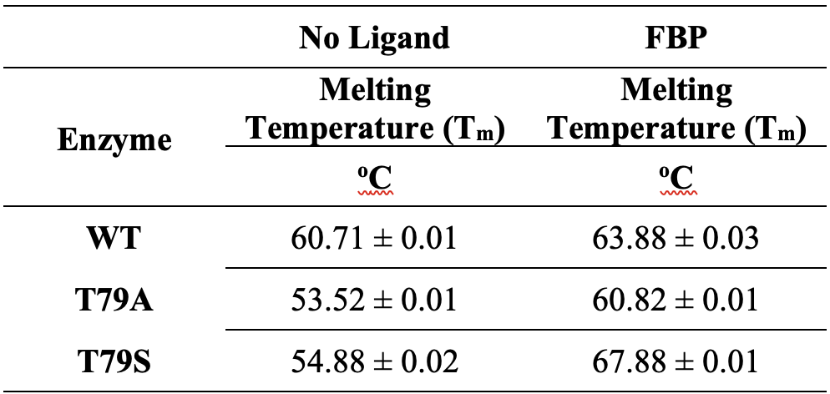
Thermal Shift Data from E. coli
WT
T79A
T79S

Slide 17
Conclusions
Ser65 residue in Melainabacteria critical for allosteric activation and binding of activators
Thr79 residue in E. coli critical for allosteric activation however the activator is still able to bind due to FBP having a second phosphate
Thermal shifts confirmed that in general the activators were unable to bind as the shifts were far less pronounced for the mutant when compared to the WT

Slide 18
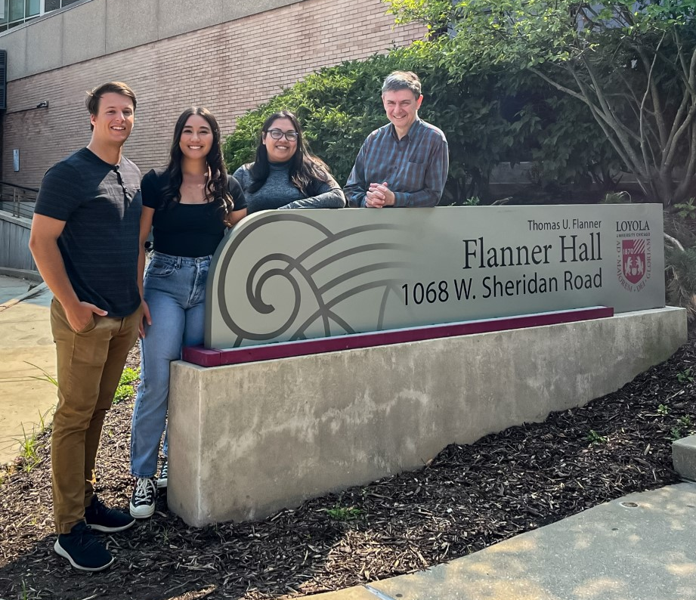

Acknowledgements
Faculty Member
Dr. Miguel A. Ballicora
Graduate Students
Gaby Martinez-Ramirez
Yuanpu Niu
Jaina Bhayani
Undergraduate Students
Gina Canavan
Patrick Lin
Linuki Gunasekara

Slide 19
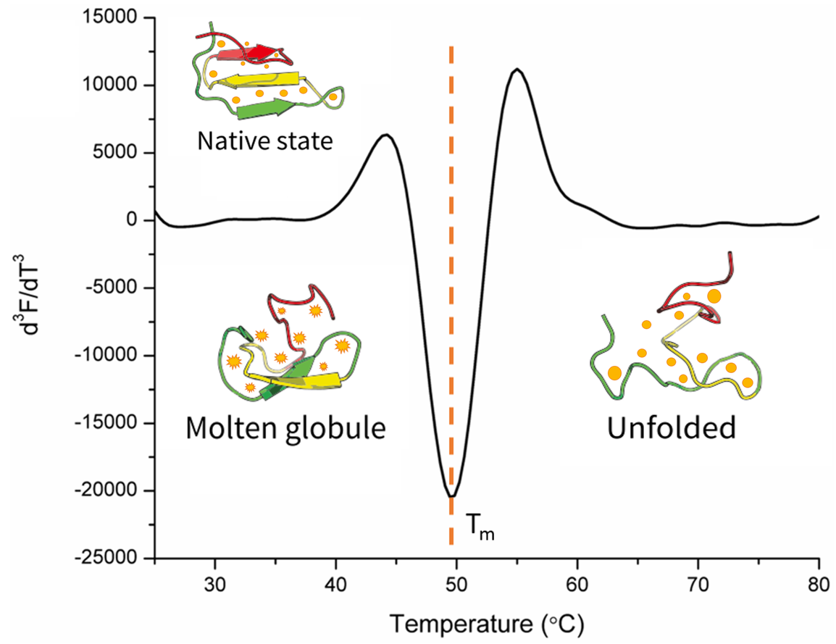
Thermal Shift Assay

Slide 20
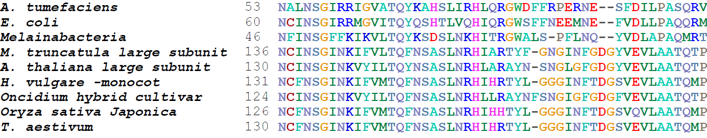
Homologous residues
Homologous residues, all polar uncharged side chains
  Ser72
  Thr79
  Ser65

