Slide 1
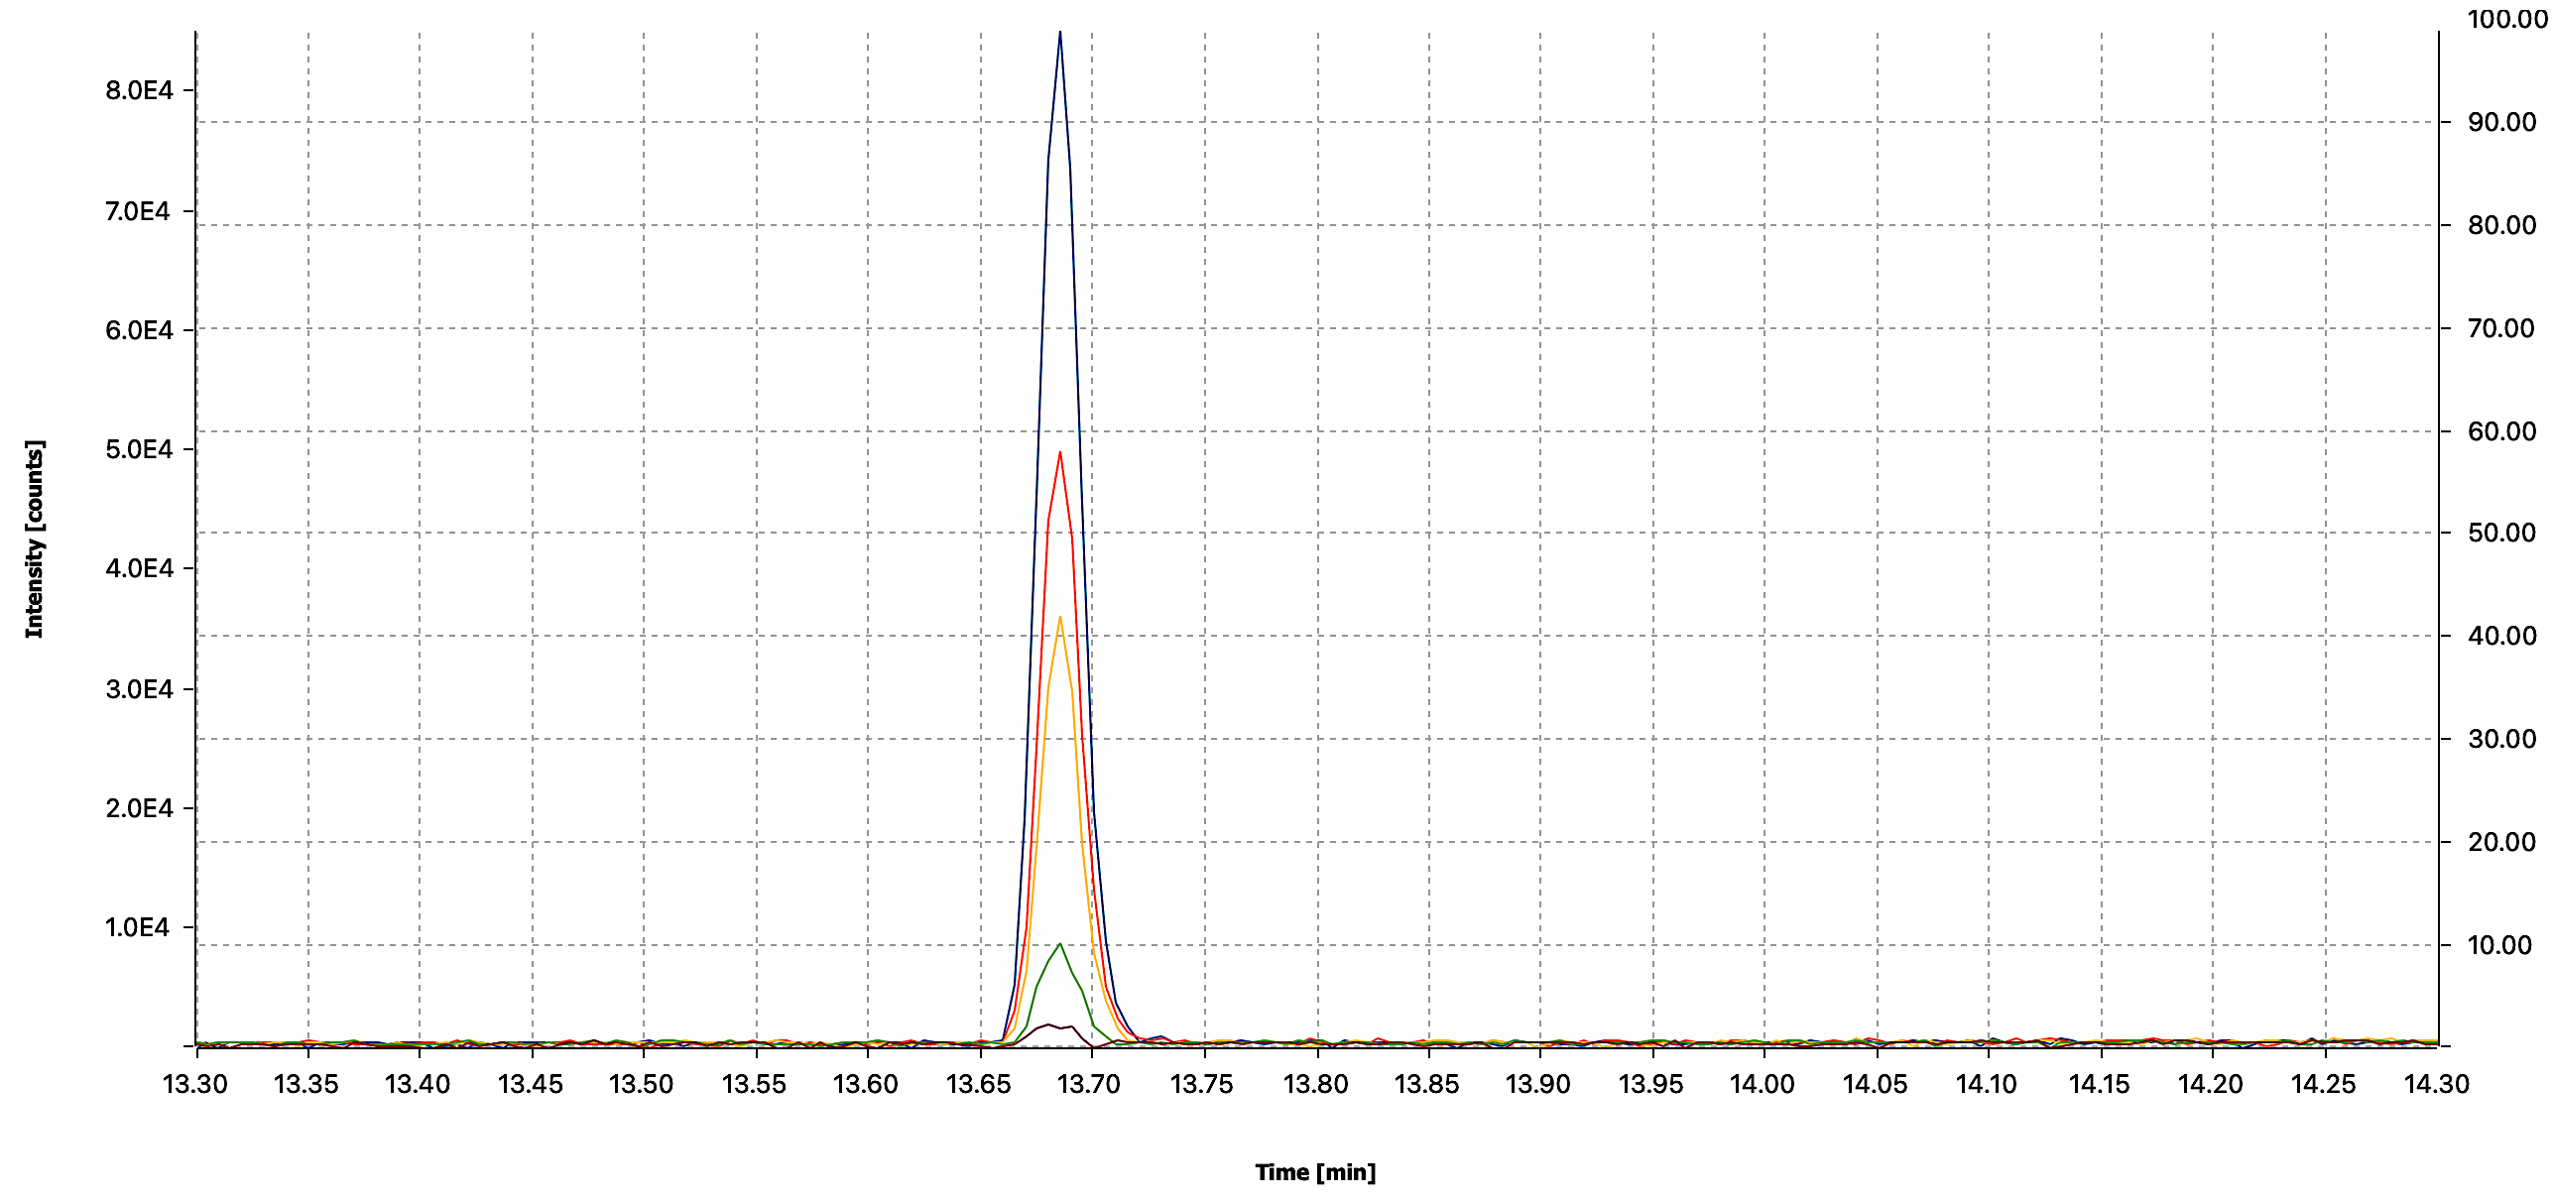
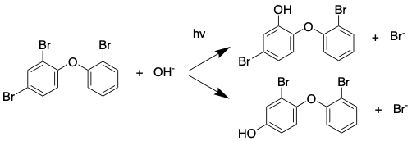
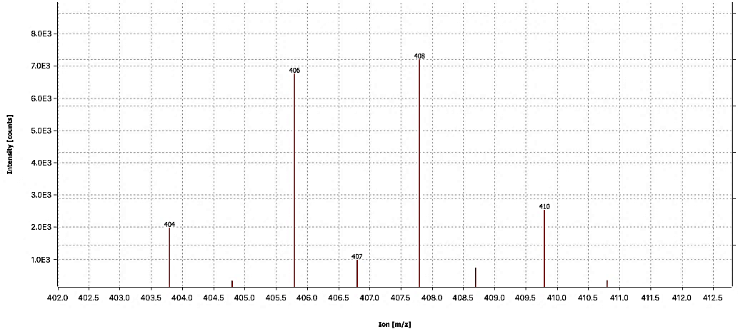
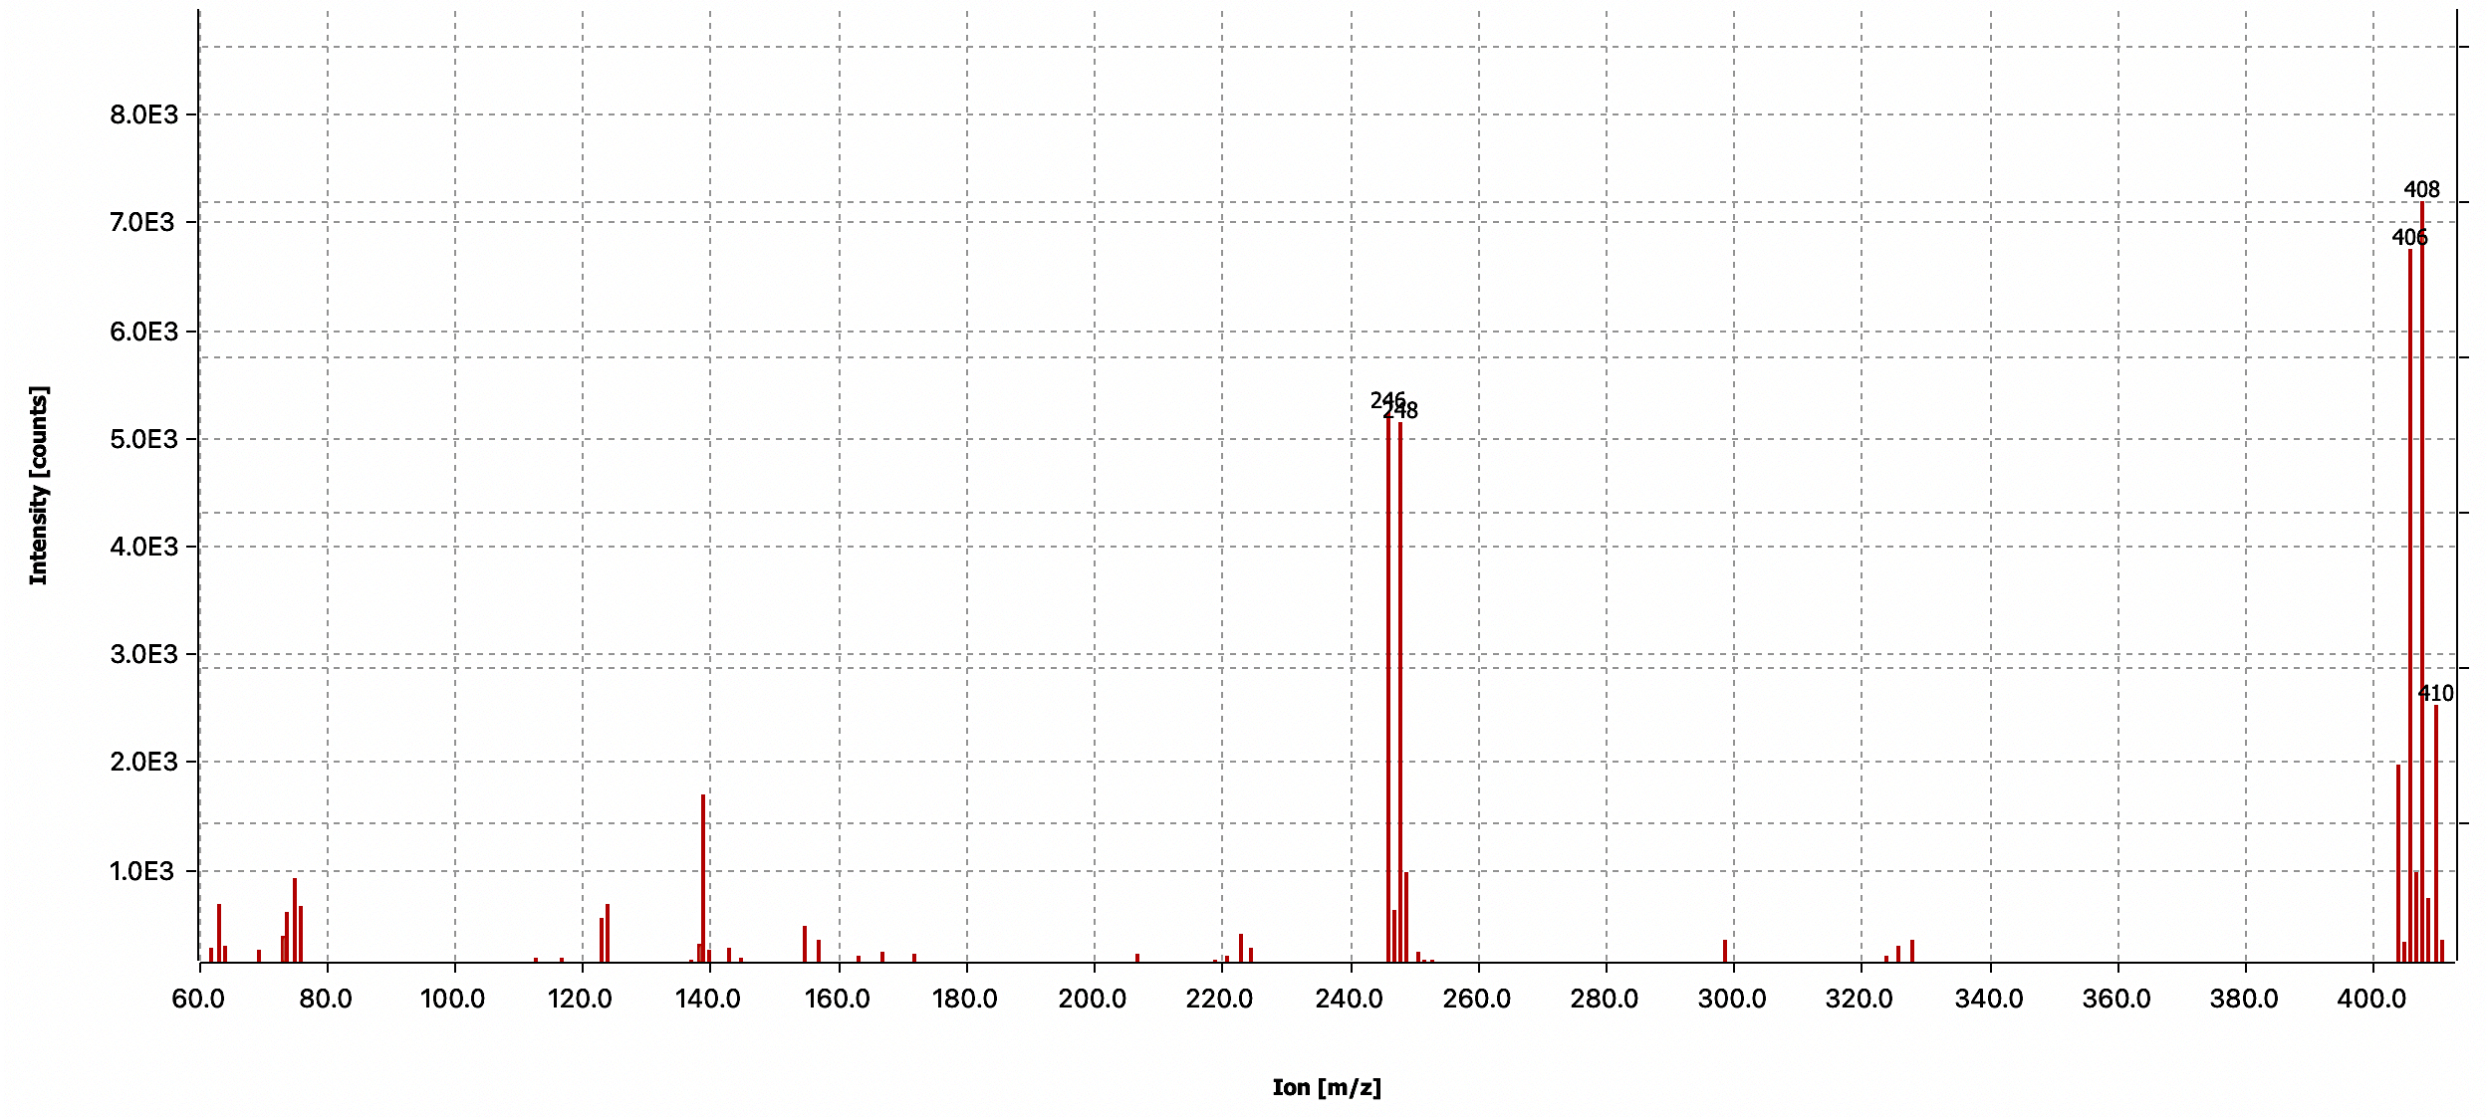
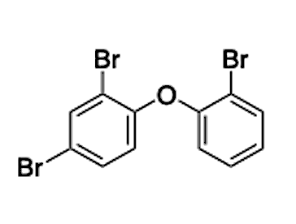
Plastic Mediated Photolysis of Halogenated Flame Retardants in Aqueous Solutions
Nikolas Jeffries, Caroline Weber, Claire Calhoun, Xiolmara Martinez, M. Paul Chiarelli
Department of Chemistry and Biochemistry, Loyola University Chicago
Overview
Experimental
Results Continued
Purpose
We are investigated the photolysis reaction of BDE-28 (2,4,4'-tribromodiphenyl ether) while adsorbed on PE (polyethylene) plastic.
Methods
Aqueous solutions of BDE-28 with and without PE were irradiated from 0 to 90 minutes using 300 nm lamps. Samples were analyzed by GC-MS.
Results
No evidence was observed for the addition/coupling reactions in the analysis of extracts
Photolysis Experiments
Aqueous solutions of BDE-28 were prepared in 15 mL borosilicate glass tubes in water. Samples were spiked with 50 mg of PE beads. The samples were stored overnight to allow time for the adsorption of the BDE. Samples were irradiated simultaneously from 0-90 minutes at 300 nm at a power density of 140 W/cm² using a Southern New England Ultraviolet RPR-100 photoreactor (Branford, CT. USA). Once irradiation was complete, the samples were stored in the refrigerator, and extracted within a week.
Extraction
Aqueous samples were acidified with concentrated sulfuric acid and extracted with separatory funnel using methyl tert-butyl ether (MTBE). The MTBE layer was transferred to an autosampler vial with dry sodium sulfate prior to analysis. Plastic beads were isolated by filtration and extracted by sonication with MTBE. The MTBE was transferred to an autosampler vial prior to analysis.
Analysis
Samples were analyzed by GC-MS using electron
Ionization. The mass detector was operated in the full scan mode. The GC was programed from 100 °C to 280 °C with a rate of 15 °C/min.
We observed that BDE-28 was degrading during photolysis at 330 nm (Figure 2) and after 90 minutes of irradiation the compound was almost reacted completely.
Figure 2: GC/MS chromatograms of BDE-28 0 (brown), 15 (green), 30 (yellow), 60 (red), and 90 minutes (blue) of irradiation in the presence of PE plastic beads.
We did not observe photolysis products in the GC-MS mass spectra , so reaction extracts were analyzed by ESI where no evidence of coupling reactions were observed. Evidence of degradation products such as bromide ions were observed by ESI. The results suggest that the compound may be mineralized soon after fragmentation is initiated. (into small compounds such HBr or acetic acid). We will analyze BDE-28 by ion chromatograpy next to check for these compounds.
Introduction
Plastic debris is accumulating in the environment, and it is known that plastics can absorb water pollutants of limited solubility and transfer them to aquatic organisms which results in their premature death. Work in our laboratory has shown that emerging contaminants will undergo photolysis 25X faster on the surface of plastics than in water.¹ During the 1970s, laws were created to mandate that household products be flame-resistant. Furthermore, halogenated flame retardants (HFRs) have become ubiquitous in the environment.² The goal of these experiments is to determine if the flame-retardant BDE-28 will undergo a bimolecular reaction (Scheme 1) while adsorbed on to the surface of PE. This compound was chosen as its aqueous solubility is lower compared to other halogenated flame retardants that contain hydroxyl groups. Therefore, a larger fraction will adsorb to the surface of the plastic more efficiently.
Scheme 1: Photolysis of BDE-28 in the presence of hydroxyl groups along with potential photoproducts
Results
Conclusion
We irradiated BDE-28 in aqueous solution in the presence of PE plastic beads. No evidence for the addition/coupling reactions were found in the analysis of the extracts. The mass spectrum of BDE-28 is shown in Figure 1.
Figure 1: GC/MS mass spectrum of BDE-28 eluting at 13.65 minutes.
The photolysis of the flame retardant 2,4,4’-
tribromodiphenyl ether, has been studied in aqueous solution with and without plastic at 300 nm. Approximately 95% of the compound degraded after 90 minutes irradiation time. No products were detected by GC/MS or LC/MS methods other than bromide ions. The data suggests that the flame retardant is mineralized into smaller molecules.
406
408
404
410
References
1. Martinez, X.; Renyer, K; Chiarelli, M.P. “Plastic catalyzed photolysis of emerging contaminants in aqueous environments” Environ. Sci. Technol. In preparation.
2. Barja-Fernández, A.; Álvarez-Otero, R. Histopathological effects of 2,2′,4,4′-tetrabromodiphenyl ether (BDE-47) in the gills, intestine and liver of turbot (Psetta maxima). Ecotoxicology and Environmental Safety, 2013, 95, 60–68.
3. Wang, X.; Hu, X.; Zhang, H.; Chang, F.; Luo, Y. Photolysis Kinetics, Mechanisms and Pathways of Tetrabromobisphebol A in Water under Simulated Solar Light Irradiation. Environ. Sci. Technol. 2015, 6683-6690.

