Slide 1
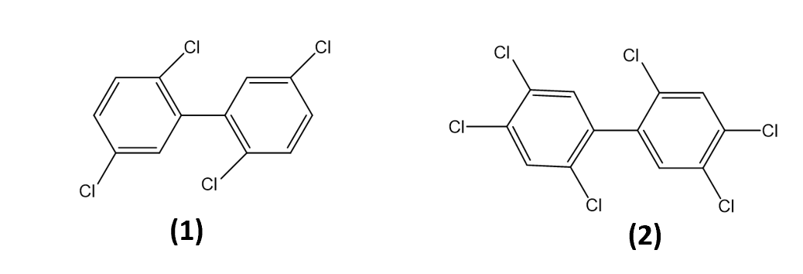
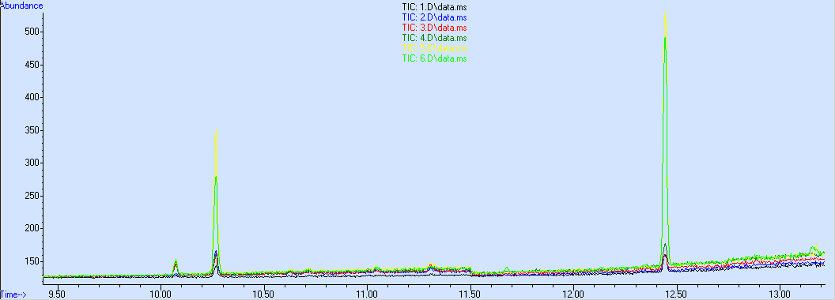
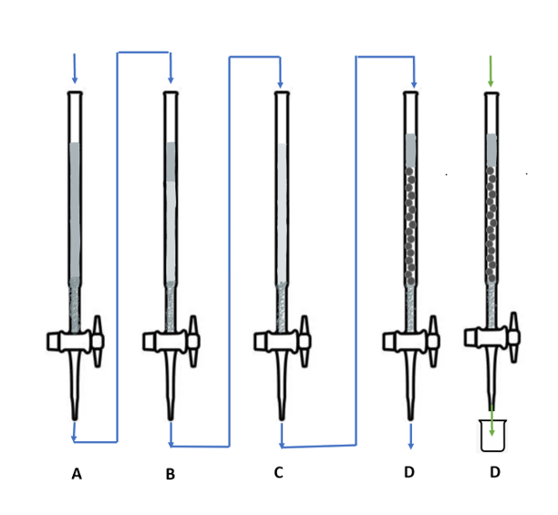
Enhancement of PCB uptake in Zebrafish by Different Microplastics Heba Hussain¹, Emily Radz¹, Baraa Hussein², Stephanie Walker², Rodney M. Dale², and M. Paul Chiarelli¹ ¹Department of Chemistry and Biochemistry
²Department of Biology
Loyola University of Chicago
Overview
After extraction, the matrices and solvent were separated by centrifugation and then the solvent was decanted into a graduated glass volumetric bottle. The extracts were evaporated overnight and then dissolved in 100 mL of hexane. The hexane was combined with acidic silica gel was and shaken thoroughly for a few minutes. The solution was then passed through a series of four columns. First, the sample was passed through an anhydrous sodium sulfate column. The sample was then passed through an acidic silica gel column. The third column was acidic silica gel. The last column was a basic alumina column. After filtration through the basic alumina column, the column was eluted with 40 mL of n-hexane/DCM (1:1, v/v) into a 50 mL beaker, which was then evaporated to dryness using nitrogen gas. The residue was dissolved in 100 ul of nonane in autosampler vial for analysis by GC/MS.
Purpose
To investigate how the structural differences of PE, PC, and PMMA will affect the uptake of PCBs in zebrafish.
Methods
Zebrafish exposure to different microplastics spiked with PCBs, extraction, and analysis by GC/MS.
Results
We validated a method to extract PCBs from zebrafish
Exposed to three different types of plastic. We have begun to analyze fish exposed to 2,2’,5,5’-tetrachlorobiphenyl (PCB-052) and 2,2’,4,4’,5,5’-hexachlorobiphenyl (PCB-153) in solution in the presence of polyethylene (PE), polycellulose (PC), and polymethylmethacrylate (PMMA) beads.
e
Figure 1: Structures of the PCBs used in this study (1) 2,2’,5,5’-tetrachlorobiphenyl (PCB-052) and
(2) 2,2’,4,4’,5,5’-hexachlorobiphenyl (PCB-153).
Results
Introduction
Figure 2: Structures of plastic polymer monomers (1) polyethylene (2) polycellulose and (3) polymethyl methacrylate.
GC/MS analysis shows we were successful in extracting the PCBs from the fish tissue. Figure 4 shows overlaid chromatograms of six different individual samples.
e
Pollution caused by plastic debris is one of the biggest threats to our environment. There are eight million metric tons of discarded plastics in the world’s oceans [1]. Different plastics have different chemical and physical properties, which govern how they interact with the aqueous environment. Polyethylene (PE) (Structure 1 in Figure 1) is the most common plastic in the aquatic environment. Polycellulose (PC) (Structure 2 in Figure 1) is a biodegradable plastic made up of hydrophilic cellulose monomers [2]. Polymethyl methacrylate (PMMA) (Structure 3 in Figure 1) is a rigid plastic often used as a substitute for glass [3]. One way plastics damage the environment is that they can transfer absorbed pollutants to aquatic animals causing premature death [4]. The purpose of this study is to determine how the structural differences between PE and PC affect the uptake of different PCB’s in zebrafish. Due to the hydrophilicity of PC, we hypothesize that zebrafish tissue will show greater concentrations of PCB 126 when exposed to PC beads rather than PE and PMMA beads because the PCB’s will be most easily transferred to the fish tissue. Zebrafish (Danio rerio), a sentinel species, are being used in this experiment. Zebrafish have phenotypic and genotypic responses to environmental stressors such as microplastics [5].
Exposure Studies
Zebrafish (8-10) were exposed to 50 mg of plastic beads that had been loaded with PCB-052 and PCB-153 (5 ug each) in 2.00 L beakers.
Ten exposures (individual beakers) were carried out. Two with each of the three different plastic particles, a control with PCB only, and a control with no PCB or plastic. Exposures were carried out for a week.
At the end of the week the fish were euthanized and stored in a freezer
until they were extracted. Approximately one gram of fish tissue was processed for each analysis.
Extraction Method
We have developed a procedure for extracting different pollutants from fish tissue using a microwave assisted extraction (MAE) technique followed by column chromatography seen in Figure 3.
Figure 3. Fish sample clean up columns. Panel A representing the anhydrous sodium sulfate column. Panel B representing the acidic silica gel column. Panel C representing the silica gel column. Panel D representing the basic alumina column. Blue pathway symbolizes the initial 100 mL of sample solution. Green pathway symbolizing the 40 mL of sample solution that is used for analysis.
The MAE extraction was performed on a CEM MARS 5 Microwave Accelerated Reaction System (CEM Corporation, Matthews, NC, USA). Before usage, the extraction cylinders were rinsed with n-hexane, followed by acetone. Each sample of fish was mixed with 1.5 g anhydrous sodium sulfate powder, and then loaded into their respective extraction cylinder. 30 mL n-hexane/acetone (1:1, v/v) was added and the extraction was performed. The condition was as follows: the temperature was ramped to 115ºC in 10 min and held for 15 min, then cooled down in 20 min; microwave power was 1200W.
Figure 4: GC/MS chromatograms (overlaid) showing the relative amounts of PCB-052 (Rt 10.3 minutes) and PCB-153 (Rt 12.45 minutes) absorbed to the three different plastic particles in this study. The yellow trace represents polycellulose, the green trace represents polymethylmethacrylate, and blue trace represents polyethylene.
The control sample containing only zebrafish did not give any detectable PCB signal. Fish exposed to PCBs without any plastic present did not give as abundant PCB signals as the zebrafish exposed to plastics.
Experimental
Materials
PE and PMMA spheres (63-75 um diameter) were purchased from Cospheric, Inc. (Santa Barbara, CA.). PC particles (20 um diameter) were purchased from Millipore Sigma (Miwaukee, WI). All plastics were sonicated in methyl tert-butyl ether (MTBE) for 10 minutes prior to use. 2,2’,5,5’-tetrachlorobiphenyl (PCB-052) and 2,2’,4,4’,5,5’-hexachlorobiphenyl (PCB-153) were purchased from Accustandard Inc (New Haven, CT) and used without further purification. The structures of the PCBs are shown in Figure 1. The structures of the polymers that make up the plastics used in this study are shown in Figure 2.
References
Plastics in the Ocean. https://www.condorferries.co.uk/plastic-in-the-ocean- statistics#:~:text=There%20is%20now%205.25%20trillion,their%20way%20into%20our%20oceans.
Fish Freaking LOVE To Eat Plastic, And That's A Problem. Huffpost Fish Freaking LOVE To Eat Plastic, And That's A Problem | HuffPost Impact.
Liyanage, S., Acharya, S., Parajuli, P., Shamshina, J. L., & Abidi, N. (2021). Production and Surface Modification of Cellulose Bioproducts. Polymers (20734360), 13(19), 3433. https://doi.org/10.3390/polym13193433
Britannica, The Editors of Encyclopaedia. "polymethyl methacrylate". Encyclopedia Britannica, 20 Mar. 2023
Limonta, G., Mancia, A., Benkhalqui, A. et al. Microplastics induce transcriptional changes, immune response and behavioral alterations in adult zebrafish. Sci Rep 9, 15775 (2019). https://doi.org/10.1038/s41598-019-52292-5

