Slide 1
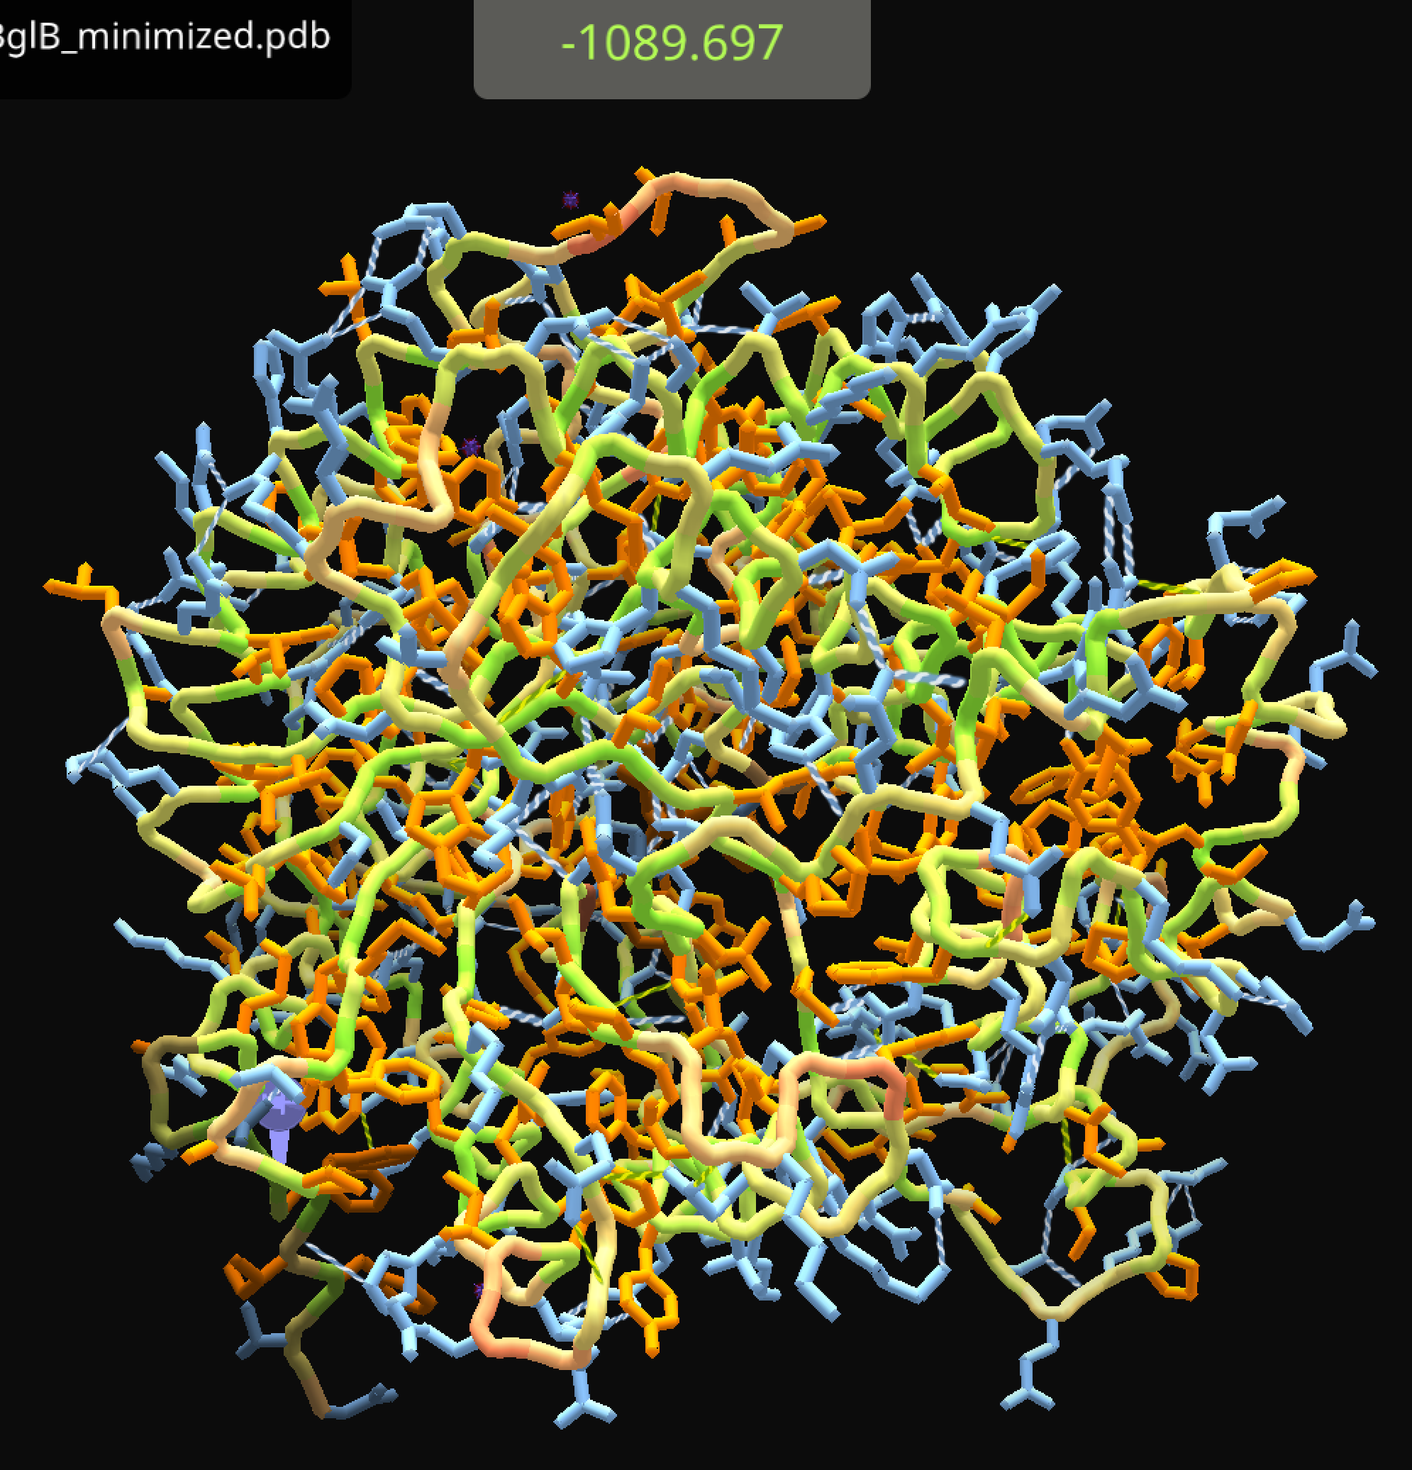
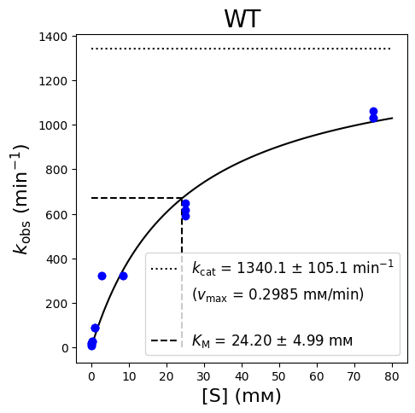
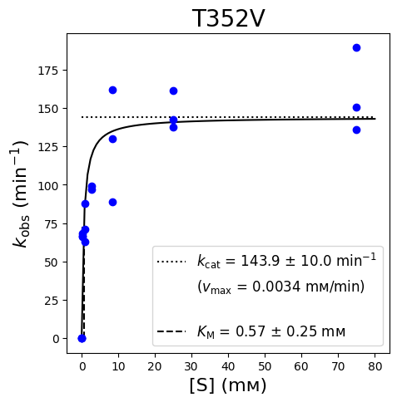
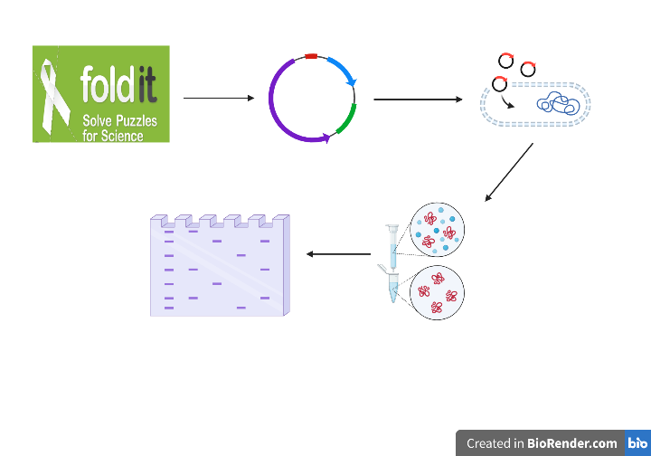
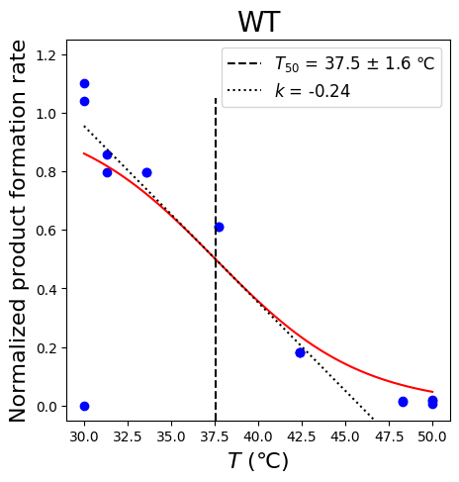
Characterizing the T352V Mutation of Beta-glucosidase B Olivia Hodge, Renee Stanec, and Dr. Emma Feeney
Introduction:
The goal of our research is to determine if the functionality of a protein can be predicted based on its structure and composition of amino acids. Design to Data, D2D, is a project aimed at gathering data to create a database that accurately predicts protein structure. We contributed to this project by gathering data related to mutations of Beta-glucosidase B, or BglB. Beta-glucosidase B (BlgB) belongs to the Beta-glucosidase family, which functions to remove non-reducing terminal glucosyl residues from saccharides and glycosides^{2,3}. Bgl-B specifically hydrolyzes the β(1,4)-glycosidic bonds of cellobiose to release glucose monomers¹. The data from our research will help create a dataset through D2D to accurately predict enzyme function based on structure and composition. Algorithms that accurately predict the structure and function of a protein are vital to the scientific community as they greatly contribute to research. These algorithms allow researchers to accurately predict how a protein will change as a result of a mutation without actually having to create the mutation themselves, saving time and money⁴. We predicted that the BglB T352V mutant will demonstrate decreased catalytic efficiency and/or thermal stability in comparison to the wild-type BglB because the increased local score and increased overall score signify that the protein has become less stable with increased hydrophobic interactions and higher activation energy, decreasing catalytic efficiency.
Discussion
We came to the conclusion that our BglB T352V mutant has no catalytic activity. Our SDS-PAGE results show us that we did in fact express our protein as a band was present. However, the results of our kinetic and thermostability assays show some nonsensical data that suggest our protein has no catalytic activity. In figure 3 of the results section, the graphs that represent the results of our kinetic and thermostability assays are shown. Graphs 3A and 3B show the kinetic assay graphs for wild-type BglB as well as T352V mutant BglB. The wild-type shows that BglB follows the Michaelis-Menten kinetics and is catalytically active. The T352V mutation shows many outliers, meaning there was a lot of noise and suggests that the mutation is not catalytically active. Additionally, the k_{obs} values are much lower for the T352V mutation, which suggests that it is not an efficient enzyme, whereas the high k_{obs} values for the wild-type demonstrate its high catalytic activity. Graph 3C represents the results of the thermostability assay for wild-type BglB. The T352V mutant graph is not shown because the data did not follow any sort of pattern in the graph and could not be applied to a graph, meaning the enzyme was immediately denatured. In conclusion, the results prove that the T352V BglB mutation is not catalytically active compared to wild-type BglB.
Figure 1: Foldit 3D predictive models of wild-type β-glucosidase B (left) and Mutant T352V (right). The pink, circled residue on the right is the point mutation valine (T352V).
Figure 2: SDS-PAGE of β-glucosidase B variant T352V, verifying expression and purification of mutant protein. Molecular weight determined by Molecular Weight Ladder.
3A
3B
Acknowledgements:
We would like to thank our collaborators, Ashley Vater and the Justin Seigel Lab at the University of California - Davis for conducting their research and allowing us to contribute. We would also like to thank the National Science Foundation for their support.
References:
Chen A, Wang D, Ji R, Li J, Gu S, Tang R and Ji C (2021) Structural and Catalytic Characterization of TsBGL, a β-Glucosidase From Thermofilum sp. ex4484_79. Front. Microbiol. 12:723678. doi: 10.3389/fmicb.2021.723678. https://www.frontiersin.org/articles/10.3389/fmicb.2021.723678/full
Ketudat Cairns, J. R., & Esen, A. (2010). β-Glucosidases. Cellular and molecular life sciences : CMLS, 67(20), 3389–3405. https://doi.org/10.1007/s00018-010-0399-2 https://pubmed.ncbi.nlm.nih.gov/20490603/
Nur Shima Fadhilah Mazlan & Nurul Bahiyah Ahmad Khairudin (2016) A molecular dynamics study of Beta-Glucosidase B upon small substrate binding, Journal of Biomolecular Structure and Dynamics, 34:7, 1486-1494, DOI: 10.1080/07391102.2015.1081570. https://www.tandfonline.com/doi/abs/10.1080/07391102.2015.1081570
Zhang, Y. (2009). Protein structure prediction: When is it useful? Current Opinion in Structural Biology, 19(2), 145–155. https://doi.org/10.1016/j.sbi.2009.02.005
Methods:
1. Foldit 3D Modeling
2. Plasmid Prep, Quantification Sequencing
3. Plasmid Transformation
Heat shock transformation
LB plates with Kanamycin
Compare local and overall scores of WT Bgl-B and Mutant T352V
Plasmid pET29b(+)
QIAPrep Miniprep Kit
DNA sequencing confirms presence of mutation
3C
4. Protein Expression and Purification
Induction of Bgl-B expression via IPTG
Histidine tags for affinity chromatography
5. SDS-PAGE, Enzyme Kinetic and Thermostability Assays
Kinetic Assay: measuring and visualizing Mutant T352V enzymatic activity
Thermal Assay: T50 measurement
SDS-PAGE: determine expression, purification, and size of Mutant T352V
Figure 3: D2D Graphical Representations of Kinetic Assays for WT (3A) and Mutant T352V (3B) β-glucosidase B and of Thermostability Assay for WT (3C) β-glucosidase B

