Slide 1
ASPIRE Scholarship:
Internship with Congresswoman Schakowsky’s District Office
Clarissa Steinbrecher, senior
Undergraduate Research Symposium
April 22nd, 2023

Slide 2
What does a Congressperson do?
Legislative
Day-to-day
Develops and brings legislation before the Congress on issues facing constituents
Votes on other bills
Conduct hearings
Casework with constituents; communication with federal agencies
Field legislative opinions
Connect constituents to resources: NGO, NPO, or gov
Delegation to other offices; i.e. City, State.

Slide 3
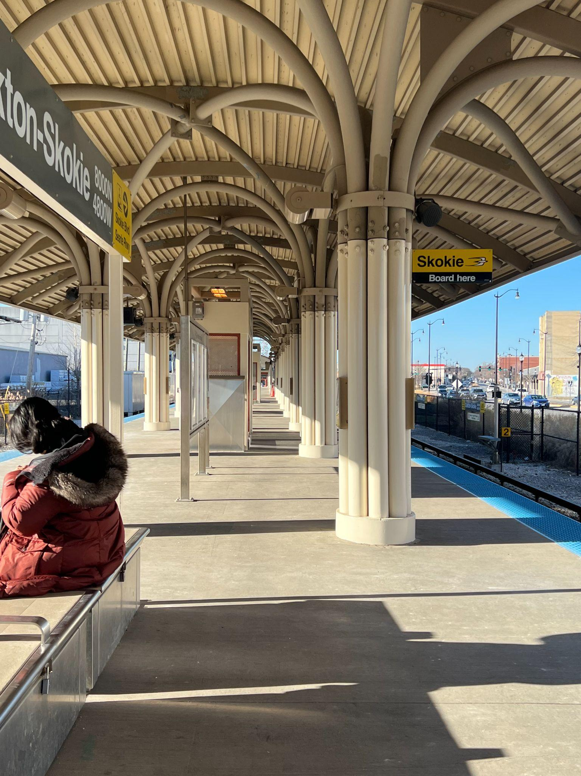
My Responsibilities
Casework intern - process intake of all walk-in, phone, and email cases
Draft first initiation of contact with various federal agencies
USCIS, NVC, VA, DOS, TAS
Connect constituents to resources
Homelessness & food insecurity, senior resources
Field legislative opinions to the D.C. team
Compiled a list of 20+ contacts within new district boundaries

Slide 4
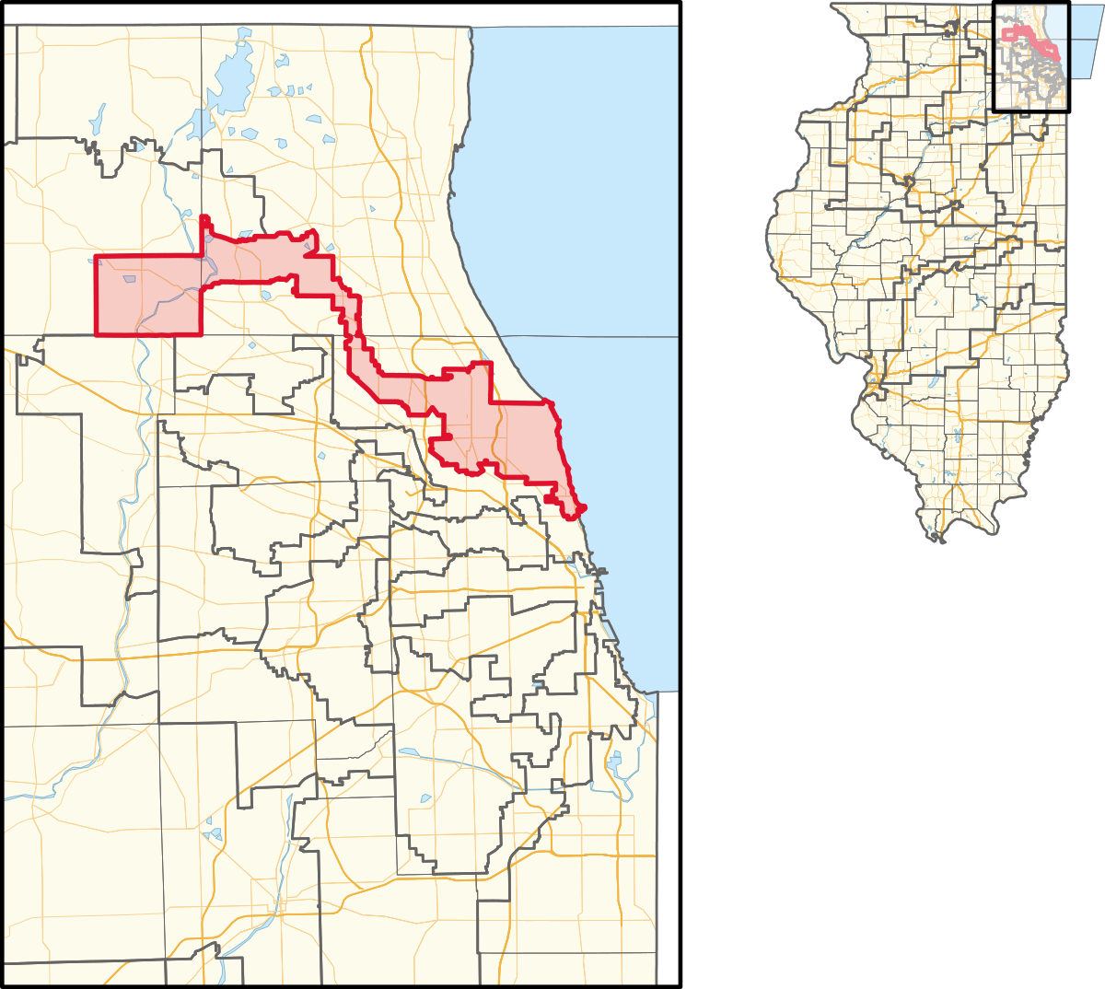
New 2023 District
Old district boundaries - 2013
New district boundaries for 2023
Notes:
Census - redistricting with census
New district incorporates more NW suburbs and less of the City

Slide 5
Conclusion
What I’ve learned!

Slide 6
Thank you!

