Slide 1
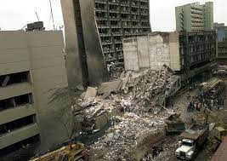
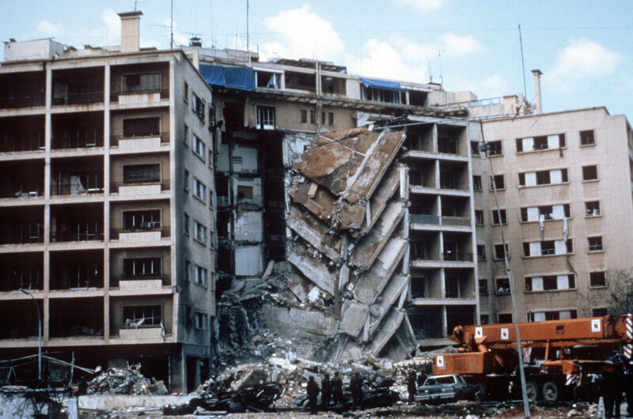
Violent Mediation: A Study of the Impact of Terrorism in US Diplomacy
1998 Embassy bombing in Nairobi, Kenya
1983 Embassy bombing Beirut, Lebanon

Slide 2
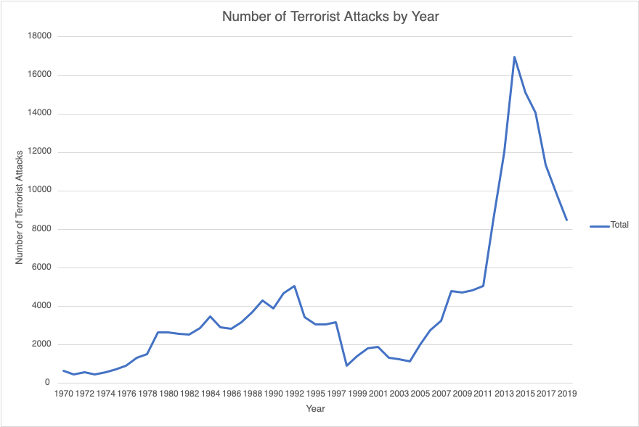
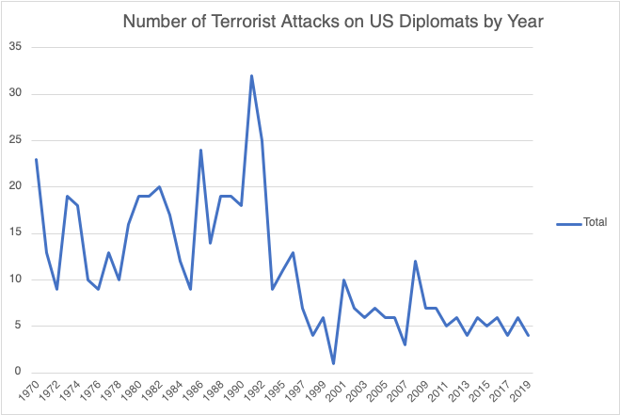
Why did terrorist attacks against US diplomats rapidly decline in the 1990s?
When terrorism spiked in 2011, why was there no corresponding spike in attacks against US diplomats?

Slide 3
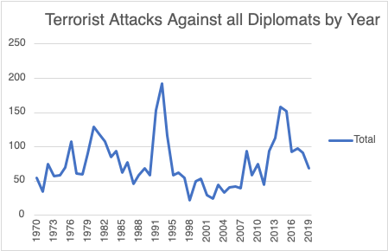

Slide 4
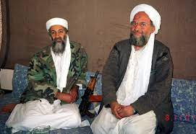
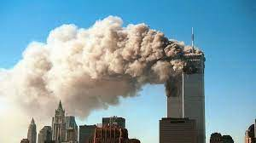
Existing Literature & Theoretical Frameworks
Terrorists as Rational Actors
Strategic, use of violence, adaptable
Target Choice and Tactical Adaptation
Target hardening and shifting to softer targets
Brandt & Sandler (2010)
3 factors that cause terrorists to shift target selection
1) increasing security 2) declining state sponsorship 3) changing preferences
Milton (2017)
3 reasons terrorists target US diplomats
1) strategic rationale 2) easier compared to military targets 3) attacking them can drive out forces meant to prevent conflict
2 major gaps – 1990s decline in attacks & impact of attacks on diplomacy
Notes:
3a) terrorists as rational actors 3aa) strategic 3ab) with violence 3ac) adaptations
3b) target choice and tactic adaptation
3c) two studies draw from in particular 3ca) Brandt and Sandler 2010 3cb) Milton 2017
3d) additional studies warrant mention (?) 3da) Bell 2017 3db) Hsu and McDowall 2017
3e) implementation of greater embassy security and why differs from what many studies say

Slide 5
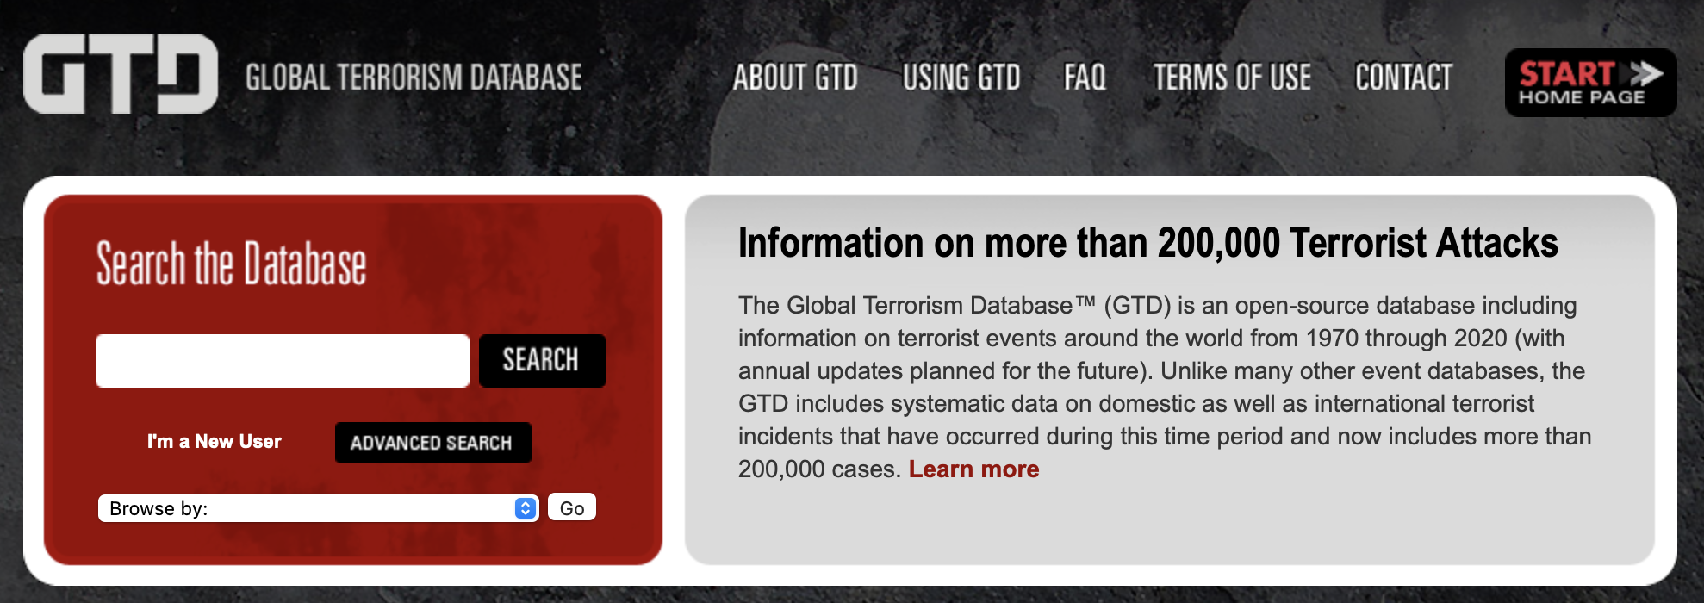
Longitudinal Study Design
Terrorist attacks from 1970-2019 from the Global Terrorism Database
Data from 1993 is missing because the original data cards were lost before they could be electronically coded.
Using the GTD’s "target type” classification of attacks, I isolate the subset of data that includes only terrorist attacks against “Government (Diplomatic)” targets.
I further isolate this subset of data by the “Nationality” classification to look at the attacks against the U.S.
I look at major trends and inflection points across the data and breakdown each decade to identify what caused them.
Number of Terrorist Attacks 1970-2019 | 201,183
Number of Terrorist Attacks Against Diplomats 1970-2019 | 3,738
Number of Terrorist Attacks Against US Diplomats 1970-2019 | 555

Slide 6
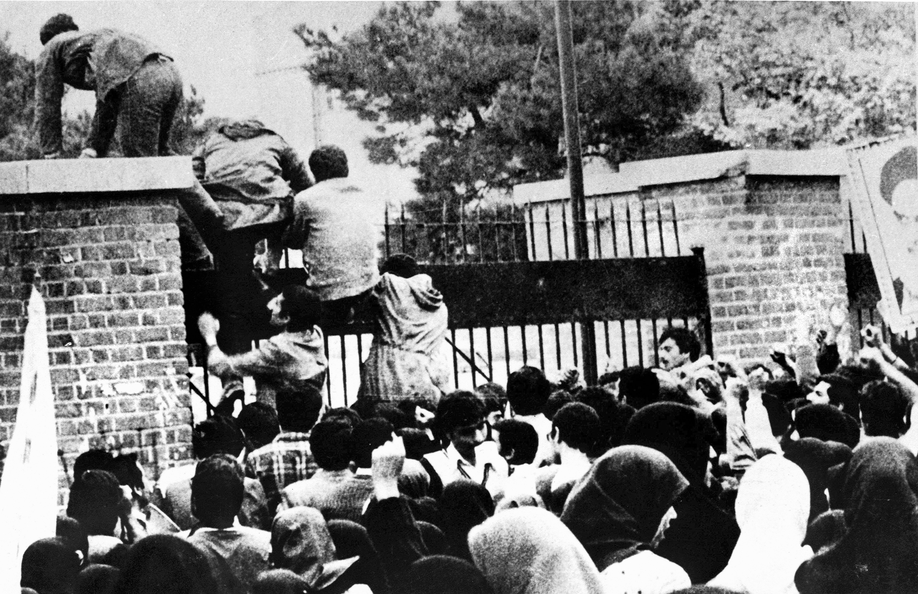
Key Developments in the 1970s
Terrorism
Rising popularity of American targets
November 4, 1979, Iranian Hostage Crisis
Diplomatic Security
Office of Security (SY)
No budget for diplomatic security
Victor Dikeos, Deputy Assistant of State for Security 1974-78, reorganization of SY 1975
5 Offices – Personnel Security, Protective Security, Operations, Executive Office Staff, Miscellaneous
Mobile Training Teams
Region | Number of Attacks
Australasia & Oceania | 2
Central America & Caribbean | 8
East Asia | 4
Eastern Europe | 1
Middle East & North Africa | 50
North America | 9
South America | 22
South Asia | 3
Southeast Asia | 12
Sub-Saharan Africa | 2
Western Europe | 27
Total | 140
Notes:
Argentina – the anomaly of the decade
Series of attacks against US diplomats throughout the first half of the decade
Successful security enhancements
Terrorists stopped targeting US diplomats

Slide 7
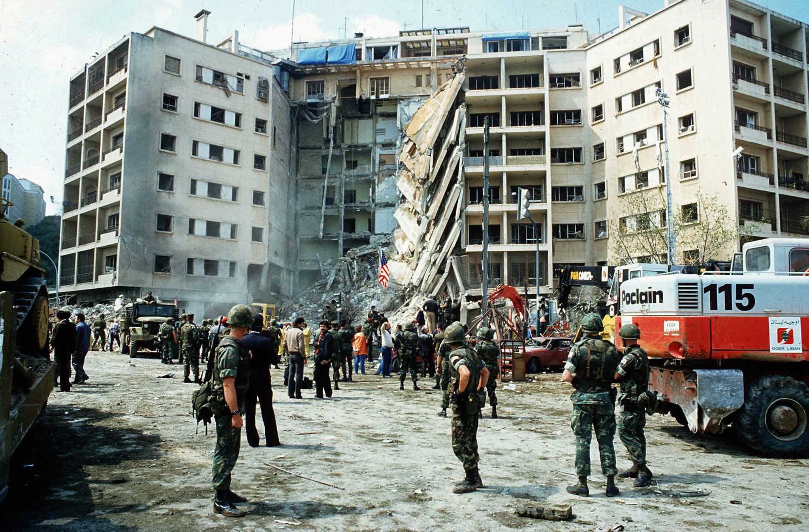
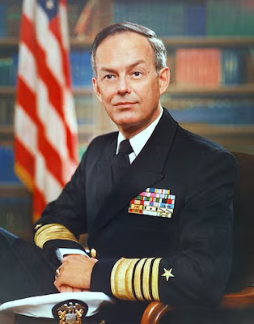
Year | 1980 | 1981 | 1982 | 1983 | 1984 | 1985 | 1986 | 1987 | 1988 | 1989 | Total
Attacks | 19 | 19 | 20 | 17 | 12 | 9 | 24 | 14 | 19 | 19 | 172
Hezbollah bombs US Embassy, Lebanon
April 18, 1983
Hezbollah bombs US Embassy, Lebanon
Sept. 20, 1984
24 terrorist attacks (16-year high)
1986
Iranian Hostage Crisis
1979-1981
Hezbollah bombs US Embassy, Kuwait
Dec. 12, 1983
Terrorism
Security
Security Enhancement Program
1980
Enhanced SEP
May 1983
Act to Combat International Terrorism
Oct. 19, 1984
Inman Report
June 1985
Omnibus Diplomatic Security and Anti-Terrorism Act
Aug. 27, 1986
Bureau of Diplomatic Security
Nov. 4, 1985
Key Events in the 1980s
Notes:
3 major terrorist attacks during the decade that drove diplomatic security enhancements that clearly weren’t very effective because look at those numbers of attacks…

Slide 8
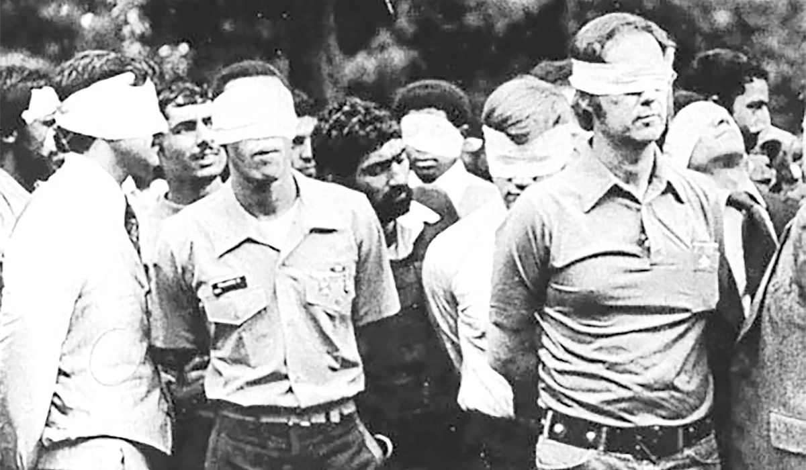
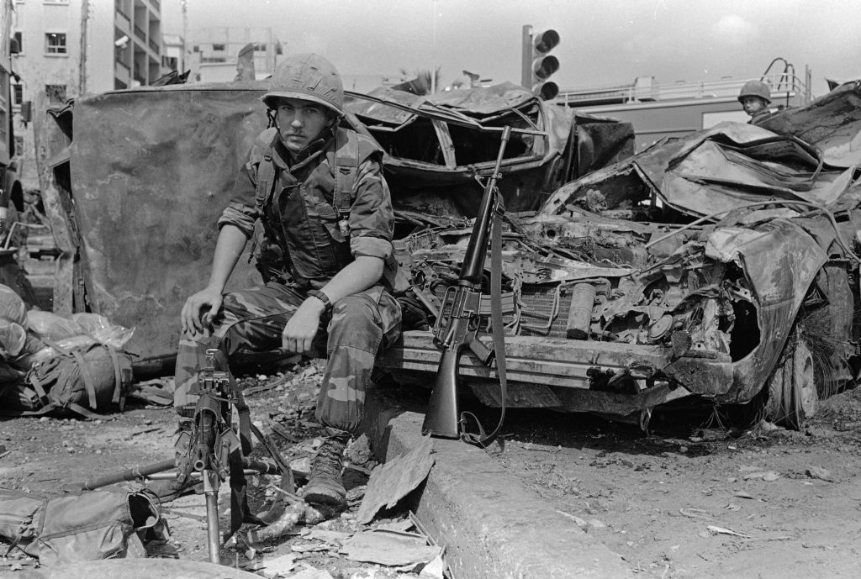
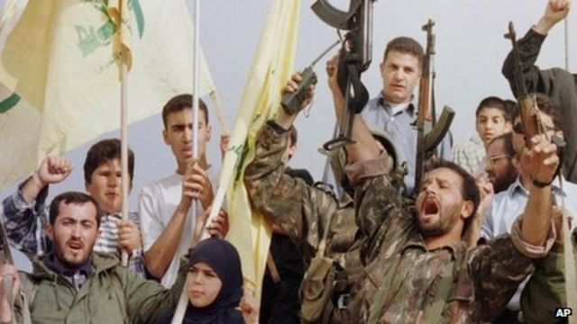
Major Security Failures Terrorists Exploited
1970s
Inconsistency of security measures
Lack of mandated security training
Security efforts only responded to threats that had been seen before
Security changes focused on the bureaucratic and personnel element more than on substantial changes on the ground
1980s
More talk than tangible actions
Lack of commitment from those in positions of power
Focusing security only on select areas with no way to guarantee the “right” embassies were receiving enhancements
Bureaucratic politics
Lack of follow through on security recommendations
Notes:
Thematic overview of how/why terrorists were able to continue successfully attacking US diplomats despite efforts being made to improve security

Slide 9
Key Events in the 1990s
Year | 1990 | 1991 | 1992 | 1993 | 1994 | 1995 | 1996 | 1997
Attacks | 18 | 32 | 25 | missing | 9 | 11 | 13 | 7
East Africa Embassy Bombings
1998
Terrorism
Security
Security Budget Cuts
1988-1996
DS Hiring Freeze
1990-1997
Major Diplomatic Security Overhaul
1998 →
Eric J. Boswell becomes Assistant Secretary of State for DS
1996
Adoption of Risk Management Strategy
1990
Notes:
3 major terrorist attacks during the decade that drove diplomatic security enhancements that clearly weren’t very effective because look at those numbers of attacks…

Slide 10
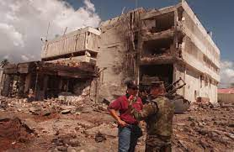
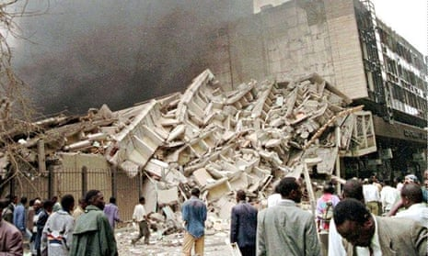
1998 and Security Failures
East Africa Embassy Bombings,
August 7, 1998
Nairobi, Kenya – 200+ killed; 4,000+ injured
Dar Es Salaam, Tanzania – 11 killed; 80+ injured
How did this happen?
Fundamental misunderstanding of how terrorists operate
Failures of threat assessment program and risk management strategy
Kenya = medium threat
Tanzania = low threat
Collective failure of security policy implementation
“an unwillingness to give sustained priority and funding to security improvements”
100-foot setback zone - 83.4% of posts did not meet this requirement
US Embassy, Dar es Salaam, Tanzania
Nairobi, Kenya

Slide 11
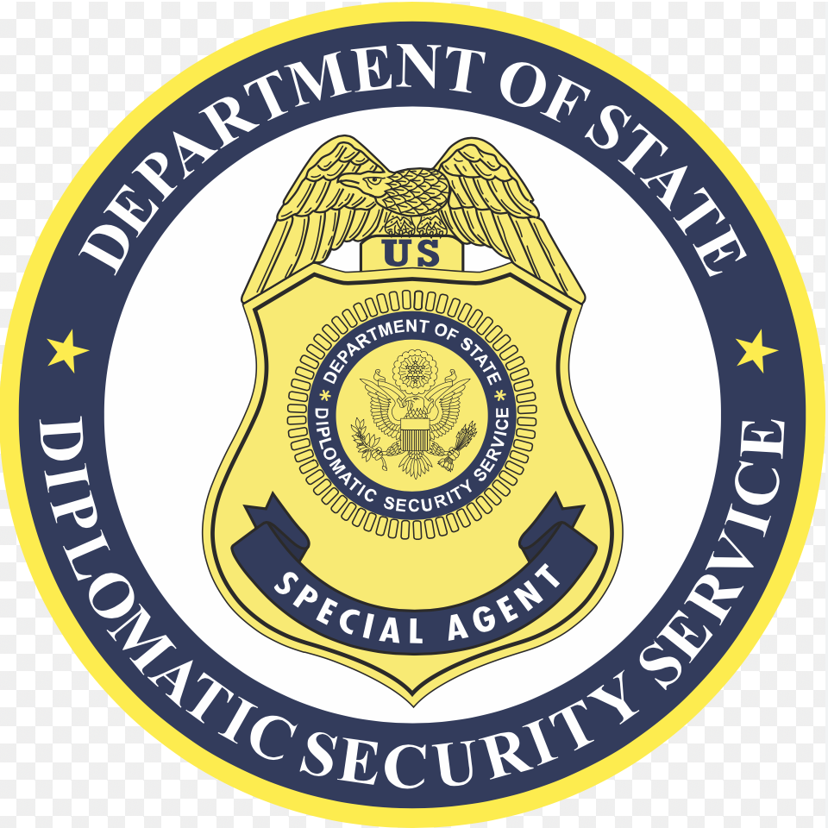
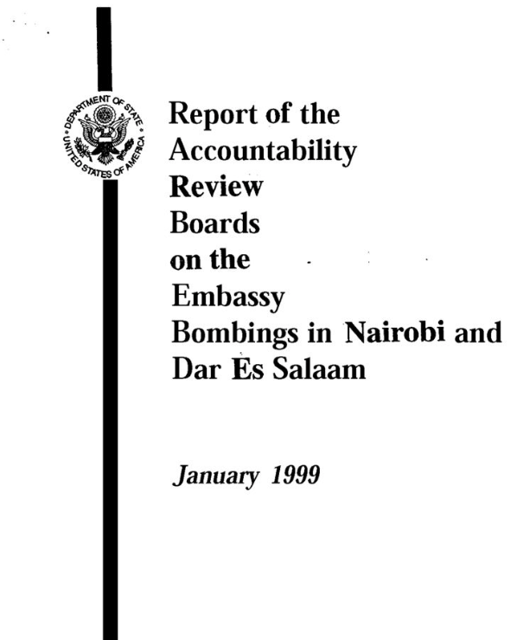
1998 Permanently Changed Diplomatic Security
“You treated the threat of terrorism as the price of being a diplomat. You didn’t demand resources for embassy security. Now you do.”
– Senior Foreign Service Officer
$1.4 billion for “emergency security improvements overseas” from Congress
DSS staffing increased by 25%
Creation of an Emergency Coordination Group as the “focal point for all security action issues”
Creation of 7 Embassy Security Assessment Teams to assess security and make recommendations for changes
Surveillance Detection Program
Temporary closures where threat too great to be secured against
Creation of the position of Regional Directors of Security
1999 Secure Embassy Construction and Counterterrorism Act – codified security improvements as core tenets of diplomatic security

Slide 12
2000s & 2010s Key Trends
The number of attacks per year remained significantly lower than pre-1998 levels.
1970-1998 average of 15.4 attacks against US diplomats per year
1998-2019 average of 5.9 attacks per year
Attacks against US diplomats diverge from trends of attacks against all diplomats and terrorism overall.
dd
Terrorists continued planning and executing attacks, but they chose to focus on different targets than US diplomats.
September 11, 2001
2011

Slide 13
Main Takeaways
Terrorists strategically targeted U.S. diplomats between 1970 and 1998 because they are softer targets than military options yet high profile enough to make their message clear.
In response to increasing attacks on diplomats, the U.S. slowly improved diplomatic security with the 1998 East African Embassy bombings serving as a major turning point.
Terrorists responded to the increased security by adapting their target selection to softer targets – civilians.
When terrorism spiked in 2011, there was no corresponding increase in the number of attacks against U.S. diplomats.

Slide 14
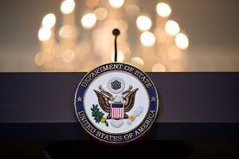
Pragmatic Policy Implications
Can soft targets such as civilians be hardened?
Is there a way to successfully deter terrorists without target hardening?
Directions for Future Research
Future studies could replicate a similar process examining terrorism against diplomats from other countries.
Do terrorists treat US diplomats differently than diplomats from other countries?
How have the practices of different countries done in comparison?
Future studies could consider the effectiveness of terrorism against diplomats.
Was targeting diplomats successful for terrorists?
How has hardening diplomatic targets changed the practices of diplomacy over time?

