Slide 1
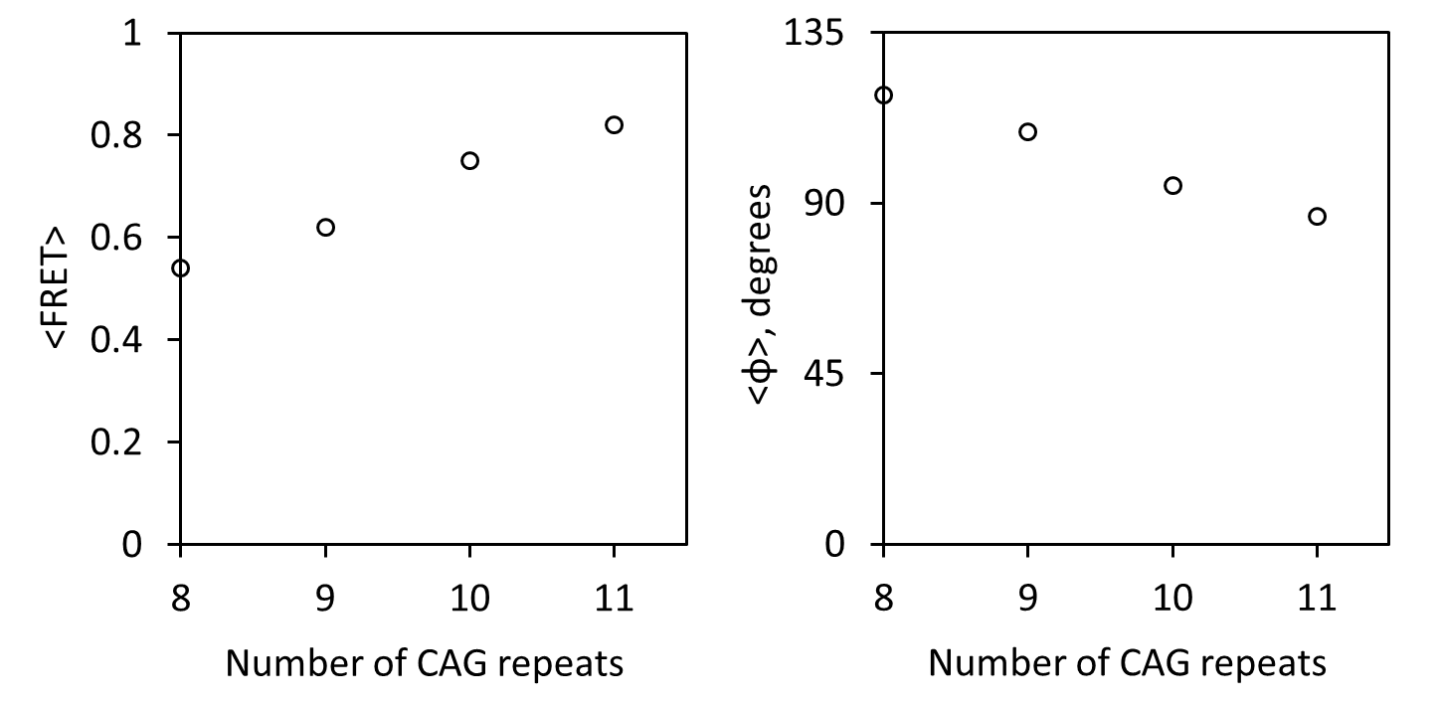
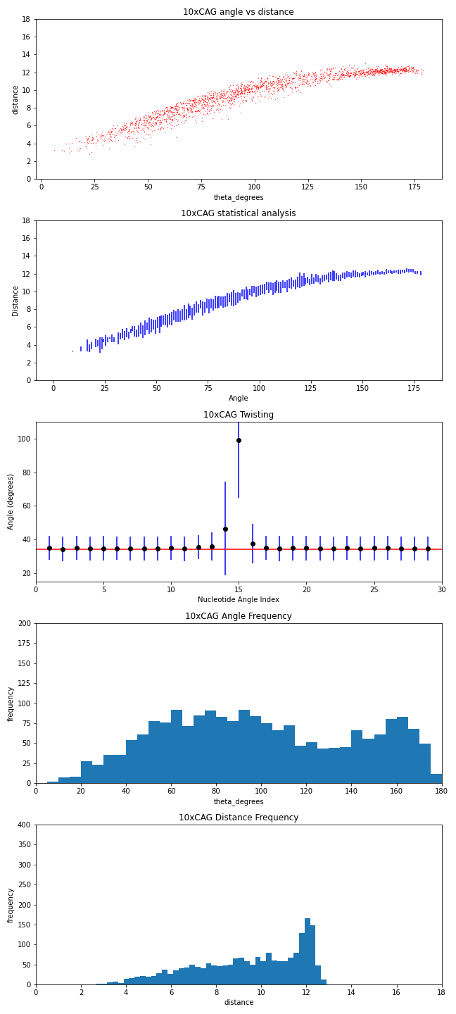
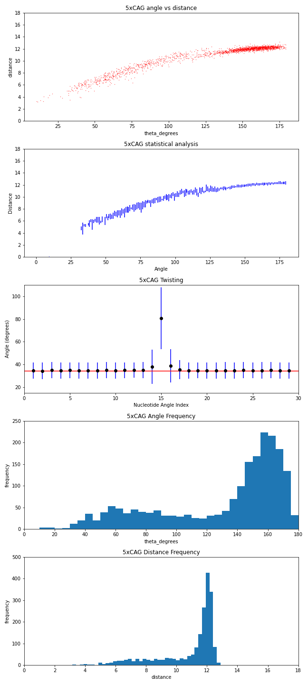
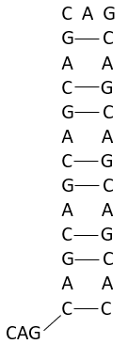
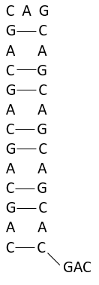
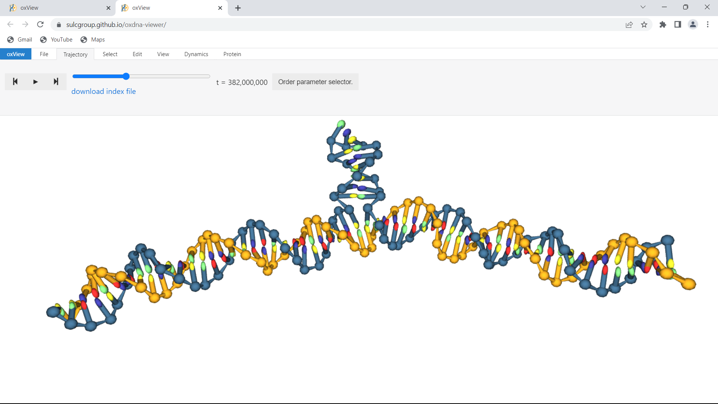
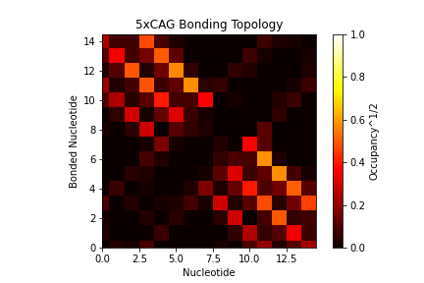
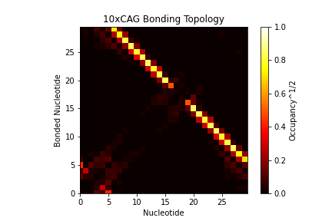
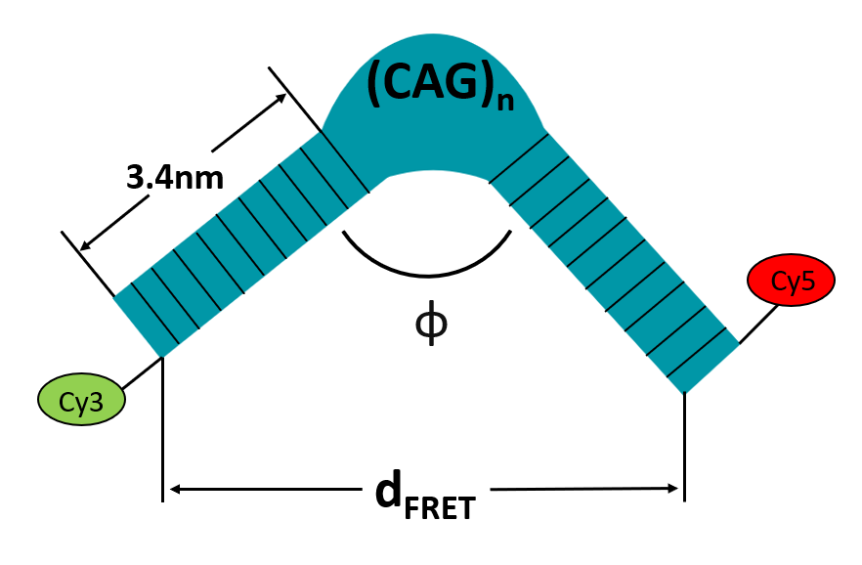
Single-molecule FRET and Computational Modeling of Distinct Conformations by Repetitive DNA Junctions
Benjamin Ward, Sarah Murczek, and Brian Cannon
Department of Physics, Loyola University Chicago
Abstract
smFRET Results for φ
OxDNA Analysis of Structure
Numerous genetic diseases arise from repetitive DNA sequences, such as CAG, that induce non-helical structures, which interfere with normal DNA processing and promote the disease state. Here, using a combination of single-molecule fluorescence microscopy and coarse-grained computational modeling, we have developed a workflow to identify the connection between the non-helical topology induced by repetitive sequences and the intrastrand interactions that specify the detected topologies. DNA three-way junctions (3WJs) were designed with two arms as helical domains and one arm consisting of a defined number of trinucleotide repeats of the sequence CAG. These DNA constructs were labeled with fluorescent dyes for single-molecule FRET experiments to measure the bend angle as a function of the number of CAG repeats. As the number of repeats increased, the DNA became increasing nonlinear and kinked. The coarse-grained modeling was performed via the oxDNA web server. With this software, thousands of potential structures were generated, which were then analyzed in terms of geometry and nucleotide-level bonding energies for intrastrand interactions. With this methodology, we are determining the size-dependent, specific nucleotide-level interactions that promote biologically relevant topologies associated with disease states.
Figure 2&3: FRET and helical angle versus number of CAG repeats.
Coarse-grained modeling of DNA structures using oxDNA
OxDNA is a popular coarse-grained model used by the DNA/RNA nanotechnology community to prototype, analyze and rationalize designed DNA and RNA nanostructures. Using oxDNA, evolutions of (CAG)₅ and (CAG)₁₀ were simulated over a 10-4 s timeframe to produce a trajectory file of 2000 discrete structures per evolution with 150 ns time difference. Bond formation and energy are related to structural kinking to provide insight for expected behavior in a convenient workflow.
Figure 6&7: For (CAG)₅ & (CAG)₁₀ distance vs angle, distance vs angle statistical analysis, helical twisting around the 3WJ, and angle and distance histograms.
Design of Single-molecule FRET measurement of bend angle
Bonding and Topology
Florescence Resonance Energy Transfer (FRET) measures the distance between two dyes, Cy3 and Cy5, attached to each arm of a single DNA molecule through imaging. Analysis of the images gives the FRET efficiency as the number of photons emitted from Cy5 over the sum of the emissions from Cy5 and Cy3 over a 35 second interval. The expectation value from the FRET histogram determines the distance using equation 1. Equation 2 finds φ using the law of cosines, where d=distance from FRET analysis and a=3.4nm, the length of 10 base pair DNA strand.
Bond formation can be conveniently summarized by a heat map to allow immediate interpretation of behavior. The following bonding maps from oxDNA analysis (figure 8) and theory (figure 4) show the simulation appears to fail to closely cohere with theory. (CAG)₅ has unstable bonding and rapidly transitions between states with accumulation and without, while (CAG)₁₀ appears more stable with consistent accumulation on one side. (CAG)₁₀ will experience dominant accumulation on the other side and other topologies, but it has not in this evolution.
Figure 4&5: CAG repeat bonding theory for (CAG)₅ & (CAG)₁₀. Conformations of (CAG)₁₀ and one of (CAG)₅ oxDNA.
The angle φ and distance d can be replicated by simulation analysis with structural topology from the OxDNA trajectory being comparable to angle distance distributions produced by analysis of imaging results (figure 6&7), which are used to draw a connection to the replication behavior of DNA affected by TWJs with trinucleotide repeats. Moving forward, the work is interested in and focused on the connection of these geometric properties to intrastrand bond interactions and associated disease states.
On the TWJs trinucleotide domain, bonding energy and frequency of the CAG interactions were accessed using computational methods. Due to the geometry created by different sizes of the CAG sequence, expected bonding behavior will vary with this paper interested in the amount and location of unbonded nucleotides on the mutated structure. These nucleotides accumulate in (CAG)_{n} amounts on either side of the trinucleotide repeat structure and on the endcap of the structure. (CAG)₁₀ and (CAG)₅ have different expected behavior for the accumulation of unbonded nucleotides with (CAG)₅ having no expected accumulation at the base (see figure 4), and (CAG)₁₀ having (CAG)₁ expected accumulation (figure 4).
Figure 1: FRET Imaging diagram
Figure 8: Bonding on the trinucleotide domain for (CAG)₅ & (CAG)₁₀.
(1)
Contact Information
Ben Ward: bward5@luc.edu
Sarah Murczek: smurczek@luc.edu
Brian Cannon: bcannon1@luc.edu
Work is supported by NSF grant #1942776
(2)

