Slide 1
Chicago Methodist Senior Services Internship
Virina Khalil
Human Resource Intern
Loyola University Chicago
Parkinson School of Health Sciences and Public Health

Slide 2
Table of Contents
Who is CMSS
Projects
Takeaways
Aquí puedes dar una breve descripción del tema del que quieres hablar. Por ejemplo, si quieres hablar de Mercurio, puedes decir que es el planeta más pequeño de todo el Sistema Solar y el más cercano al Sol.
For more info: SLIDESGO | BLOG | FAQS
You can visit our sister projects: FREEPIK | FLATICON | STORYSET | WEPIK | VIDEVO

Slide 3
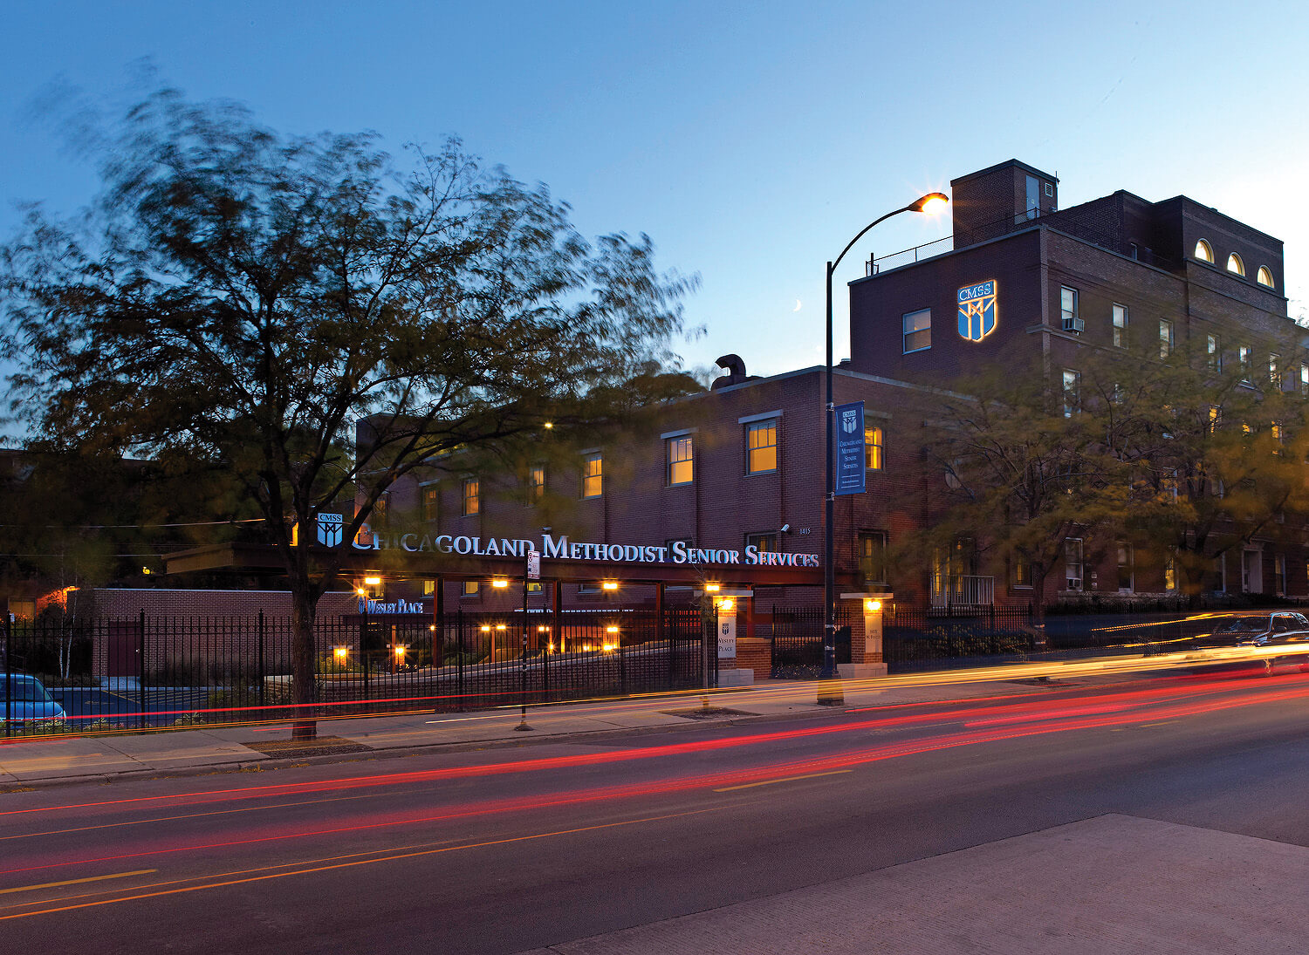
Who is CMSS?
The roots of Chicago Methodist Senior Services can be traced back to 1898, when Mrs. E.E. Hartwell rented a six-room flat in Chicago to provide housing for elderly women in need.
Over the years, they have expanded their community and residential services to better serve the changing needs of the people we serve.
Aquí puedes dar una breve descripción del tema del que quieres hablar. Por ejemplo, si quieres hablar de Mercurio, puedes decir que es el planeta más pequeño de todo el Sistema Solar y el más cercano al Sol.

Slide 4
CMSS Evolution
Wesley Place
Hartwell Place
Covenant Home of Chicago
West Suburban Senior Services
Winwood & Glenwood Apartments
United Methodist Homes & Services
United Methodist Healthcare Recruitment
SASI Home Care
Aquí puedes dar una breve descripción del tema del que quieres hablar. Por ejemplo, si quieres hablar de Mercurio, puedes decir que es el planeta más pequeño de todo el Sistema Solar y el más cercano al Sol.
Notes:
These are all the different locations that have been evolved over the years.
As you can see, it all started with a very kind woman who decided to help other elderly women in her neighborhood as a part of giving to her community, and this kind gesture turned into a very successful organization

Slide 5
Projects
01
02
New Hire Orientation
CMSS Staff Interviews
Help creating and editing new hire orientation for new employees who are joining the CMSS team.
This project was very important to me because it was very eye-opening seeing it from the HR perspective rather than an employee perspective.
I was assigned to conduct interviews with Current CMSS staff.
This experience also helped me look at how the HR department prepares when they are interviewing individuals for a specific position.

Slide 6
Key Takeaways From CMSS
Aquí puedes dar una breve descripción del tema del que quieres hablar. Por ejemplo, si quieres hablar de Mercurio, puedes decir que es el planeta más pequeño de todo el Sistema Solar y el más cercano al Sol.
02
The benefits of Networking
Importance of communication and time management
01
Understanding Workplace Culture
03
Notes:
To wrap up, I would love to share some key takeaways that I learned from my experience at CMSS. The first one is that networking is essential in the workplace. When I got introduced to the staff, it was way easier to work with those who I networked with than those who I did not. I learned that Networking in the workplace creates a bond and therefore helps with the success of any project. I was also very nervous on my first day, but when I got to talking to all of the employees i got morre comfortable and was able to meet a lot of new people and make a lot of networks.
Another one is understanding workplace culture. Here at CMSS I have seen how much the employees comply with rules and guidelines and the amount of respect they have to one another is something that has been very unique and I would proudly say that I spent my internship in such an environment.
I also learned a lot about how communication is the key to success. At the beginning I was very nervous to make any mistakes or ask for help in fear of being misunderstood. However, Sarah and Michael made it really clear that if i needed any help at any time they would be more than happy to help and when the time came and asked for help, I got nothing but positive feedback, so thank you both very much!
Lastly, time management is something that I really learned here at CMSS. At first I was overwhelmed when I was given a project or two to work on at the same time. Over the course of three months, I really learned how to manage my time through each project. I learned to prioritize and give all my effort while also giving each project the time it deserves to be successful.

Slide 7
Thank you for Tuning in!
Aquí puedes dar una breve descripción del tema del que quieres hablar. Por ejemplo, si quieres hablar de Mercurio, puedes decir que es el planeta más pequeño de todo el Sistema Solar y el más cercano al Sol.

