Slide 1
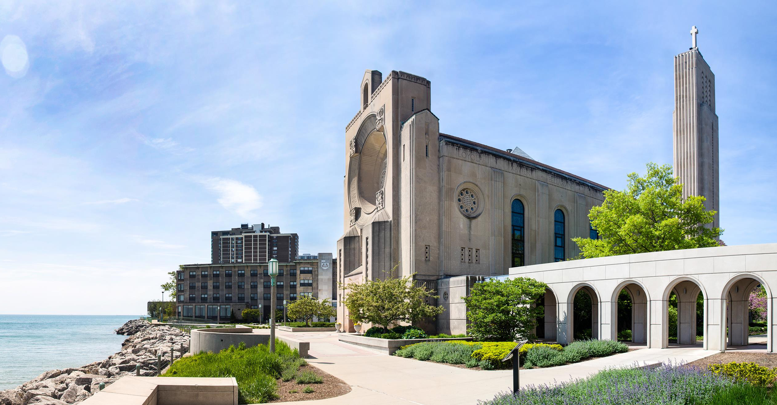
KCommunications Graphic Design Internship (remote) Mellon Internship Award Spring 2023
Enes Eldes

Slide 2
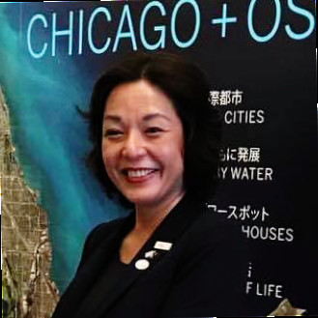
About KCommunications LLC
KCommunications, LLC is a Chicago-based boutique public relations agency providing businesses, non-profits and artists communications, marketing and branding consulting services. The agency works with a large network of professionals and institutions in the related fields to provide results for our clients. Our strategy is to serve as our clients’ advocate while cultivating long-term relationships with media professionals and business partners.
Founder, Kimiyo Naka, a bilingual professional (Japanese, English), has 20 years of experience in communications, media relations and project management. As a strategic thinker with strong verbal and written skills, she specializes in building rapport with stakeholders from diverse backgrounds. Prior to launching her own business in 2015, Kimiyo worked at Encyclopædia Britannica for 11 years as an International Project Manager, completing a number of challenging traditional and digital publishing projects around the globe.
Kimiyo Naka

Slide 3
Responsibilities
The graphic design internship for KCommunications LLC took place during the Spring 2023 semester. As the graphic design intern, I curated a variety of graphics for various clients and projects and assisted in digital marketing tasks for the Chicago Sister Cities International Osaka Committee. The experience allowed me to build my portfolio and participate in projects that allowed me to improve my digital marketing skills.
Curate graphics for social media
Assist in social media marketing creation - strategy and copywriting
Designing, managing and updating websites
Design brand materials (flier, posters, etc.)
Design/create newsletter/email marketing materials
Checked in daily in the morning and afternoons, stating at the end the work I had done for the day.
Attended various online meetings to communicate design ideas and discuss details for projects handled over
Created various versions and mockups for design works and communicated design process and applied adjustments based on client and advisor feedbacks.

Slide 4
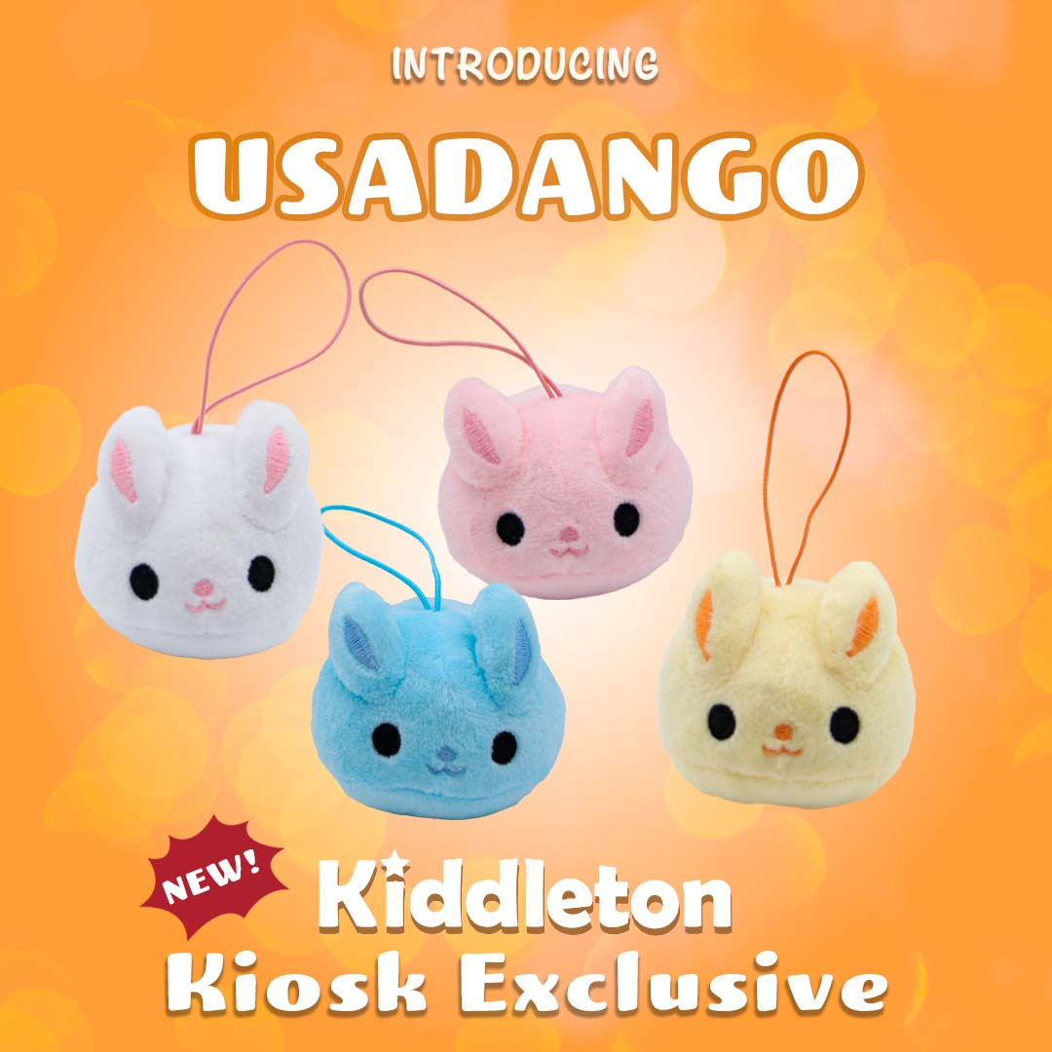
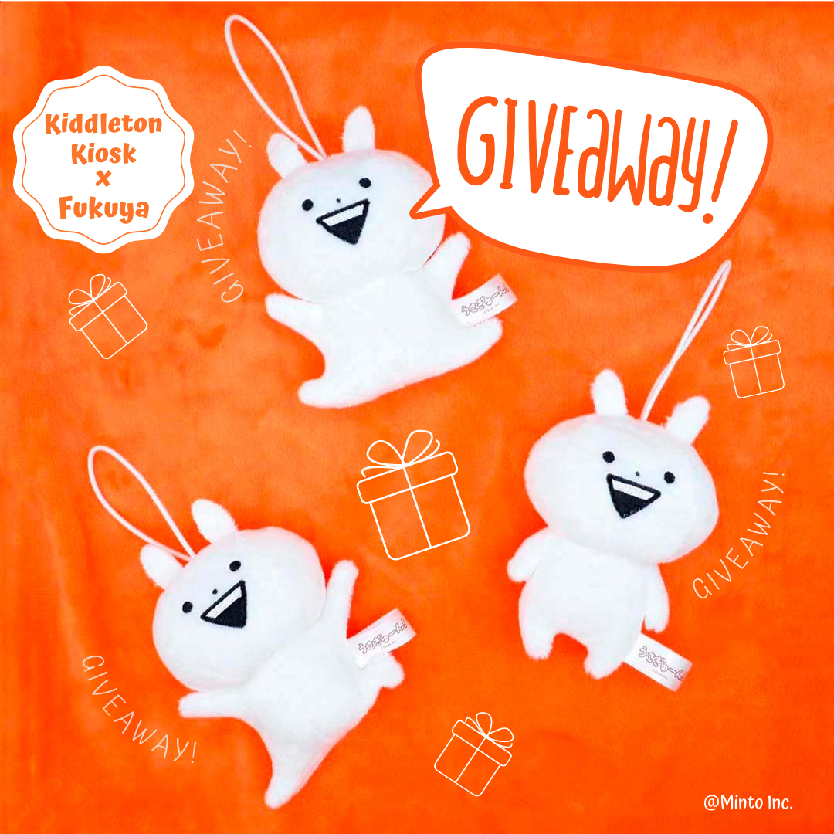
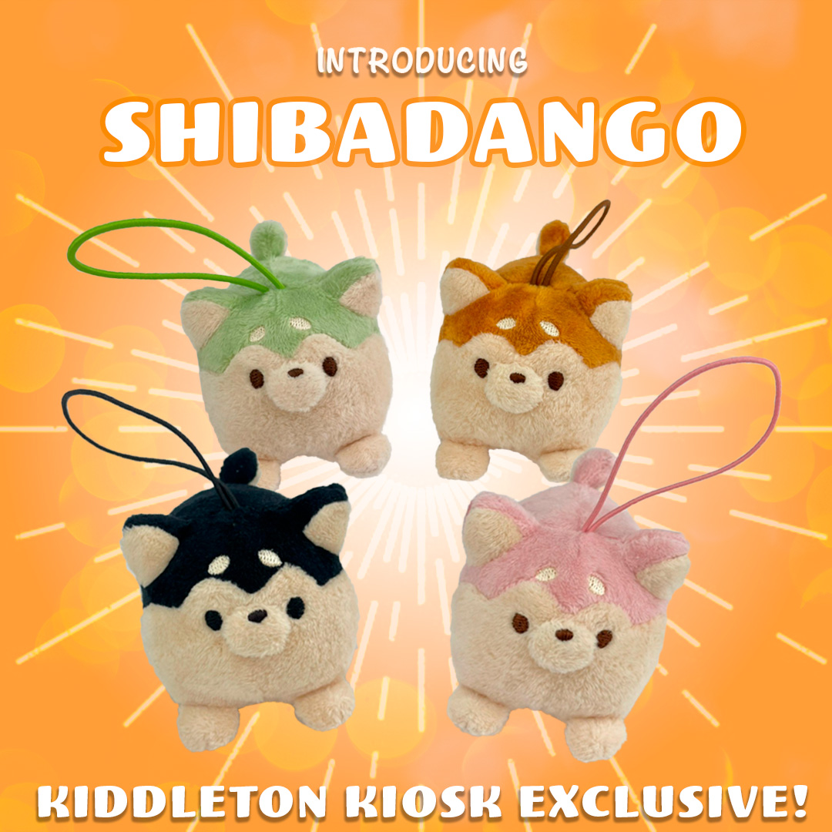
Works Created
Social Media graphics ( Clients: Kiddleton, Uka Sake)

Slide 5
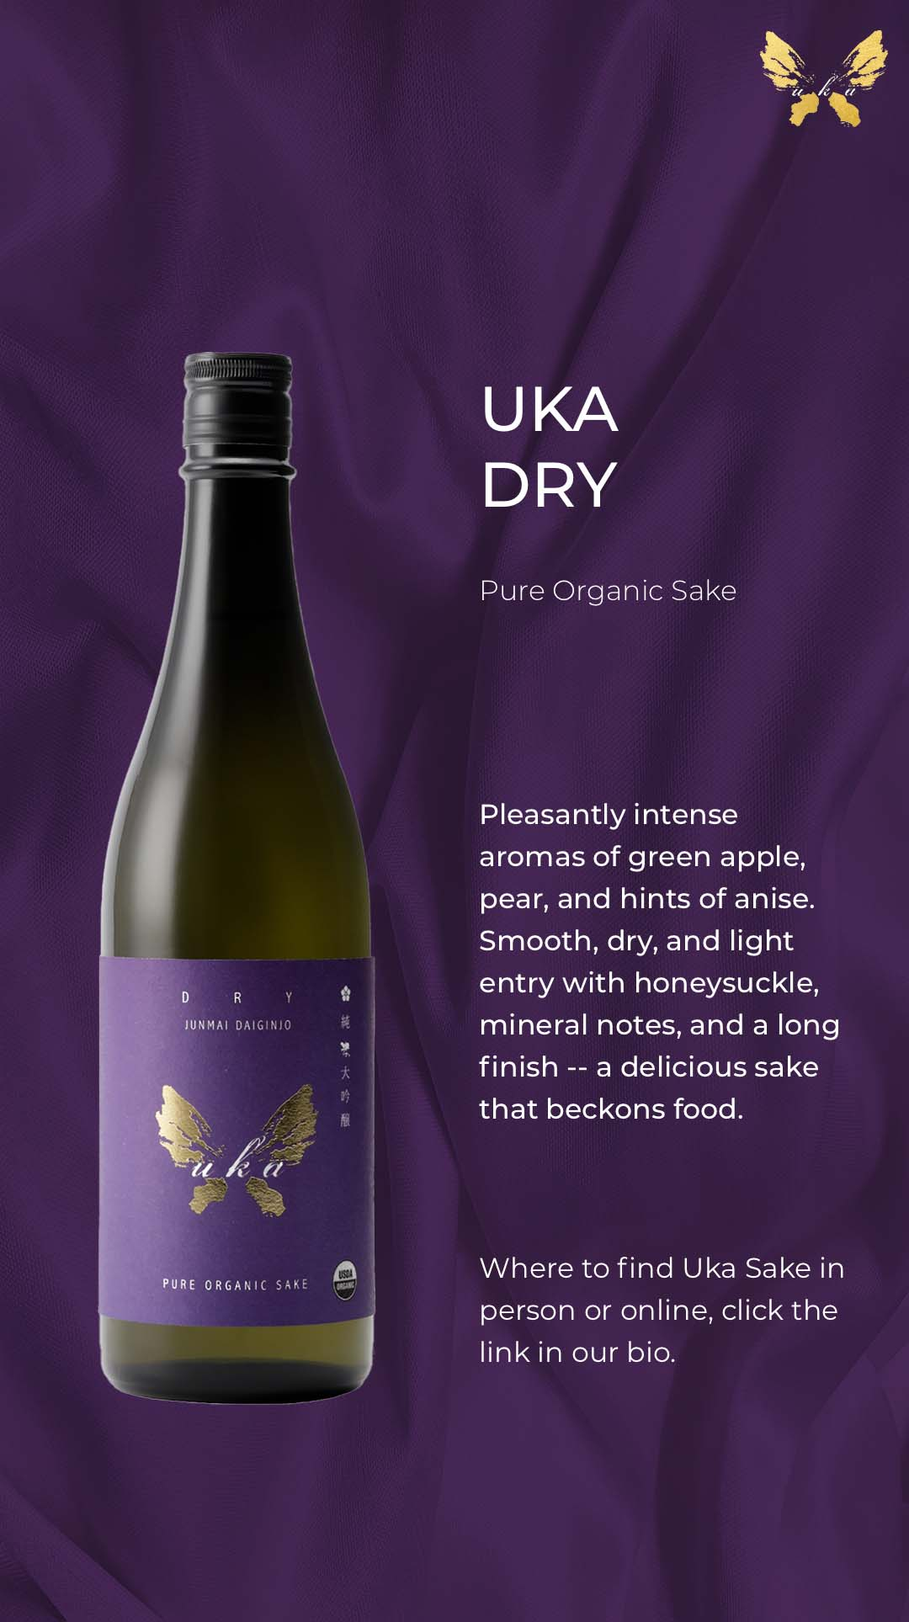
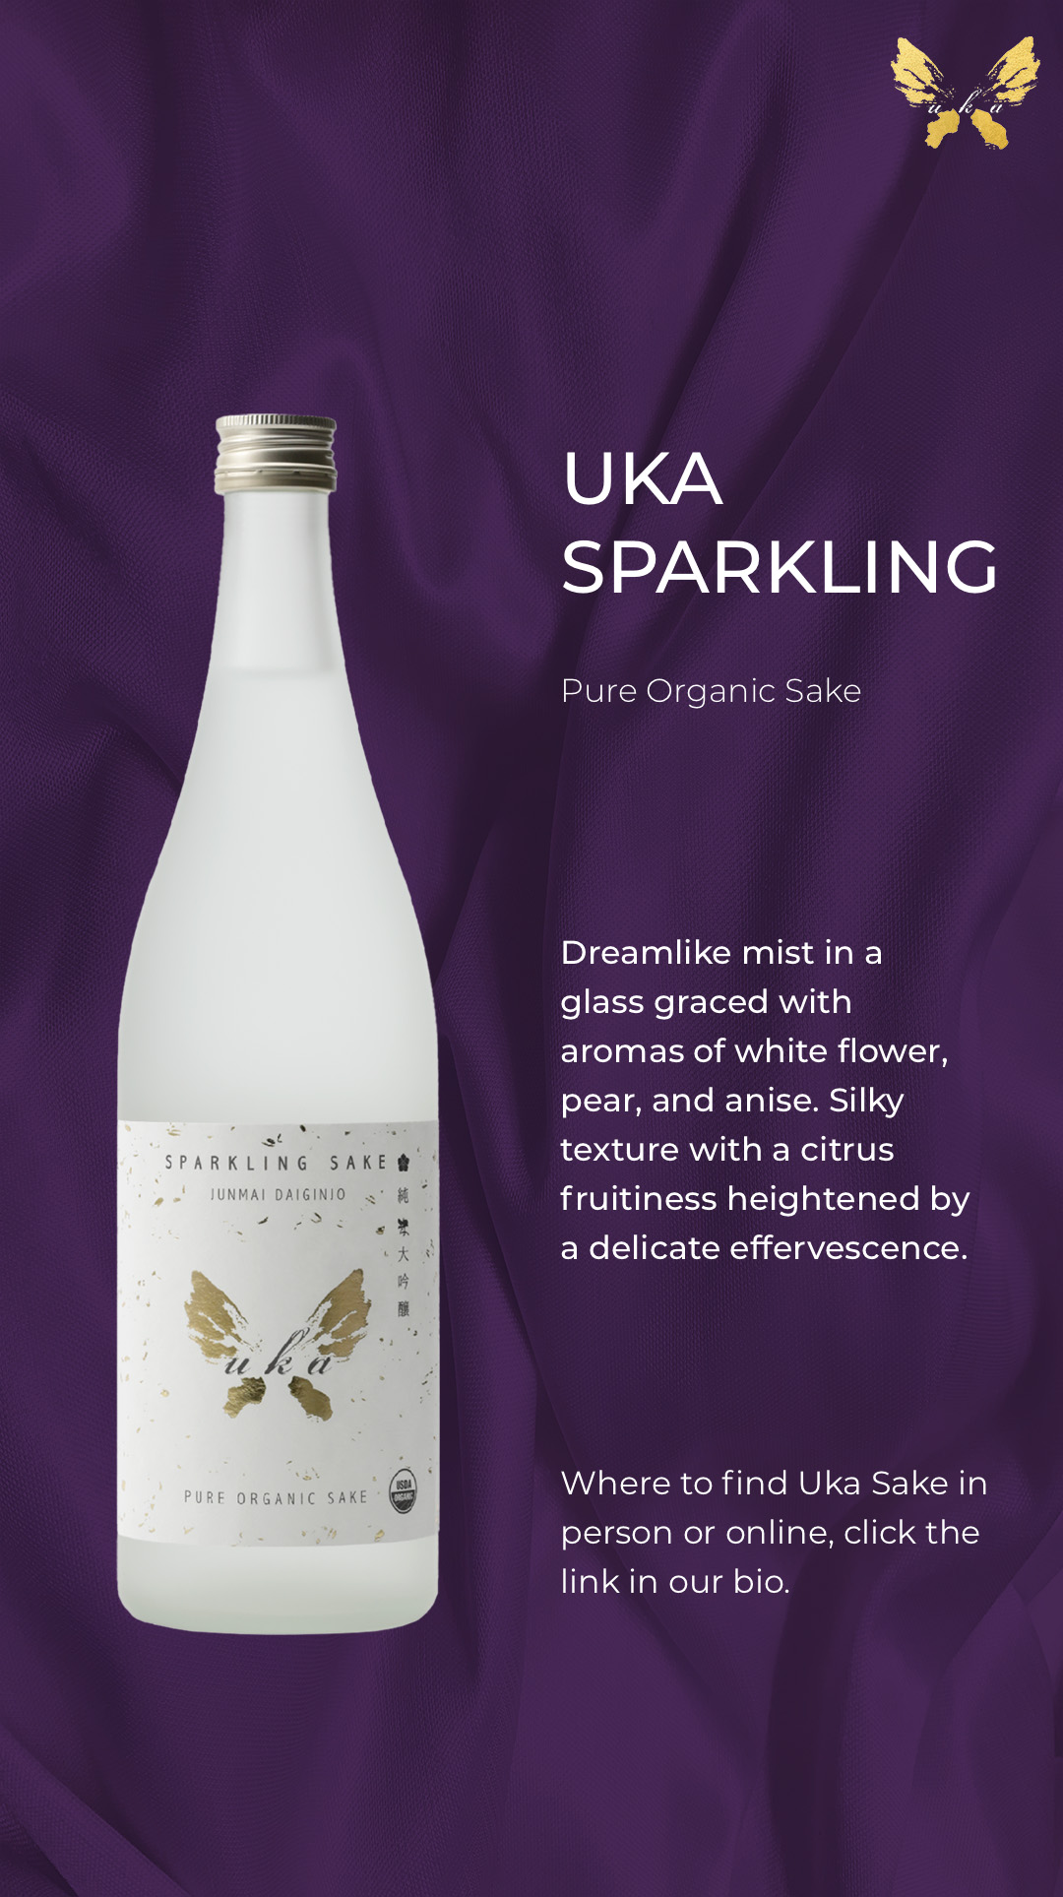
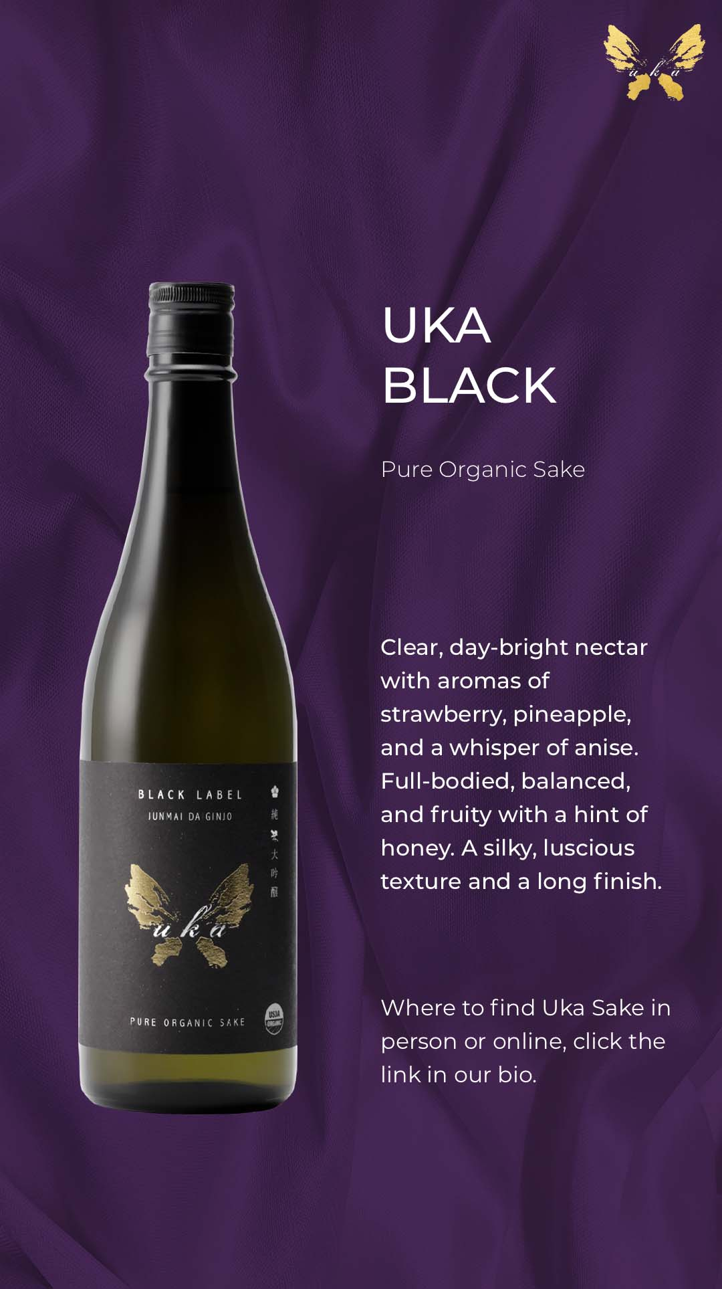
Works Created
Social Media graphics ( Clients: Kiddleton, Uka Sake)

Slide 6
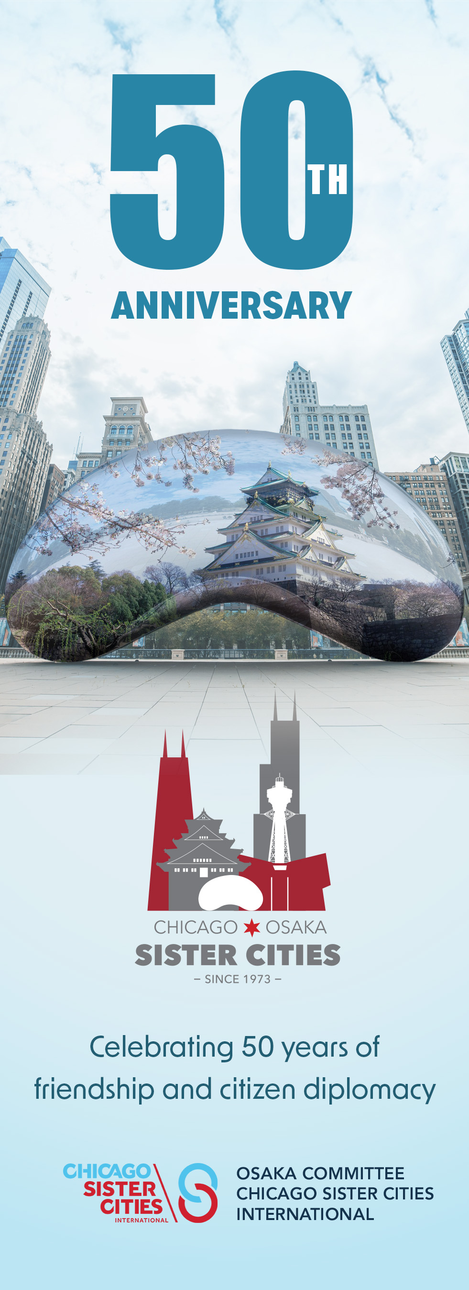
Works Created
Promotional materials for Chicago Sister Cities International Osaka Committee 50th Anniversary
(flyer, banner, tablecloth).

Slide 7
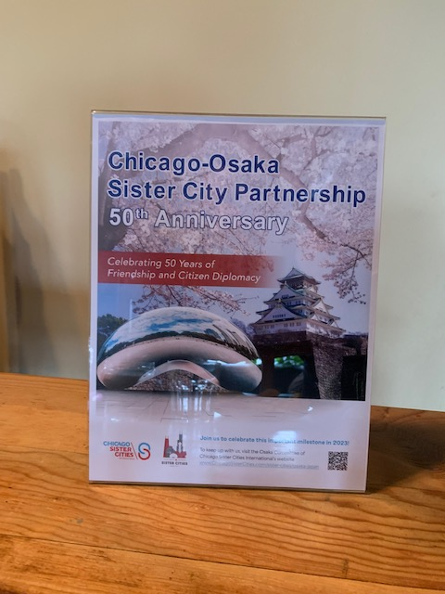
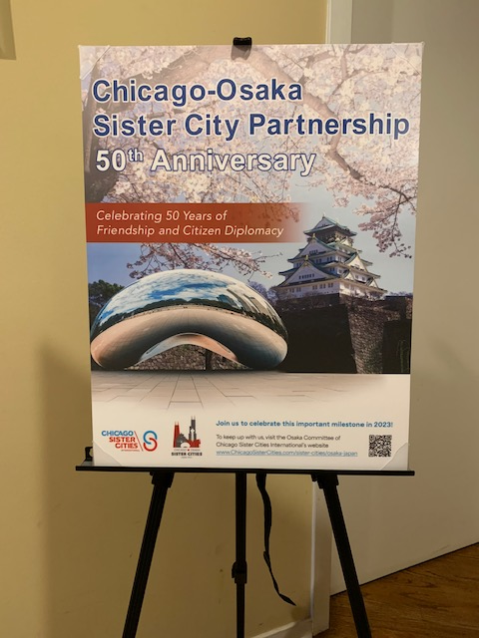
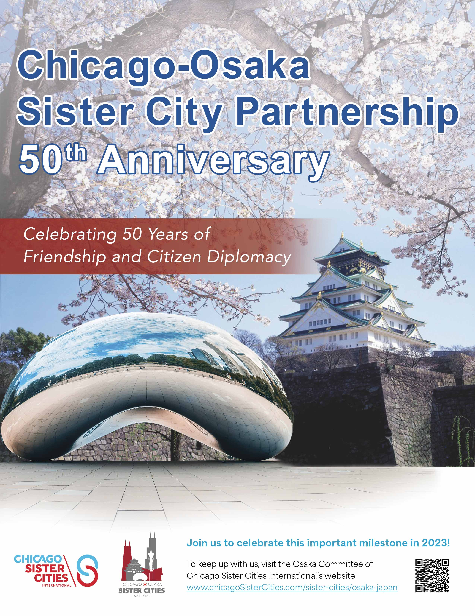
Works Created
Cont.

Slide 8
Internship Reflection
This internship was very exciting and filled with great graphic advertising experience. My advisor introduced me to the environment of the advertising world and what it means to deal with clients and create promotional materials that is to be showcased to the world. It also allowed me to understand in more detail the design process and allowed me to take on projects that I had not created before. Being part of a team was also a very rewarding yet a learnable experience as you are part of a bigger machine contributing to bigger works.
THANK YOU
If you have any questions or would like to talk, my contact info can be found below:
enes.eldes@gmail.com eneseldes.com

