Slide 1
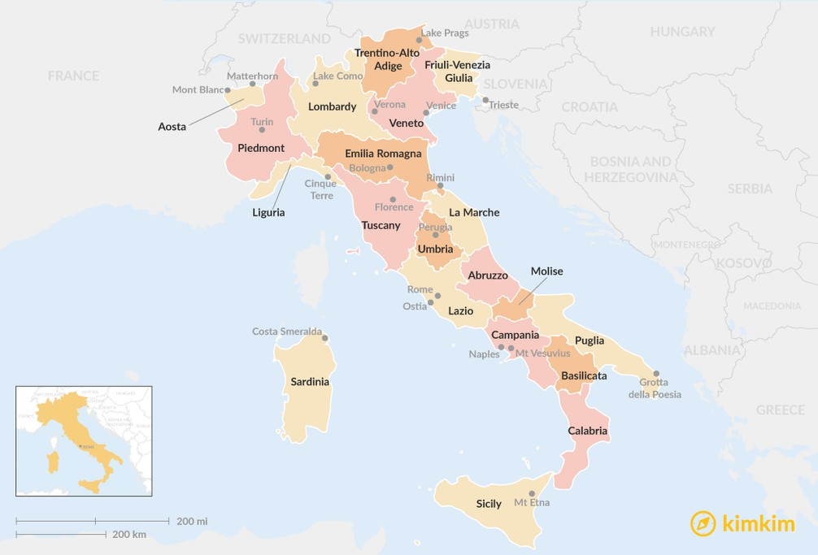
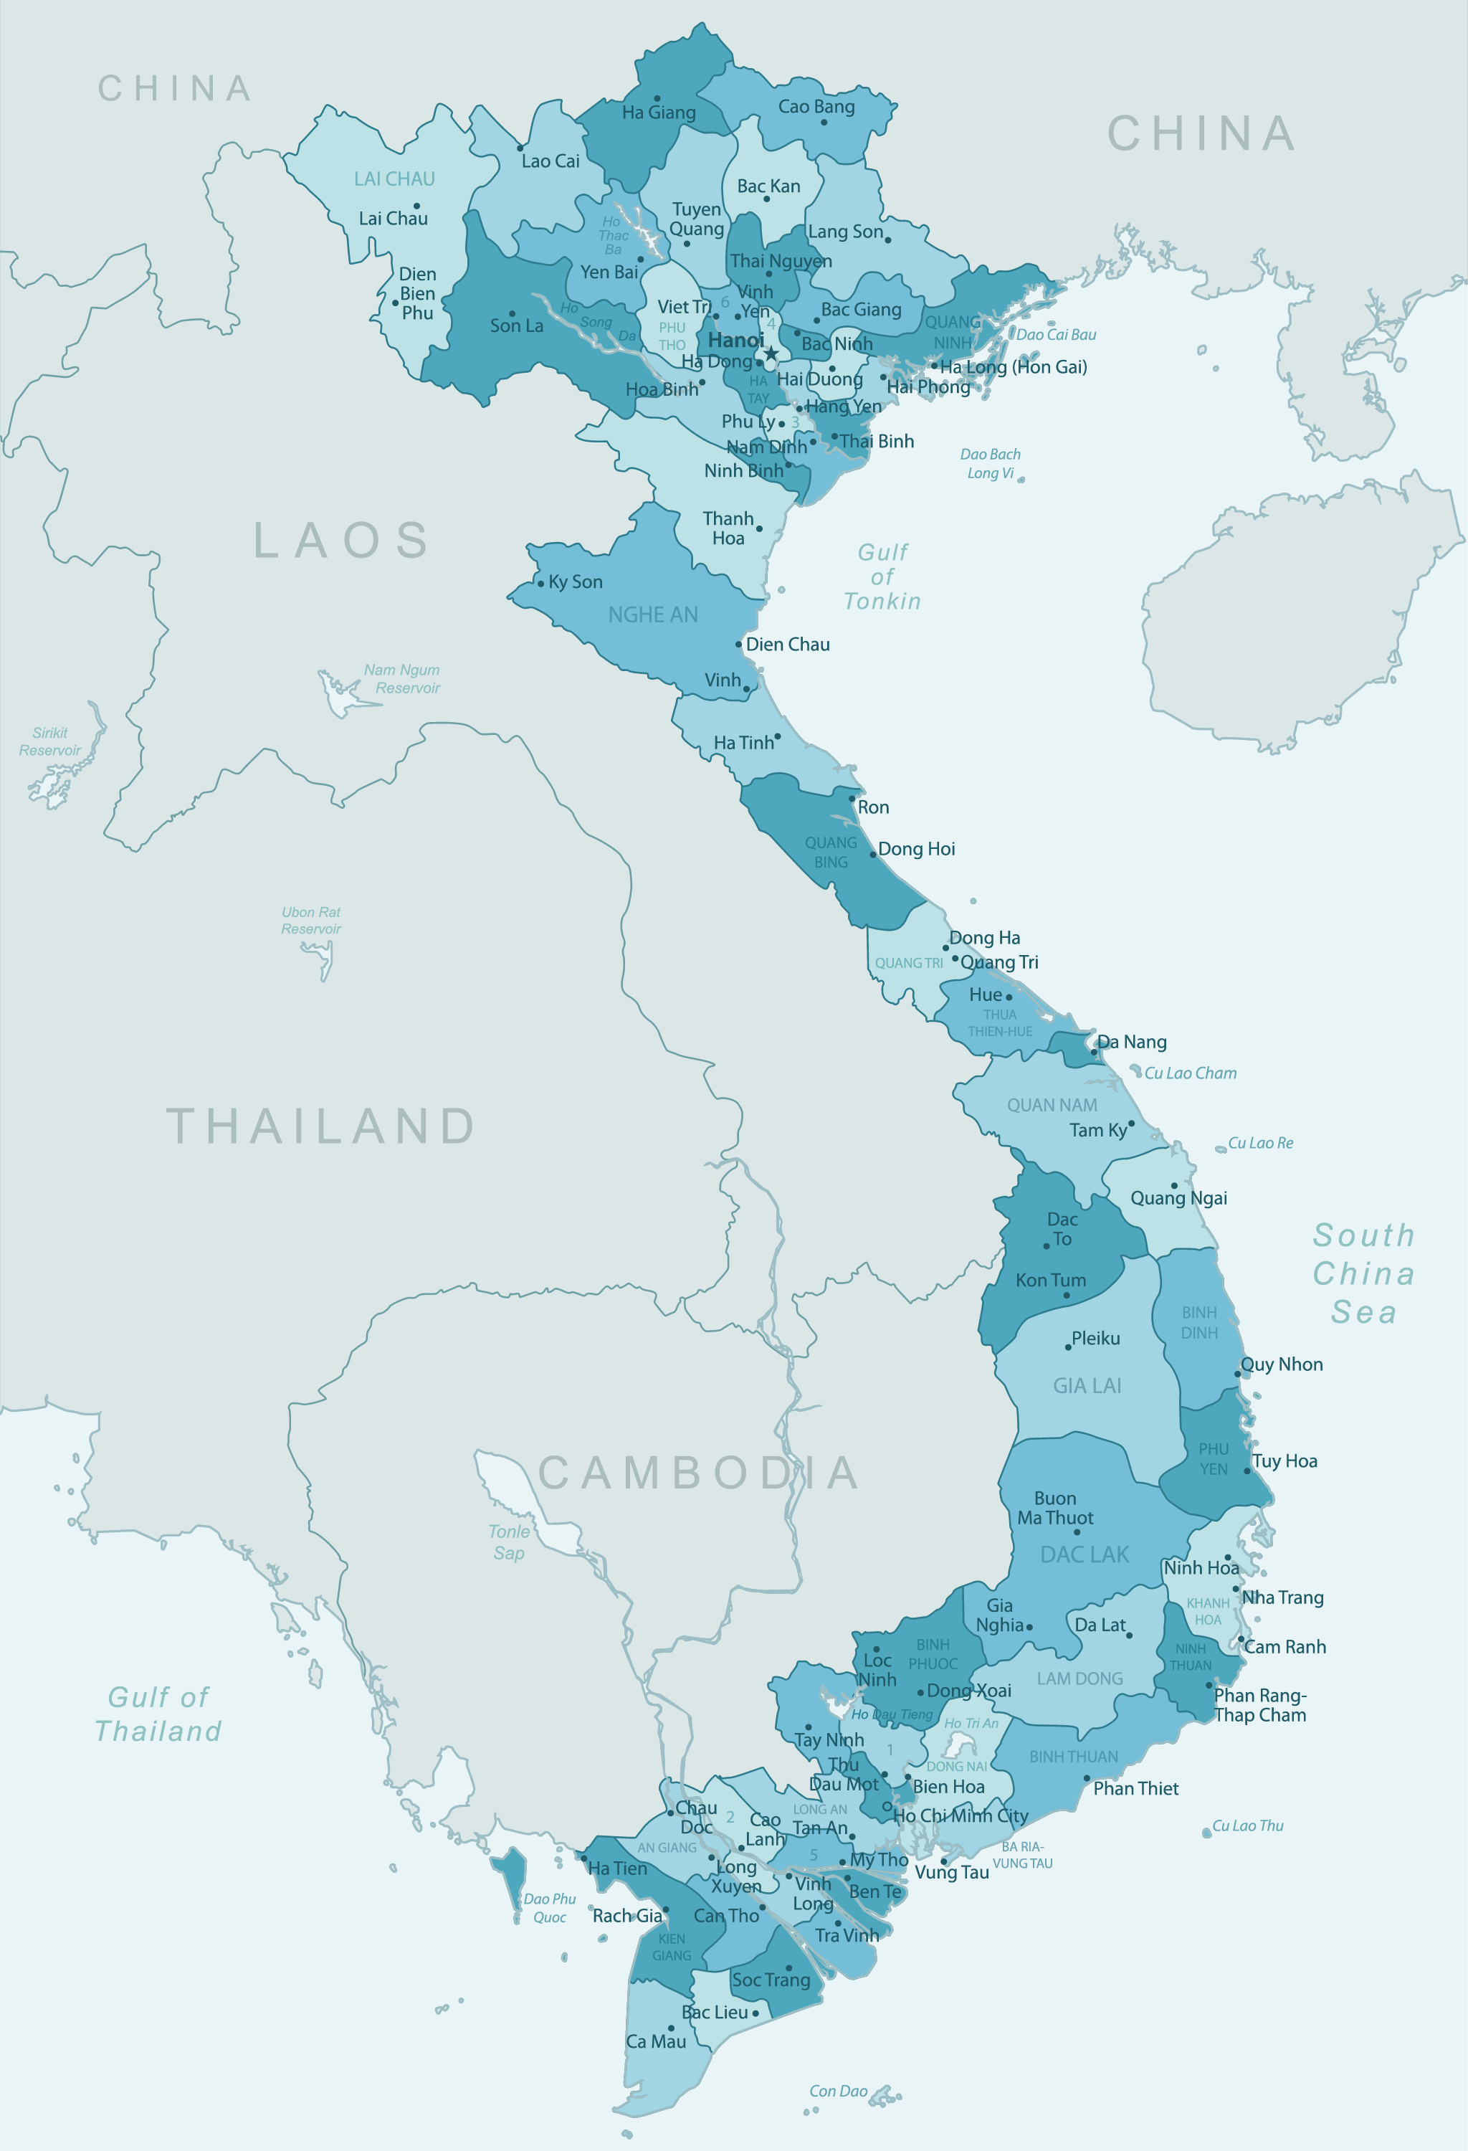
2021 - 2022 Ricci Scholarship Cohort
Impact of NGO Outreach on At-Risk Youth Populations in Italy and Vietnam
Emma Geiser, Principal Investigator
Abstract
Seconde Generazioni (G2)
Comparative Analysis
The outreach tactics and target population of non-governmental organizations vary by country and political & cultural climates. This project centers on NGO outreach to different populations of at-risk youth in both the Western and Eastern hemisphere. In Italy, there exists a generation of children of immigrants that are not automatically granted citizenship due to Italy's traditional naturalization laws. In Vietnam, the Khmer ethnic minority makes up 1.38% of the Vietnamese population and is a traditionally agrarian group. Despite the differences in political and cultural climate, the common denominator between these two groups of at-risk youth is the impact of educational opportunities and academic performance.
The at-risk youth group I examined in Italy are the second generation Italian immigrants known colloquially as G2. Italy operates their legal system on the principle of jus sanguinis, or the rule of blood, which means you can claim citizenship if either of your parents are citizens. Due to Italy’s naturalization laws, it is hard for members of G2 to easily naturalize because their parents aren’t citizens. G2 members have one opportunity to have their application process expedited from the day they turn 18 to the day they turn 19.
Key findings:
No formal NGOs tackling this particular legal issue
G2 members instead have formed associations and started advocating for themselves by lobbying government officials
Socio-economic status and level of ethnic school segregation are the main determinants of academic success
Not very many statistics on this group alone, hard to tell the size of the population
Both at-risk youth groups experience educational disparities when compared to the respective national averages, and both groups have experienced the isolation of what it means to be a minority.
Education is one of, if not, the most important opportunity for social mobility for any of the youth in these two groups. The higher quality of an education that these youth get, the more likely they’ll be to successfully transition into adulthood.
While there are no NGO operations supporting the seconde generazioni, they have decided to take their fate into their own hands and lobby the government for a new citizenship law. On the other hand, NGOs are definitely having a positive impact on the Khmer in Vietnam as they are empowering Khmer girls in their educational aspirations.
Khmer Ethnic Minority
The at-risk youth group I examined in Vietnam is the Khmer ethnic minority which makes up only 1.37% (1.3 million) of the Vietnamese population. The Khmer minority are indigenous to parts of Cambodia and Southern Vietnam; the majority live in the Mekong River Delta as they live traditionally agrarian lifestyles. This is also the main contributing factor to their poverty levels as harvesting can be very unpredictable and lead to fluctuating levels of income.
Key findings:
Literacy rate of Khmer females aged 15 and older are at 68% compared to the national females aged 15 and older at 91%
Ethnic minority schools that meet the national standard are 19%
ECO Vietnam Group is a social enterprise that provides educational and recreational programming for Khmer youth
Room to Read is an INGO that employs social mobilizers to work among schoolteachers to empower Khmer girls
Background
The Ricci Scholarship program was developed as a chance for third-year students to conduct cross-cultural comparative research on a chosen topic. The student develops their research proposal sophomore year and then conducts their research while abroad in their junior year, focusing on Italian research in the first semester and Vietnamese research in the second semester. After a year abroad, the student finishes the comparative analysis aspect of their research.
Acknowledgements:
Dr. Mine Cinar, PhD., Faculty Sponsor
Dr. Anne Wingenter, PhD., Italy Research Supervisor
Dr. Ngyuen Luu Bao Doan, PhD., Vietnam Research Supervisor

