Slide 1
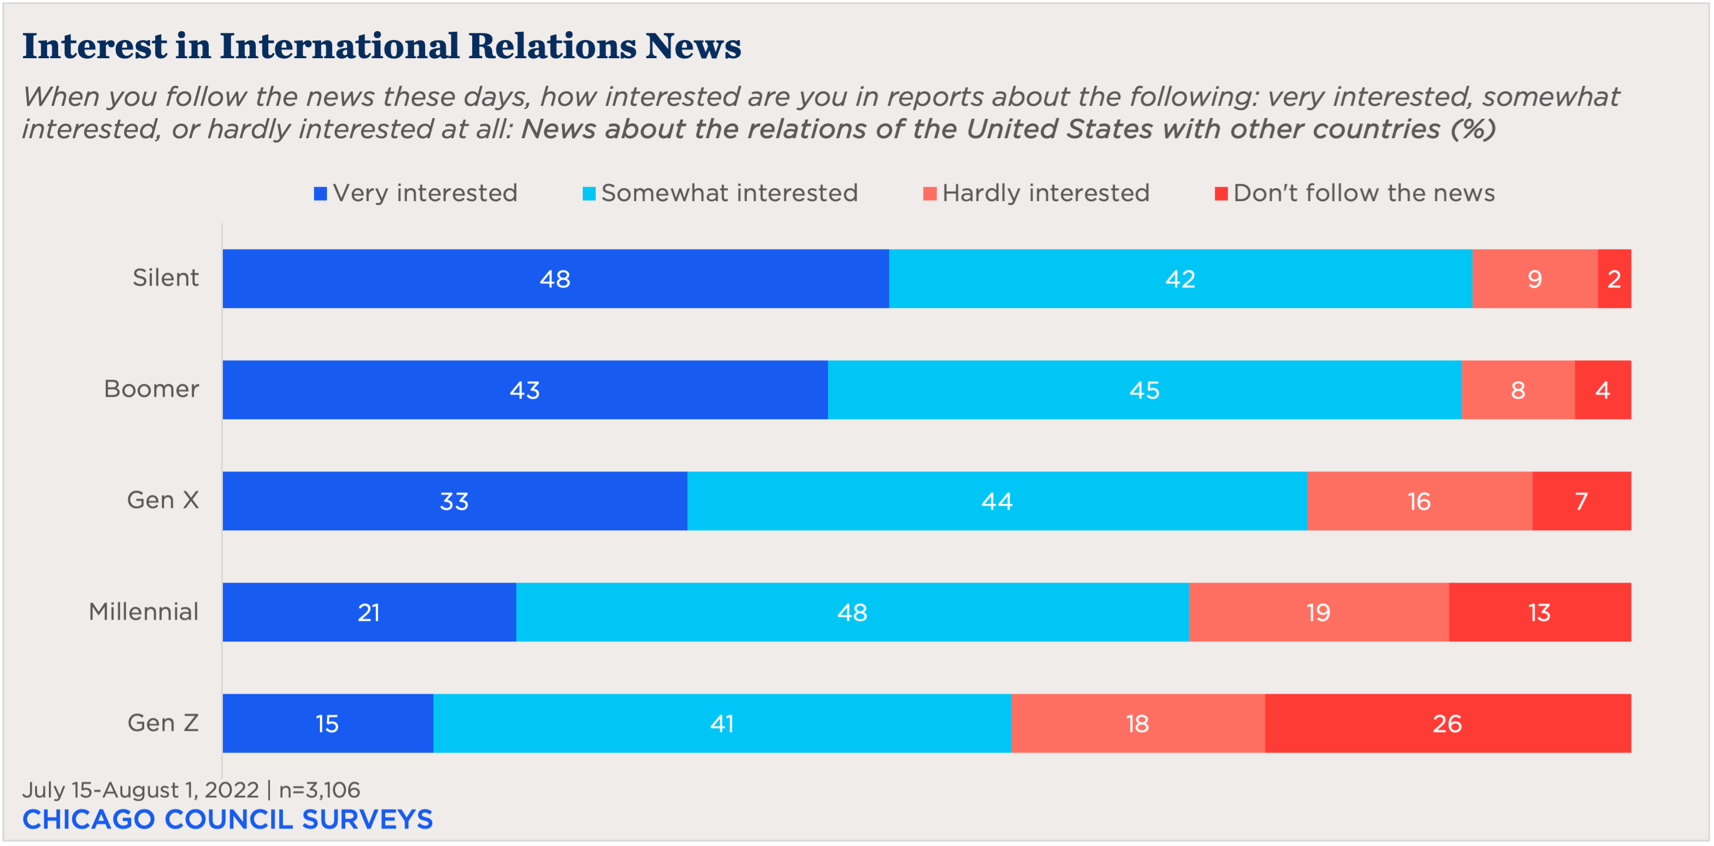
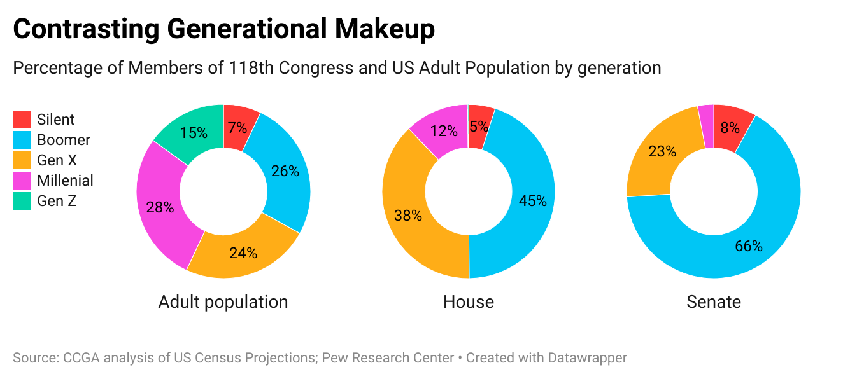
Mellon Foundation Unpaid Academic Internship Award - Spring 2023 Recipient
Internship at the Chicago Council on Global Affairs
Emma Geiser
About
The Chicago Council on Global Affairs is a nonpartisan, nonprofit organization to increasing knowledge and engagement in global affairs. Founded in 1922, the mission of the Council is to provide accessible discussion about policy initiatives. There are several research centers in the Council that provide in depth research analysis available to the public including the Lester Crown Center on US Foreign Policy, the Center on Global Cities, and the Center on Global Food and Agriculture.
Public Opinion team
Since January, I have worked for the Public Opinion team (Survey team) at the Lester Crown Center on US Foreign Policy as an intern. This team is mostly responsible for carrying out prominent public opinion surveys such as the annual Chicago Council Survey. This specific survey has been tracking American’s attitudes since 1974. When the team isn’t busy on the CCS, they collaborate with international polling centers to track public opinion around the world.
My main job responsibilities include writing academic lit reviews, creating toplines of surveys for review, and creating Excel figures out of survey data. Seeing the data in a visualizing way is not only appealing to the audience but it also helps the writer notice trends or patterns that might not have been apparent before.
I also get to contribute to the Survey teams blog, Running Numbers, intermittently on topics of choice. This has been a good way to get my hands dirty with public polling data done by other firms.
US Gerontocracy
Generations Report
In my most recent blog post titled Does Older Mean Wiser? US Views on Gerontocracy, I examined American attitudes on the idea that the people in power are too old to be representing the American population. As seen on the figure below, the generational makeup of those individuals in Congress do not match up with the voting-eligible population.
The oldest members of Gen Z (1997–2012) are just now reaching the lower age limit for election to the House (25) and thus have only one representative in the 118th Congress. However, Millennials (1981–1996), the second-youngest generation of American adults, are severely under-represented in the legislature. Despite making up 28 percent of the adult population, Millennials hold only 10 percent of the seats in Congress.
The Survey team recently compiled the most compelling data points from the 2022 CCS disaggregated by generation (see the figure above). Surprisingly, the survey found that Gen Z and Millenials are much less interested in engaging with any US foreign policy news.. There is a clear relationship between individuals that report being interested in foreign policy news and interest in US engagement abroad. A possible explanation for this is that interest in the news generally increases with age.
Gen Z and Millenials would also rather see the federal defense budget decreased rather than increased, whereas the Silent gen, Boomers, and Gen X preferred to increase the size. Younger generations are also much less concerned about geopolitical threats. A majority of Millenials and Gen Z do not perceive Russia and China’s territorial ambitions to be a critical threat. They are also slightly less likely to be concerned about the decline of democracy around the world, compared to the older generations.

