Slide 1

Lorin Drazenovic
Lorin Drazenovic

Slide 2

Table of Contents
Investment Thesis
Business Description
Industry Analysis
Financial Analysis
Valuation
Investment Risks

Slide 3
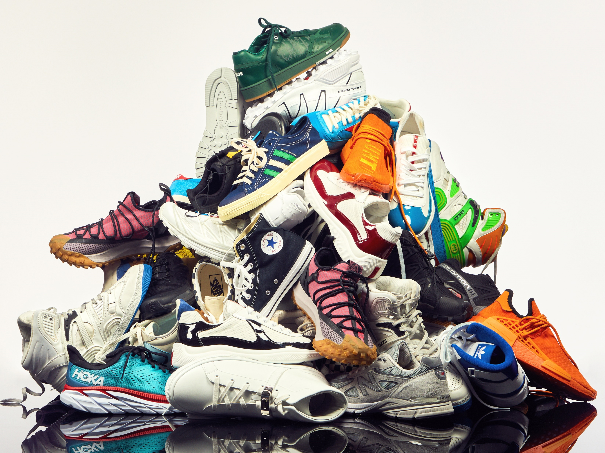
Investment Thesis

Slide 4

Investment Thesis
Recommendation: Buy DBI Shares
Current Price: $11.94
Target Price: $27.45
Upside: 129.9%
Key Drivers:
Owned Brands
Vertical Brand Penetration
Target EPS Range
Reinstate $0.05 Dividends
Sourcing/Supply Chain growth

Slide 5

Company Overview
Sector: Consumer Cyclical
Employees: 14,000
HQ: Columbus, OH
Industry: Footwear and Accessories
Doug Howe, CEO of DBI

Slide 6
Business Description

Slide 7
Business Description
Share Price | $11.94
Market Cap | $694.10
Dividend Yield | 1.68%
BETA | 2.00
P/E | 5.84
P/Book | 1.66
P/FCF | 2.55
ROE | 33.85%

Slide 8


Business Description
Operational Verticals
Retail Stores
E-commerce
Brands and Private Label
Merchandising
Customer Loyalty Programs
Geography

Slide 9
Industry Analysis

Slide 10
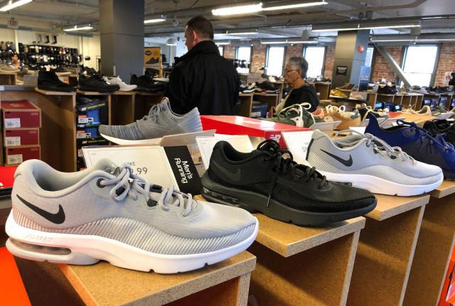
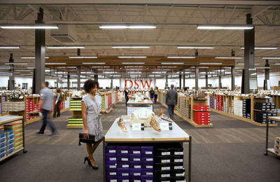
Industry Analysis
Market Growth
Competitive Landscape
Consumer trends
Supply Chain/Sourcing

Slide 11
Financial Analysis

Slide 12
Financial Analysis

Slide 13
Financial Analysis

Slide 14
Financial Analysis

Slide 15
Valuation

Slide 16

Valuation
Dividend Discount Model

Slide 17

Valuation
Free Cash Flow to Equity Model
Constant Growth Model
Growth Rate | 0.00%
Number of Years in Stage 1
Stage 2 Growth Rate
Number of Years in Stage 2
Stage 3 Growth Rate
Growth Path | Constant
Cost of Equity Capital | 14.05%
Free Cash Flow to Equity, LTM | $376.64
Free Cash Flow to Equity
 | k / terminal g | -1.50% | -1.00% | -0.50% | 0.00% | 0.50% | 1.00% | 1.50%
 | 12.55% | $52.39 | $54.60 | $56.98 | $59.55 | $62.33 | $65.35 | $68.64
 | 13.05% | $50.59 | $52.66 | $54.88 | $57.26 | $59.84 | $62.64 | $65.67
 | 13.55% | $48.91 | $50.85 | $52.92 | $55.15 | $57.55 | $60.14 | $62.95
 | 14.05% | $47.34 | $49.16 | $51.10 | $53.19 | $55.43 | $57.84 | $60.44
 | 14.55% | $45.86 | $47.58 | $49.41 | $51.36 | $53.45 | $55.70 | $58.12
 | 15.05% | $44.48 | $46.10 | $47.82 | $49.65 | $51.62 | $53.72 | $55.98
 | 15.55% | $43.17 | $44.70 | $46.33 | $48.06 | $49.90 | $51.87 | $53.99
Average | $53.78

Slide 18
Investment Risks

Slide 19

Investment Risks
Fashion Trends
Global Economic Downturn
Vendor relations
Supply Chain disruptions

Slide 20
Investment Thesis
Recommendation: Buy DBI Shares
Current Price: $11.94
Target Price: $27.45
Upside: 129.9%
Key Drivers:
Owned Brands
Vertical Brand Penetration
Target EPS Range
Reinstate $0.05 Dividends
Sourcing/Supply Chain growth

Slide 21
Questions?

Slide 22
Sources
Refinitiv.com
https://simplywall.st/stocks/us/retail/nyse-dbi/designer-brands
https://finviz.com/quote.ashx?t=DBI&p=d
https://finance.yahoo.com/quote/DBI/
https://www.designerbrands.com/

