Slide 1

United Natural Foods, Inc
By Ella Thompson

Slide 2
Table Of Contents:
Investment Thesis 3
Company Overview 4
Business Description 6
Industry Analysis 10
Financial Analysis 14
Valuation 19
Risk Factors 23
Sources 25
Questions 26

Slide 3
Investment Thesis:
Recommendation: Hold Shares of UNFI
Current Price: $14.90 I Target Price: $12.80
Free Cash Flow to Equity: 55%
Scenario 1: $4.37
Scenario 2: $3.41
Free Cash Flow: 35%
Scenario 1: $80
Scenario 2: $49.81
EV/EBITDA: 10%
$14.29
Key Drivers and Threats:
  Growing demand for organic and specialty food
  Increasing competition in the industry
  Failure to meet earnings predictions

Slide 4




Company Overview:
Symbol | UNFI
Share Price | $14.91
Market Cap | $872.53 M
Beta | 0.97
Debt/Equity | 1.38
P/E | 36.38
EV/EBITDA | 9.07
Sector: Food and Beverage HQ: Rhode Island
Employees: 28,300 Industry: Organic and Specialty Foods

Slide 5
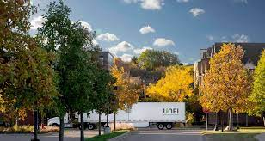
Business Overview

Slide 6



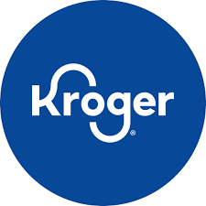


Slide 7



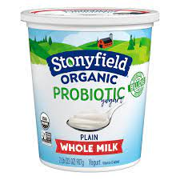

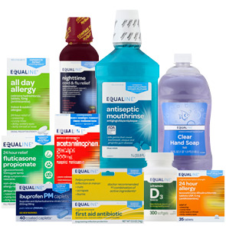
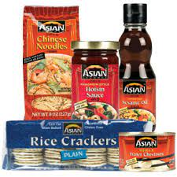
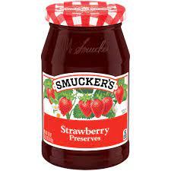

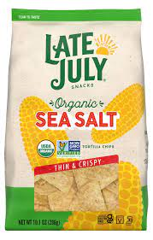
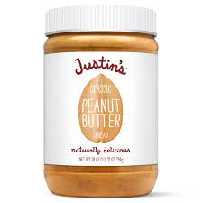
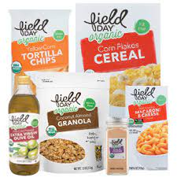
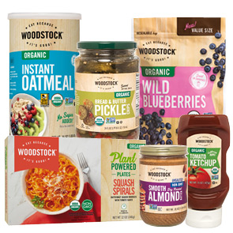
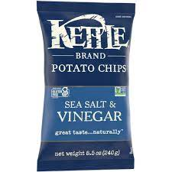

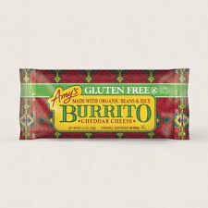
Brands Sold: Private Brands:

Slide 8
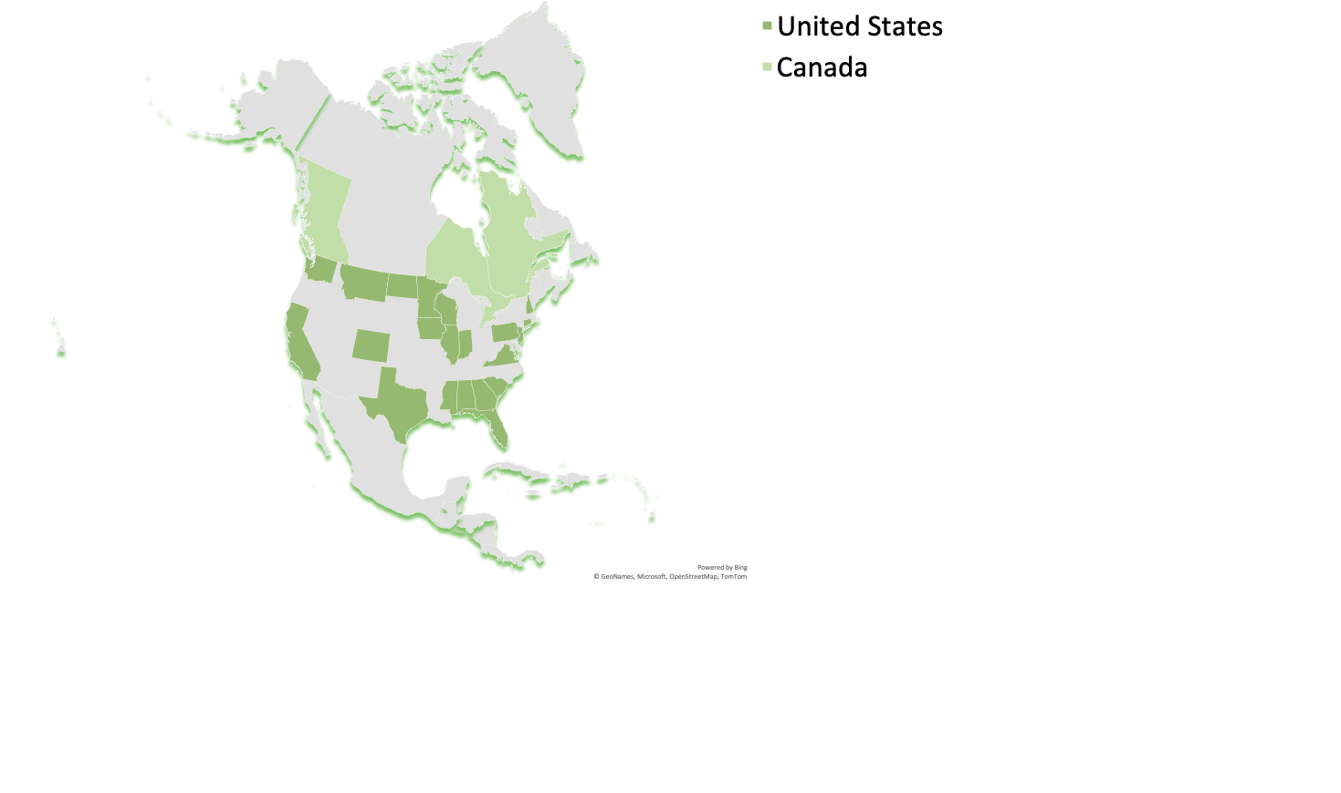
Distribution Centers:
Largest in Minnesota, Pennsylvania, and California
Total Square Footage: 30,044,000

Slide 9



Retail Stores:

Slide 10
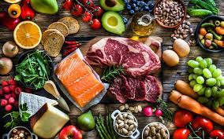
Industry Analysis

Slide 11
Food and Beverage Sector:
$7,221 Billion
Food and Beverage –
Characterized by low profit margins and high sales volume
Highly competitive
Consumer Defensive
Organic Food and Beverage -
Sales have been rising consistently for the past 10+ years
95% increase in sales since 2013
$231 Billion

Slide 12
Organic Industry
$231.52 Billion Market Cap

Slide 14
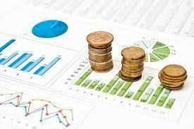
Financial Analysis

Slide 18
Industry Financials

Slide 19
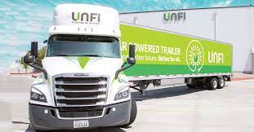
Valuation

Slide 20
Free Cash Flow to Equity
Free Cash Flow to Equity Model
Two Stage Growth Model
Stage 1 Growth Rate | 20.39%
Number of Years in Stage 1 | 7
Stage 2 Growth Rate | 1.81%
Number of Years in Stage 2
Stage 3 Growth Rate
Growth Path | Linear
Cost of Equity Capital | 9.11%
Free Cash Flow to Equity, LTM | $9.58
 | k / terminal g | 0.31% | 0.81% | 1.31% | 1.81% | 2.31%
 | 7.61% | $4.53 | $4.77 | $5.05 | $5.37 | $5.76
 | 8.11% | $4.22 | $4.42 | $4.65 | $4.92 | $5.24
 | 8.61% | $3.94 | $4.12 | $4.31 | $4.54 | $4.80
 | 9.11% | $3.70 | $3.85 | $4.02 | $4.21 | $4.43
 | 9.61% | $3.48 | $3.61 | $3.76 | $3.92 | $4.11
 | 10.11% | $3.29 | $3.40 | $3.53 | $3.67 | $3.83
 | 10.61% | $3.11 | $3.21 | $3.32 | $3.45 | $3.58
Average | $4.37
Free Cash Flow to Equity Model
Constant Growth Model
Growth Rate | 3.70%
Number of Years in Stage 1
Stage 2 Growth Rate
Number of Years in Stage 2
Stage 3 Growth Rate
Growth Path | Constant
Cost of Equity Capital | 9.11%
Free Cash Flow to Equity, LTM | $9.58
 | k / terminal g | 2.20% | 2.70% | 3.20% | 3.70% | 4.20% | 4.70% | 5.20%
 | 7.61% | $3.09 | $3.43 | $3.83 | $4.34 | $5.00 | $5.89 | $7.15
 | 8.11% | $2.83 | $3.11 | $3.44 | $3.85 | $4.36 | $5.03 | $5.92
 | 8.61% | $2.61 | $2.85 | $3.12 | $3.46 | $3.87 | $4.39 | $5.05
 | 9.11% | $2.42 | $2.62 | $2.86 | $3.14 | $3.48 | $3.89 | $4.41
 | 9.61% | $2.26 | $2.43 | $2.64 | $2.87 | $3.15 | $3.49 | $3.91
 | 10.11% | $2.12 | $2.27 | $2.45 | $2.65 | $2.89 | $3.17 | $3.51
 | 10.61% | $1.99 | $2.13 | $2.28 | $2.46 | $2.66 | $2.90 | $3.18
Average | $3.41

Slide 21
Free Cash Flow:
Free Cash Flow Model
Two Stage Growth Model
Stage 1 Growth Rate | 20.39%
Number of Years in Stage 1 | 7
Stage 2 Growth Rate | 1.81%
Number of Years in Stage 2
Stage 3 Growth Rate
Growth Path | Linear
Cost of Equity Capital | 9.11%
Free Cash Flow, LTM | $301.00
k / terminal g | 0.31% | 0.81% | 1.31% | 1.81% | 2.31% | 2.81% | 3.31%
7.61% | $85.22 | $92.74 | $101.45 | $111.67 | $123.81 | $138.48 | $156.56
8.11% | $75.38 | $81.75 | $89.06 | $97.54 | $107.47 | $119.28 | $133.55
8.61% | $66.73 | $72.18 | $78.38 | $85.50 | $93.74 | $103.40 | $114.89
9.11% | $59.08 | $63.78 | $69.09 | $75.12 | $82.04 | $90.06 | $99.46
9.61% | $52.26 | $56.35 | $60.92 | $66.08 | $71.95 | $78.69 | $86.49
10.11% | $46.16 | $49.72 | $53.70 | $58.15 | $63.17 | $68.88 | $75.43
10.61% | $40.65 | $43.79 | $47.26 | $51.12 | $55.46 | $60.35 | $65.90
$80.00
Free Cash Flow Model
Constant Growth Model
Growth Rate | 3.70%
Number of Years in Stage 1
Stage 2 Growth Rate
Number of Years in Stage 2
Stage 3 Growth Rate
Growth Path | Constant
Cost of Equity Capital | 9.11%
Free Cash Flow, LTM | $301.00
k / terminal g | 2.20% | 2.70% | 3.20% | 3.70% | 4.20% | 4.70% | 5.20%
7.61% | $40.02 | $50.44 | $63.23 | $79.28 | $100.05 | $127.95 | $167.42
8.11% | $31.80 | $40.50 | $50.97 | $63.81 | $79.94 | $100.80 | $128.83
8.61% | $24.86 | $32.23 | $40.97 | $51.49 | $64.39 | $80.60 | $101.56
9.11% | $18.92 | $25.26 | $32.67 | $41.45 | $52.01 | $64.98 | $81.26
9.61% | $13.79 | $19.29 | $25.66 | $33.10 | $41.92 | $52.54 | $65.56
10.11% | $9.30 | $14.13 | $19.66 | $26.06 | $33.54 | $42.40 | $53.06
10.61% | $5.35 | $9.62 | $14.48 | $20.04 | $26.46 | $33.97 | $42.87
$49.81

Slide 22
EV/EBITDA:

Slide 23
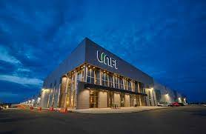
Risk Factors

Slide 24





Reliance on Principal Customers
Inflation
Low Barriers to Entry
Changes in Consumer Purchasing Habits
Government Regulation
Notes:
Whole foods distribution agreement expires 2027

Slide 25
Sources:
https://www.harriswilliams.com/our-insights/piece-pie-specialty-food-distribution-growth-opportunities
https://www.pwccn.com/en/industries/food-supply-and-integrity/ten-global-trends-driving-change-in-the-food-industry.html
https://www.statista.com/statistics/244409/organic-sales-growth-in-the-united-states/
https://www.grandviewresearch.com/industry-analysis/organic-foods-beverages-market
https://atlanticdominiondistributors.com/blog/trends-in-wholesale-food-distribution-whats-new-and-whats-next/
https://www.ers.usda.gov/topics/natural-resources-environment/organic-agriculture/#:~:text=Sales%20Increase%20in%20All%20Organic%20Food%20Categories&text=U.S.%20sales%20of%20organic%20food,Journal%20(NBJ%2C%202022)
https://www.cnbc.com
Refinitiv
https://finviz.com
https://finance.yahoo.com
https://www.supermarketnews.com/organic-natural/organic-food-sales-reach-past-60b
https://ir.unfi.com/financials/annual-reports/default.aspx

Slide 26
Questions?

