Slide 1
Others: A Magazine of the New Verse
and the Correspondences with Amy Lowell
Liam Anderson, Jeanie Huynh, Adrianna P. Rodriguez Diaz, Andrew Zero
Cover art by Marguerite Zorach, used for Vol. 5, No. 2 and No. 3 of Others

Slide 2
What is ?
Known as Others: A Magazine of the New Verse
Mantra: “The old expressions are with us always, and there are always others.” (present on cover of January, 1919 edition of Others)
Set the stage for American Modernist Poetry with a focus in “free verse” and generally experimental art
Formed by Alfred Kreymborg, being funded by Walter Conrad Arensberg
Published from July, 1915–July, 1919
First issued from New Jersey art colony, Grantwood, and later issued out of the Greenwich Village art district, in New York
Generated controversy in its own period with its different subject matters discussed, associated with everything taboo and unpopular of the period with focus on “free verse”
Seen as an inferior form of poetry
Described by critics as “esoteric”, “irrational”, “free-footed” “queer” and “pornographic” (Suzanne W. Churchill, An Introduction to Others: A Magazine of the New Verse)
Open for any type of artist, with equal representation of men and women, difference in political leanings and passions within one individual space
Started off very simple: just creative work, NO advertisements, then growing a larger content pool of prose, plays, and even artwork, becoming much like other magazines during the period

Slide 3
Alfred Kreymborg (1883-1966)
Literary editor, Poet, Novelist and Anthologist
Founder of Others, main editor
Called it the “new movement” (Letter to Lowell, May 23, 1915)
Co-founder and editor of experimental magazine The Glebe with avant-garde artist Man Ray
Co-founder and editor of The Broom: An International Magazine of the Arts, which focused on bringing more experimentive art to America
Known as an Anthologist of Modernism (Poetry Foundation)
Approximately more than 40 poems in total published throughout all issues of Others
Notes:
Andrew

Slide 4
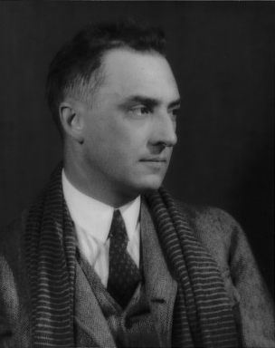
Dr. William Carlos Williams (1883-1963)
Poet, Medical Physician, Literary Editor and Playwright
Associate Editor of Others magazine and co-founder and editor of little magazine Contact
Coordinated a “Competitive Number” in July, 1916 and “Spanish-American Number” in August 1916, with translations done by his father, W. G. Williams
Wrote literary piece “Gloria!” for the last issue of Others (Volume 5, No. 6) in 1919, which discussed its failings and how it became like every other poetry magazine
Approximately 30 poems published in Others, alongside a prose piece and an entire play, “The Comic Life of Elia Brobitza”
Others, according to Williams, “saved [his] life as a writer” and started his writing career (Suzanne W. (Churchill, An Introduction to Others: A Magazine of the New Verse)

Slide 5
Who Was Featured?
Became an introduction to now well-known writers when they were still “nobodies”:
William Carlos Williams (associate editor and editor of “Competitive Number”, “Spanish-American Number” issues, 29 poems; 1 prose; 1 play)
Mina Loy (3)
Helen Hoyt (associate editor and editor of “Women’s Number” issue, 11 poems)
Lola Ridge (associate editor, 3 poems)
Ezra Pound (7)
T.S. Eliot (1)
Carl Sandburg (11)
Conrad Aiken (2)
Notes:
Robert Frost involvement from Churchill article
Loy and Man Ray, infamous experimental photographer compared to socialists/politically involved Sandburg and Ridge, “propogandist”, when discussing Sandburg’s book, Chicago Poems

Slide 6
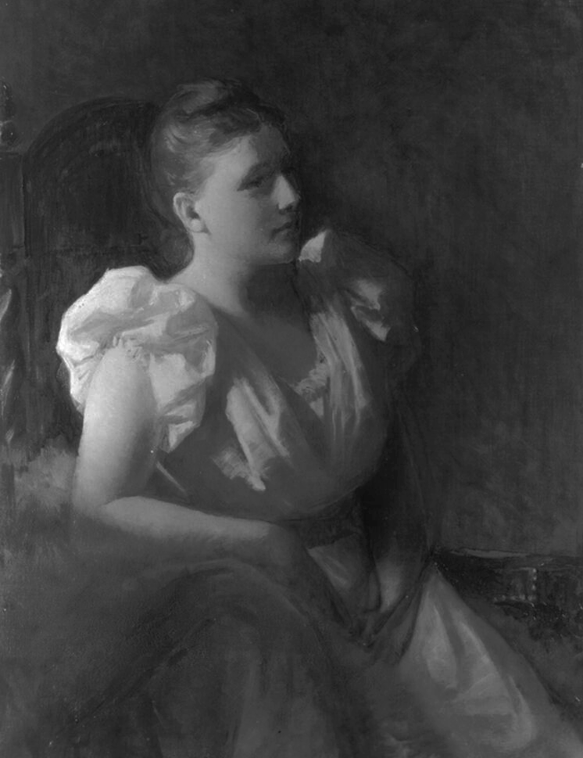
Amy Lowell (1874-1925)
Where exactly does Lowell fall into Others magazine?
Three (3) poems featured in Others’ August 1915 (Volume 1, No. 2) issue
“The Peddler of Flowers”
“A Comparison”
“Trees”
Three (3) poems featured in Others’ July 1916 (Volume 3, No. 1) “Competitive” issue
“Chinoiseries”:
“Reflections”
“Falling Snow”
“Hoar-Frost”
Controversy arose between her and William Carlos Williams, and Others magazine as a whole…

Slide 7
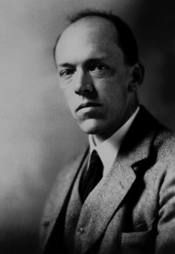
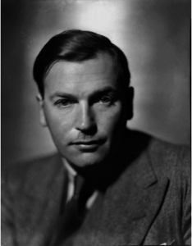
Richard Aldington (1892-1962) & John Gould Fletcher (1886-1950)
Both poets, alongside Lowell, agreed to leave participation with Others-related works.
Fletcher had four (4) total poems featured in September, 1915 (Volume 1, No. 3) and July, 1916 (Volume 3, No. 1) issues
Aldington had two (2) poems featured in November, 1915 (Volume 1, No. 5) issue

Slide 8
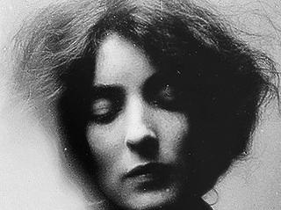
Mina Loy (1882-1966)
“Out there” artist
Was never published in Poetry Magazine
Had entirety of Others’ April, 1917 issue (Volume 3, No. 6) dedicated to her “Songs to Joannes”
Pieces originally published as “Love Songs, I-IV” in July, 1915 issue (Volume 1, No.1)
Promoted throughout run of Others in announcements segments of poetry-related work, specifically an entire edition of her poems and her editorial and translation work on a collection of Italian poems

Slide 9
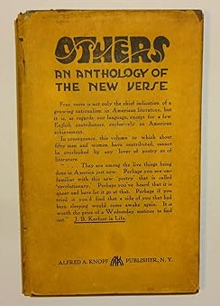
Others Anthology Book
Kreymborg begins to assemble an Anthology in 1915
Others: An Anthology of the New Verse
Different social understandings of magazines and books
Lowell’s personality clash
December 1915: “I have come to the conclusion that it would be better for me not to appear in your forthcoming Anthology … I think it wiser to withdraw my name from yours.”
Notes:
Magazine, people understand that it's just whatever the editors get, kind of just an update on what writers are up to
An anthology book won’t be replaced in a month, and creates more of an association between the authors
Lowell’s style was not as compatible with others like Loy, circle back to differences between their poems (not about that specific poem, obvi anachronism, but about that style and that culture)

Slide 10
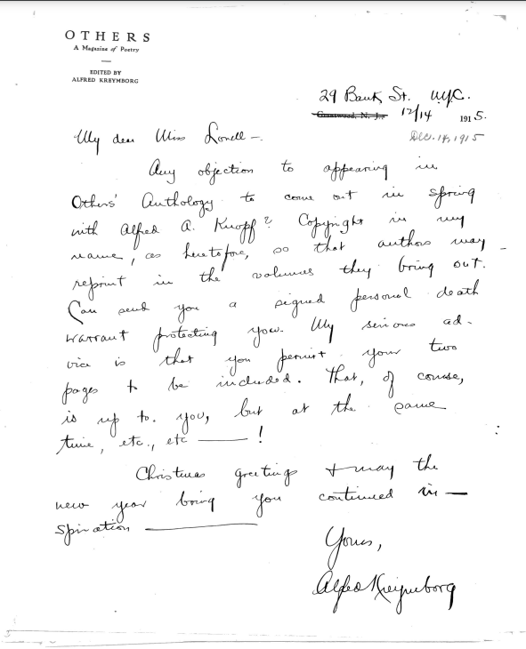
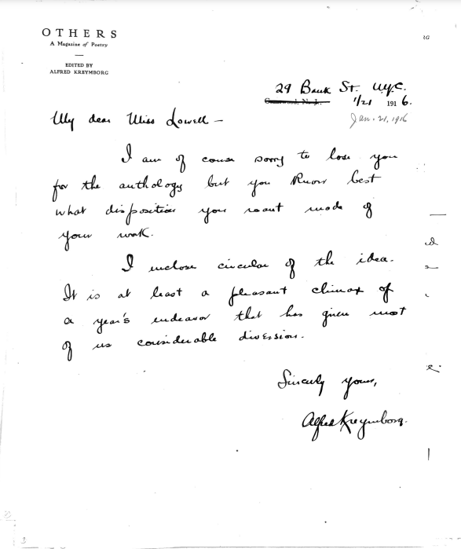
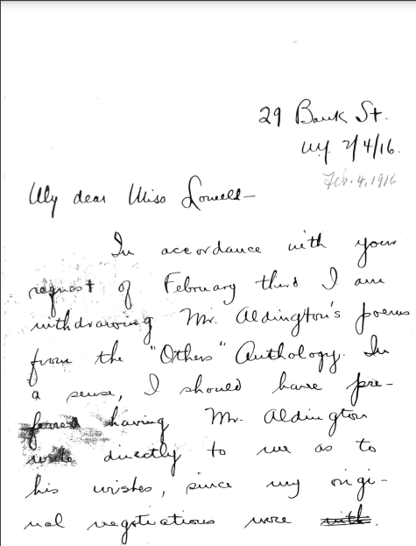
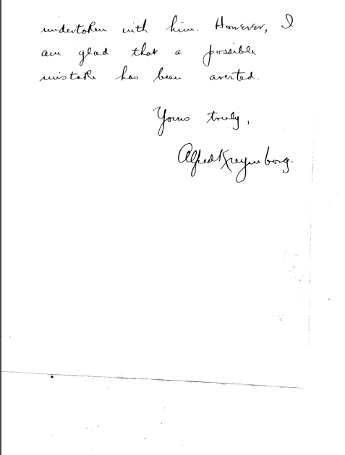
Cordialness from Kreymborg’s Side
December 14, 1915
“Any objection to appearing in Others’ Anthology to come out in Spring … ?
Christmas greetings + may the new year bring you continued inspiration”
February 4, 1916
“My dear Miss Lowell –”
“In accordance with your request of February third, I am withdrawing Mr. Aldington’s poem from the “Others” Anthology.”
January 21, 1916
“My dear Miss Lowell –
I am of course sorry to lose you for the anthology”
Had previous letters in 1915, enjoying her poetry and asking if he could “count on [her]” to submit work to Others. (May 23, 1915)

Slide 11
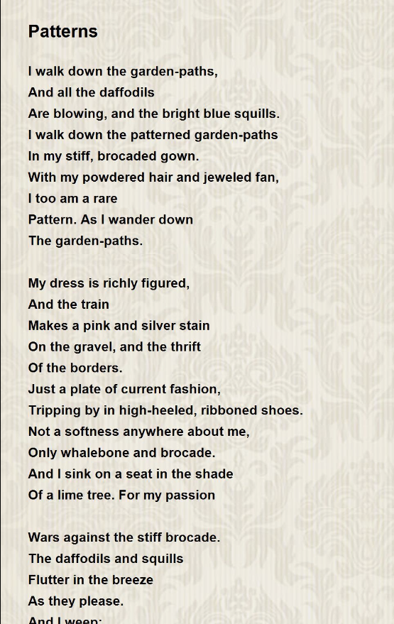
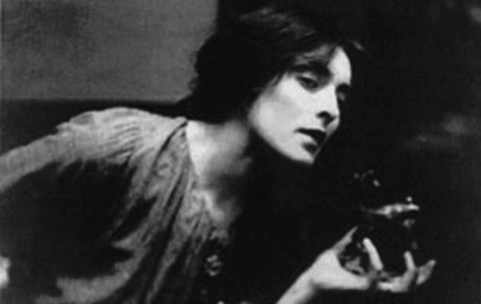
The Mina Loy
Incident
Amy Lowell’s “Patterns”
Mina Loy, “Love Songs, I-IV”, Others Vol. 1 No. 1 (July 1915)
Notes:
She and WCW co-starred in Lima Beans, an experimental play written by Alfred Kreymborg

Slide 12
Controversy of Mina Loy’s Work
Imagism is known for its concrete creation of images through words, something Mina Loy did not do.
Too bold, too unclear for Imagism!
Societal context: “free verse” style was seen as unworthy of attention, and with topic of abortion being crass, or “too much” adding onto these issues
Kreymborg in response to the public reaction to “Love Songs”:
“To reduce eroticism to the sty was an outrage, and to do so without verbs, sentence structure, punctuation, even more offensive” (Churchill and University of Pennsylvania; UPenn)
Notes:
Alfred Kreymborg remembered in his autobiography, Troubadour (1925), that for the first issue of Others (July 1915), a raffish "yellow dog" journal more tolerant of innovation than Poetry, he and co-editor Walter Arensberg agreed that poems by Loy and Wallace Stevens were a must. Most such recognition came to Mina Loy in the decade 1914-1925; thereafter she gave less attention to poetry and withdrew from the literary scene except for infrequent little magazine publications. POETRY FOUNDATION

Slide 13
Lowell’s Views on Politics and Art
What could have caused Lowell issue was Mina Loy specifically, and features of other politically-focused artists in Others and her work, “Love Songs, I-IV”, later “Songs to Joannes”, and possible insinuated themes of abortion and/or miscarriage
“In fact, the story goes that the poet Amy Lowell was so offended by “Songs to Joannes” that she refused to be published in the same journals as Loy.” (Sundress)
Lowell when discussing trial of Van Kleek Allison, male birth control advocate arrested for handing out pamphlets (“propaganda” according to Lowell) to Untermeyer:
“I believe that an artist should place art above all considerations … I agree with neither the radicals nor conservatives entirely. If I were heart and soul in sympathy with the methods of these advocates of birth control, it would be simple to come out and say so; but I am not. Their theory, as regards the ignorant proletariat, is open to question; they seem to me to defeat their own object by pursuing it in a hectic and tasteless manner. If I were asked, I should say that we really need large families more than we need birth control.” (S. Foster Damon, Amy Lowell: A Chronicle, p. 367-368)

Slide 14
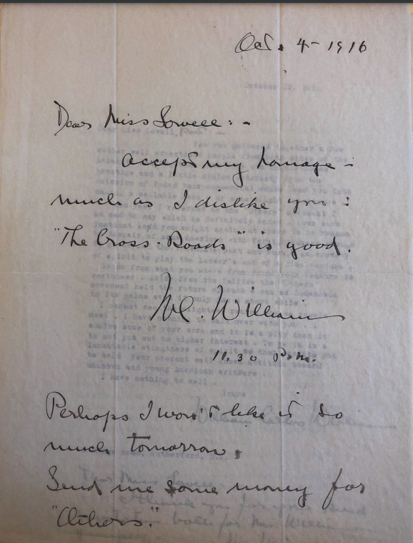
William Carlos Williams’ Relationship with Amy Lowell
Very tumultuous in October, 1916, when financial issues were apparent for Others, Williams seeing it as the end of the magazine entirely
Letter from William Carlos Williams (pictured), asking Lowell for funds for Others after just making a negative remark towards her
Lowell’s response:
“Thank you for your love letter … Of course I won’t give any money to “Others”: You know that perfectly well.” (October 9, 1916)
Difference in how they view the Modernist and New Poetry movement:
From Lowell to Williams: “By the way, I have just read in “The Egoist” that you consider the “movement” dead. What movement? The “Others” movement? For our 1915 “Anthology” has just gone into a third edition.” (October 9, 1916)
Specifically, the September 1919 (Volume 3, No. 9) issue of The Egoist with piece entitled “The Great Opportunity”
“I am sorry you are so bitter, but you must not think that any real artistic movement can be snuffed out by the failure of one magazine. As a matter of fact, “Others” was foolishly managed from the first.” (October 19, 1916)
October 4, 1916
“Dear Miss Lowell, Accept my homage - much as I dislike you: “The Cross Roads” is good. Perhaps I won’t like it so much tomorrow. Send me some money for “Others.””
Notes:
Relationship starts nasty, gets nice!

Slide 15
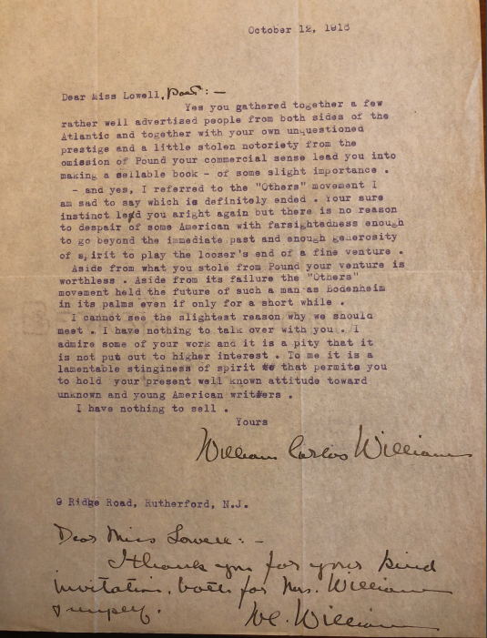
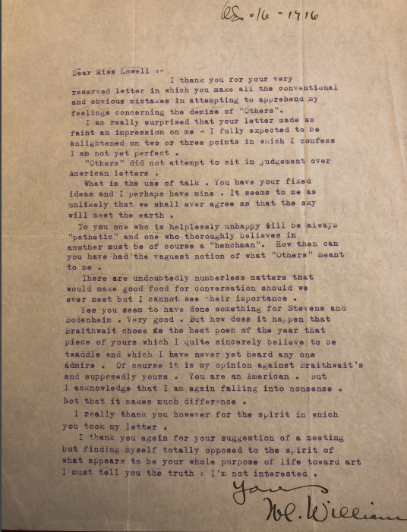
Dramatic from William Carlos Williams’ Side
October 16, 1916
“What is the use of talk. You have your fixed ideas and I perhaps have mine. It seems to me as unlikely that we shall ever agree as that the sky will meet the earth.
To you one who is helpless unhappy will be always “pathetic” and one who thoroughly believes in another must be of course a “henchman”. How then can you have had the vaguest notion of what “Others” meant to me
…
I thank you again for your suggestion of a meeting but finding myself totally opposed to the spirit of what appears to be your whole purpose of life toward art I must tell you the truth: I’m not interested.
October 12, 1916
“Aside from what you stole from Pound [Imagiste, Imagism] your venture is worthless. I admire some of your work and it is a pity that it is not put out to higher interest. To me it is a lamentable stinginess of spirit that permits you to hold your present well known attitude toward unknown and young American writers
I have nothing to sell at all.”

Slide 16
No More Others: Lowell’s Reasoning for leaving Others
“I withdrew myself as a contributor to the magazine, in the middle of last Winter, not because I felt that it was doomed to failure, as you seem to suppose, (I knew it was doomed to failure from the moment it was started, and yet I was willing to contribute with the rest of you when Mr. Kreymborg asked me to do so) I withdrew in the middle of the Winter because I found myself completely out of sympathy with the policy of the magazine. I saw that the editors had no objection to printing poems which I felt were not poetry, were not art, and the tendency of which I knew would be to lower the estimation in which the whole of the new poetry movement was held in the eye of the public. This I explained carefully to Mr. Kreymborg. The rest of my group felt exactly as I did, and the policy they pursued was identical with mine.” (October 19, 1916)
Notes:
Said “policy” she speaks of is too political, especially with work of Loy

Slide 17
Cont.,...
“When the number which you edited came, I was disgusted to see, from its contents, that you had been in sympathy with the former policy of the magazine, and I regretted having given way to a feeling of comradeship in having sent my contribution, and I refused to be in the Woman’s Number when Miss Hoyt asked me to send something for it.” (October 19, 1916)
Context: the issue Lowell was featured was in the July, 1916, “Competitive” issue edited by William Carlos Williams, alongside Carl Sandburg, Marianne Moore, Wallace Stevens, Skipwith Cannell, Helen Hoyt, John Gould Fletcher, Conrad Aiken, Maxwell Bodenheim, Alfred Kreymborg, and Mina Loy…

Slide 18
However, later on …
Years-long friendships develop or are further seen…
Kreymborg:
Interest in his little magazine Broom (May 18, 1921)
Asking about how his life is going when moving to North Carolina, his dreams, wants, etc. (March 11, 1924)
Sending praise for Troubadour, even when in ill-state of health, only a month before her death (April 17, 1925)
Williams:
Inviting him to talks she is hosting (April 11, 1921, March 18, 1921)
Gossiping about Winifred Bryher and her marriage to Richard McAlmon with one another (March 18, 1921)

Slide 19
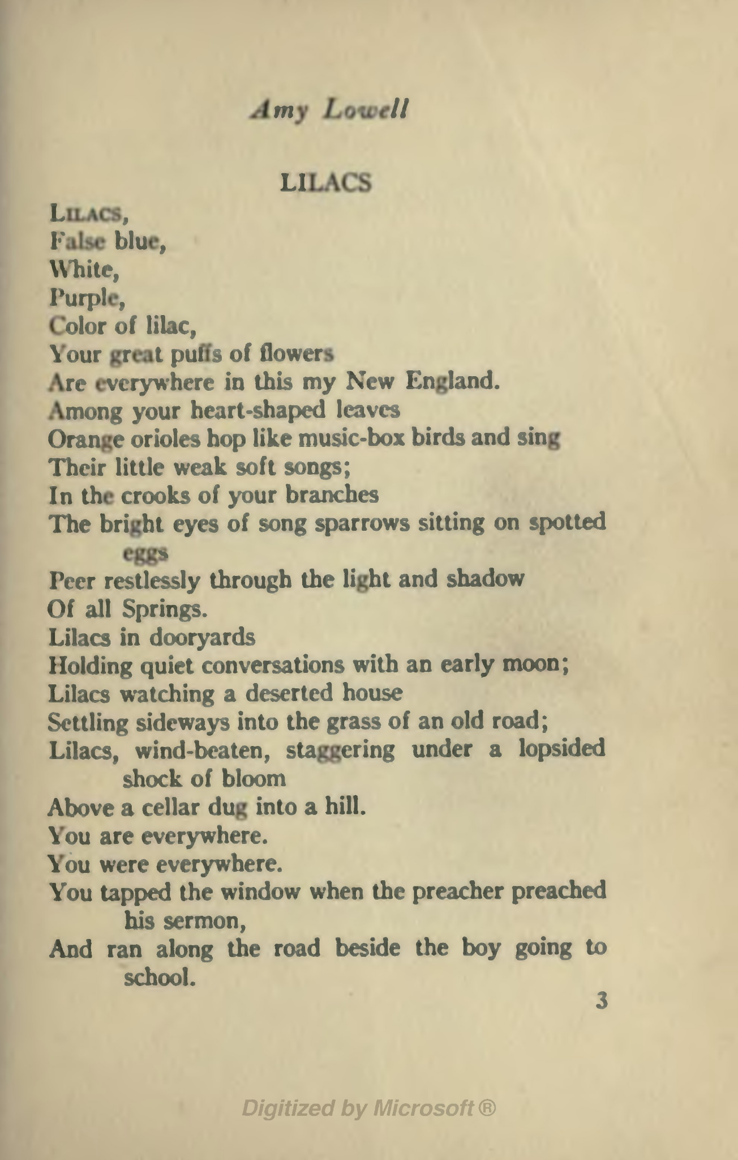
More Discovery from Lowell’s Letters
While her later letters do not tie to drama or advancement of relationships specifically, they mention a lot about Lowell’s work (both her poem “Lilacs” and her book “Legends”), as well as her declining health
Also includes enclosures of her work, invitations to her lectures
Lowell’s confidence in her own work, especially “Lilacs”, can be seen as she’s expressing strong desire and advocates for Kreymborg to feature this in his magazine, The Broom
Calls it one of her best work and the best she currently had written:
"said to be the one of the poet’s own favorites, and among the poems she recited most often in her many public readings"
“The reason I ask is that the poem I enclose is, I think, by all means the best of my unpublished work... If you would like to reprint it in the "Broom," I think it will be an advantage to you.." (March 22, 1921).

Slide 20
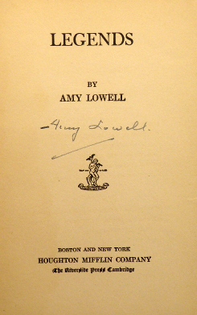
Discovery Cont. (Lowell’s Health)
There are a few instances in the letter where it seems someone else, presumably her scribe, is writing for her due to sickness. At times, she is able to address it herself.
Seen below:
“I had an operation which it took some months to recover from, and although I was in New York for two weeks” (March 1, 1921)
“Miss Lowell only yesterday had to undergo her fourth operation, therefore she was obliged to leave much of her mail unanswered. But she is delighted to know that you have so much optimism and encouragement for "The Broom," and also trusts that the trip abroad will mean all that you hope for it.” (May 18, 1921)
“I am awfully sorry to say that I am afraid Miss Lowell will not be able to see you anywhere near the 26th, as she will not be allowed even to nit up for another week or ten days. Today we post "legends" to you at her request.” (May 23, 1921)

Slide 21
Lowell’s Health
From previous knowledge gained in this course, and research to back it up, we know that her health was rapidly declining and prevented her from communicating with others, as well as continue holding her own readings.
Illnesses and other health issues:
Nearly ruined her eyesight with how much she worked
“Lowell was so upset by the lukewarm reviews that she became physically ill with gastric neuralgia and took to her bed for weeks.”
Experienced declining health during the 1920s due to a glandular condition that led to weight gain
Health problems included recurring hernia attacks, with a serious one occurring in May 1925.
Advised to stay in bed, went against medical advice two days later and passed away within a few hours of a stroke.
The combination of her glandular condition, weight-related health issues, and the complications from the hernia contributed to her declining health and ultimately led to her untimely death in May 1925.
Notes:
Reviews of dome of many colored glass released in 1912 (influenced by keats)

Slide 22
Why Does it Matter?
Newness of the art presented throughout Others; haven for experimentation
Difference in the amount of people involved (“Mina Loys”, “Carl Sandburgs”, “Ezra Pounds” of writing all together in one collective space)
Interactions between Lowell and Modernist editors and writers, discussing works, magazines, other poets and writers, and her interest or disinterest in said magazines through her support or lack thereof
Represents her influence on and within Modernist circles, being asked to fund magazines and be a supporter or contributor
The differentiation between Imagism and Free Verse
The controversy, as Others introduced so many new writers to the scene and caused an uproar outside of Lowell with its said work in free verse, associated with everything taboo and “wrong”/”opposite”

Slide 23
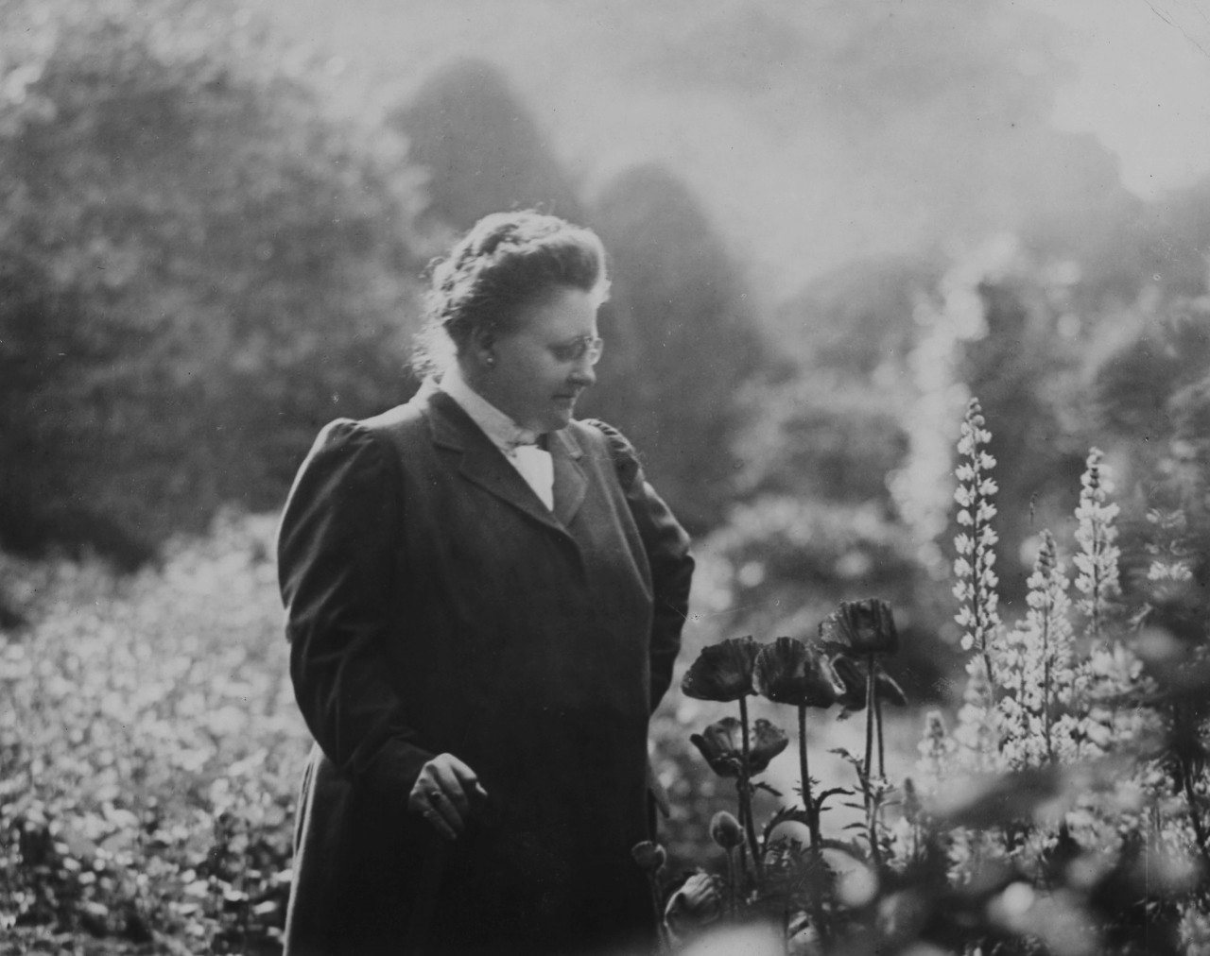
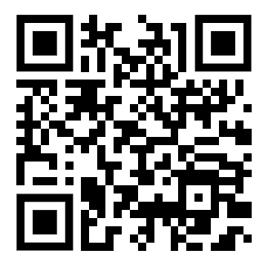
Feedback
FILLER
I’m gonna put a QR code over this
FILLER
We’d love to hear your thoughts!
Notes:
As you guys know, we have until Saturday the 9th to get everything in, including this edition and presentation. We’d love to hear what you guys have to say so we can polish this up a bit before the deadline

Slide 24
Works Cited
Kreymborg, Alfred. Letter to Amy Lowell, May 23, 1915. Houghton Library, Harvard University, MS Lowell 19 (694).
Kreymborg, Alfred. Letter to Amy Lowell, December 14, 1915. Houghton Library, Harvard University, MS Lowell 19 (694).
Kreymborg, Alfred. Letter to Amy Lowell, January 21, 1916. Houghton Library, Harvard University, MS Lowell 19 (694).
Kreymborg, Alfred. Letter to Amy Lowell, February 4, 1916. Houghton Library, Harvard University, MS Lowell 19 (694).
Kreymborg, Alfred. Letter to Amy Lowell, May 23, 1915. Houghton Library, Harvard University, MS Lowell 19 (694).
Lowell, Amy. Letter to Alfred Kreymborg, December 24, 1915. Houghton Library, Harvard University, MS Lowell 20.
Lowell, Amy. Letter to Alfred Kreymborg, March 1, 1921. Houghton Library, Harvard University, MS Lowell 20.
Lowell, Amy. Letter to Alfred Kreymborg, March 22, 1921. Houghton Library, Harvard University, MS Lowell 20.
Lowell, Amy. Letter to Alfred Kreymborg, May 18, 1921. Houghton Library, Harvard University, MS Lowell 20.
Lowell, Amy. Letter to Alfred Kreymborg, May 23, 1921. Houghton Library, Harvard University, MS Lowell 20.
Lowell, Amy. Letter to Alfred Kreymborg, March 11, 1924. Houghton Library, Harvard University, MS Lowell 20.
Lowell, Amy. Letter to Alfred Kreymborg, April 17, 1925. Houghton Library, Harvard University, MS Lowell 20.
Lowell, Amy. Letter to William Carlos Williams, October 19, 1916. Houghton Library, Harvard University, MS Lowell 20.
Lowell, Amy. Letter to William Carlos Williams, March 18, 1921. Houghton Library, Harvard University, MS Lowell 20.
Lowell, Amy. Letter to William Carlos Williams, April 11, 1921. Houghton Library, Harvard University, MS Lowell 20.
Williams, Williams Carlos. Letter to Any Lowell, October 4, 1916. Houghton Library, Harvard University, MS Lowell 19 (1333).
Williams, Williams Carlos. Letter to Amy Lowell, October 12, 1916. Houghton Library, Harvard University, MS Lowell 19 (1333).
Williams, Williams Carlos. Letter to Amy Lowell, April 11, 1921. Houghton Library, Harvard University, MS Lowell 19 (1333).
Lowell, Amy. Letter to William Carlos Williams, October 9, 1916. Houghton Library, Harvard University, MS Lowell 20.

Slide 25
Works Cited, cont.
Amy Lowell Collection of Manuscripts, 1768-ca. 1923 (MS Lowell 19). Houghton Library, Harvard University.
Amy Lowell Collection of Manuscripts, 1768-ca. 1923 (MS Lowell 20). Houghton Library, Harvard University.
Churchill, Suzanne W. “An Introduction to Others: A Magazine of the New Verse.” Modernist Journals | An Introduction to Others: A Magazine of the New Verse, modjourn.org/an-introduction-to-others-a-magazine-of-the-new-verse/.
Conover, Roger. “Mina Loy from Songs to Joannes (1917).” EPC / Mina Loy – Songs to Joannes, writing.upenn.edu/epc/authors/loy/poem_loy_Songs_to_Joannes.html#:~:text=To%20reduce%20eroticism%20to%20the,famous%20of%20all%20her%20lines.
Encyclopedia.com ." Women in world history: A biographical encyclopedia. Encyclopedia.com. https://www.encyclopedia.com/women/encyclopedias-almanacs-transcripts-and-maps/lowell-amy-1874-1925
Lewis, J. J. (2017, March 16). Amy Lowell, American Poet and Imagist. ThoughtCo. https://www.thoughtco.com/amy-lowell-biography-3530884#:~:text=This%20work%20was%20taxing%20on,with%20a%20massive%20cerebral%20hemorrhage.

Slide 26
Others Sources:
“Alfred Kreymborg.” Poetry Foundation, Poetry Foundation, www.poetryfoundation.org/poets/alfred-kreymborg.
Amy Lowell Collection of Manuscripts, 1768-ca. 1923 (MS Lowell 20). Houghton Library, Harvard University.
Amy Lowell Collection of Manuscripts, 1768-ca. 1923 (MS Lowell 19) Houghton Library, Harvard University.
Bowman, Peter. “Broom.” Index of Modernist Magazines, 18 Aug. 2016, modernistmagazines.org/american/broom/.
Bowman, Peter. “Contact.” Index of Modernist Magazines, 18 Aug. 2016, modernistmagazines.org/american/contact/#1464124286764-16c18c4a-368d97f6-c4d2.
Bowman, Peter. “Others.” Index of Modernist Magazines, 18 Aug. 2016, modernistmagazines.org/american/others/.
Bowman, Peter. “The Glebe.” Index of Modernist Magazines, 18 Aug. 2016, modernistmagazines.org/american/the-glebe/#1464124281502-9e535a72-b35305c9-8992.
Churchill, Suzanne W. “An Introduction to Others: A Magazine of the New Verse.” Modernist Journals | An Introduction to Others: A Magazine of the New Verse, modjourn.org/an-introduction-to-others-a-magazine-of-the-new-verse/.
Conover, Roger. “Mina Loy from Songs to Joannes (1917).” EPC / Mina Loy – Songs to Joannes, writing.upenn.edu/epc/authors/loy/poem_loy_Songs_to_Joannes.html#:~:text=To%20reduce%20eroticism%20to%20the,famous%20of%20all%20her%20lines.
Damon, S. Foster. Amy Lowell: A Chronicle. Houghton Mufflin, 1935.
“Modernist Journals: Egoist. an Individualist Review. Vol. 3, No. 9.” Modernist Journals | Egoist. An Individualist Review. Vol. 3, No. 9, modjourn.org/issue/bdr522533/. Accessed 8 Dec. 2023.
“Modernist Journals: Others.” Modernist Journals | Others, modjourn.org/journal/others/.
“Some Imagist Poets.” The Project Gutenberg eBook of Some Imagist Poets, by Richard Aldington, H.D., John Gould Fletcher, F. S. Flint, D. H. Lawrence, and Amy Lowell., www.gutenberg.org/files/30276/30276-h/30276-h.htm.
“William Carlos Williams.” Poetry Foundation, Poetry Foundation, www.poetryfoundation.org/poets/william-carlos-williams. Accessed 29 Nov. 2023.

Slide 27
Sources Cont.
Mina Loy Sources:
Basic Search - Gale Literature Resource Center, go.gale.com/ps/start.do?p=LitRC&userGroupName=anon~25537f9f. Accessed 29 Nov. 2023.
Litilluminations. “Who’s Afraid of Mina Loy?” Gender and Modernism, 17 May 2013, gendermodernism.wordpress.com/2013/05/16/whos-afraid-of-mina-loy/.
“Mina Loy.” Poetry Foundation, Poetry Foundation, www.poetryfoundation.org/poets/mina-loy.
“Mina Loy.” Poets.Org, Academy of American Poets, 5 July 2022, poets.org/poet/mina-loy.
Reading Mina Loy through Creative Translation Love Songs, www.people.iup.edu/sherwood/Archived-Courses/Engl317F04/Docs/reading_mina_loy_through_creativ.htm.
“Songs to Joannes.” Mina Loy, Songs to Joannes, oncomouse.github.io/loy/songs.html.
Sundresspublications. “Mina Loy Archives.” The Sundress Blog, 23 July 2015, sundressblog.com/tag/mina-loy/.

Slide 28
Sources Cont.
Lowell’s Health-related Sources:
Encyclopedia.com. (2023, November 30). ." Women in world history: A biographical encyclopedia. . encyclopedia.com. 15 Nov. 2023 . Encyclopedia.com. https://www.encyclopedia.com/women/encyclopedias-almanacs-transcripts-and-maps/lowell-amy-1874-1925
Lewis, J. J. (2017, March 16). Amy Lowell, American poet and Imagist. ThoughtCo. https://www.thoughtco.com/amy-lowell-biography-3530884#:~:text=This%20work%20was%20taxing%20on,with%20a%20massive%20cerebral%20hemorrhage.
Miss Amy Lowell’s death stuns world of letters: News: The Harvard Crimson. News | The Harvard Crimson. (n.d.). https://www.thecrimson.com/article/1925/5/13/miss-amy-lowells-death-stuns-world/
Poetry Foundation. (n.d.). Amy Lowell. Poetry Foundation. https://www.poetryfoundation.org/poets/amy-lowell

Slide 29
Image Sources
Others cover artwork: Marguerite Zorach, January -February, 1919, “Modernist Journals: Others. the Old Expressions Are with Us Always and There Are Always Others. Vol. 5, No. 2.” Modernist Journals | Others. The Old Expressions Are with Us Always and There Are Always Others. Vol. 5, No. 2, modjourn.org/issue/bdr523647/., “Modernist Journals: Others. the Old Expressions Are with Us Always and There Are Always Others. Vol. 5, No. 3.” Modernist Journals | Others. The Old Expressions Are with Us Always and There Are Always Others. Vol. 5, No. 3, modjourn.org/issue/bdr523680/.
Alfred Kreymborg:
KREYMBORG, Alfred (1883-1966). “Abebooks.” By KREYMBORG, Alfred (1883-1966): No Binding & Hard Cover (1955) | Lord Durham Rare Books (IOBA), 1 Jan. 1970, www.abebooks.com/Alfred-Kreymborg-collection-1883-1966/30643330858/bd.
Letters from Alfred Kreymborg were “Resources” made accessible by Dr. Melissa Bradshaw from the Amy Lowell Collection of Manuscripts, 1768-ca. 1923 (MS Lowell 19) (694) Houghton Library, Harvard University.
William Carlos Williams:
“William Carlos Williams.” National Portrait Gallery, npg.si.edu/object/npg_NPG.87.210.
Letters from William Carlos Williams were “Resources” made accessible by Dr. Melissa Bradshaw from the the Amy Lowell Collection of Manuscripts, 1768-ca. 1923 (MS Lowell 19)(1333). Houghton Library, Harvard University.
Amy Lowell:
Harvard. “Amy Lowell (1874-1925).” Harvard Art Museums, harvardartmuseums.org/collections/object/300024?position=1.
“Patterns - Patterns.” PoemHunter.Com, 3 Jan. 2003, www.poemhunter.com/poem/patterns/.
“Page:American Poetry 1922.Djvu/17.” Wikisource, the Free Online Library, en.wikisource.org/wiki/Page:American_Poetry_1922.djvu/17.
Lowell, Amy. “Abebooks.” By Lowell, Amy: Good Hard Cover (1921) First Edition., Signed | RON RAMSWICK BOOKS, IOBA, Houghton Mifflin, 1 Jan. 1970, www.abebooks.com/signed-first-edition/LEGENDS-SIGNED-Lowell-Amy-Houghton-Mifflin/13629128739/bd.
Bachrach (photographer) -MS Lowell 62 (5), Houghton Library, Harvard University, https://en.wikipedia.org/wiki/Amy_Lowell#/media/File:Houghton_MS_Lowell_62_(5)_-_Bachrach.jpg.

Slide 30
Image Sources, cont.
John Gould Fletcher:
“John Gould Fletcher.” Encyclopedia of Arkansas, 29 June 2023, encyclopediaofarkansas.net/media/john-gould-fletcher-jr-73/.
Richard Aldington:
“(Edward Godfree) Richard Aldington - National Portrait Gallery.” NPG X10309; (Edward Godfree) Richard Aldington - Portrait - National Portrait Gallery, www.npg.org.uk/collections/search/portrait/mw43731/Edward-Godfree-Richard-Aldington.
Mina Loy:
Stephen Haweis, 1905, Mina Loy EPC Page - Electronic Poetry Center, writing.upenn.edu/epc/authors/loy/., “’Mapping Mina Loy Studies in 2023’ Conference Report .” The Modernist Review, 6 Sept. 2023, modernistreviewcouk.wordpress.com/2023/09/06/mapping-mina-loy-studies-in-2023-conference-report/.
“Modernist Journals: Others. A Magazine of the New Verse. Vol. 1, No. 1.” Modernist Journals | Others. A Magazine of the New Verse. Vol. 1, No. 1, modjourn.org/issue/bdr523168/. Accessed 9 Dec. 2023.
Others: An Anthology of the New Verse: Abe Books “Others - An Anthology of the New Verse.” abebooks.com, December, 2016, https://www.abebooks.com/servlet/BookDetailsPL?bi=30667923697&ref_=ps_ggl_17738760402&cm_mmc=ggl-_-COM_Shopp_Rare-_-product_id=bi%3A%2030667923697-_-keyword=&gclid=Cj0KCQiA35urBhDCARIsAOU7QwnZBamIrYpvLaeknkZrfMej3lpwkmSSk6z0nd62iMzqAL_6HVZCgYoaAuCpEALw_wcB.

