Slide 1
How this Queer Cult Classic is Religious at its Core

Slide 2
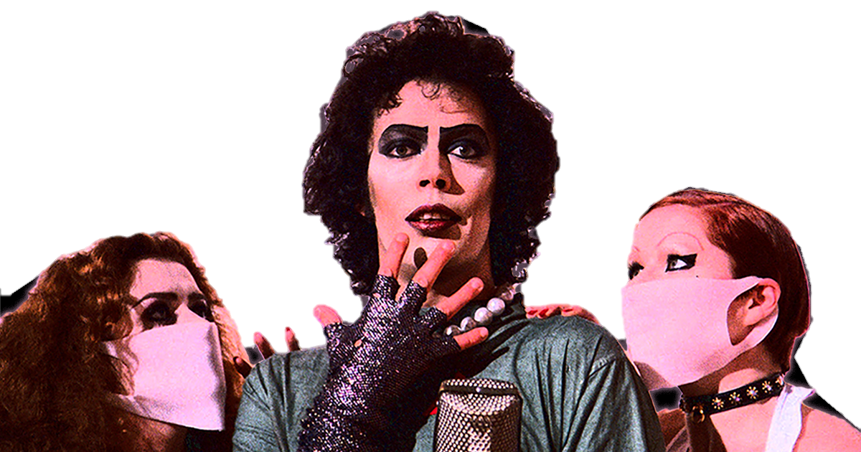
Cultural Background
Released in 1975 during the sexual liberation movement
Acts as commentary on the time period’s attitude towards the LGBTQ+ community
Focuses on challenging social norms that most people found uncomfortable at the time
Contradicts Christianity’s views on purity culture

Slide 3
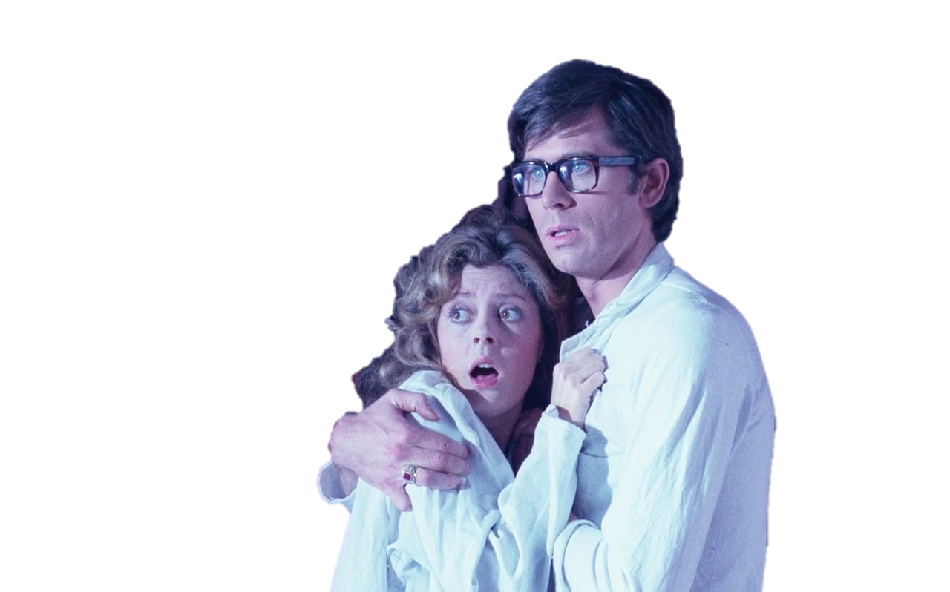
Brad & Janet : Adam & Eve
The morally righteous couple who are living pure
lives before encountering their moral downfall
Both eat the “forbidden fruit,” becoming aware of their humanity
Both disappoint a higher power through disobedience
Both banished from paradise
“At that moment, their eyes were opened, and they suddenly felt shame at their nakedness…”
Genesis 3:7 (NLT)

Slide 4
Rocky : The Forbidden Fruit, (also) Adam, & Martyr?
Rocky acts as Janet’s source of temptation in the movie, much like the fruit in the Garden of Eden
Rocky is the creation of Dr. Frank-N-Furter, as Adam is the creation of God
Biblical allusion to the creation of man in Frank-N-Furter’s song
Rocky is prepared to die for Dr. Frank-N-Furter,
and ultimately does when the doctor is killed by Riff Raff, unable to see life worth living without his creator
“In just seven days
I can make you a man.”
Dr. Frank-N-Furter
“On the seventh day God had finished his work of creation, so he rested from all his work. And God blessed the seventh day and declared it holy, because it was the day when he rested from all his work of creation.”
Genesis 2:2-3 (NLT)

Slide 5
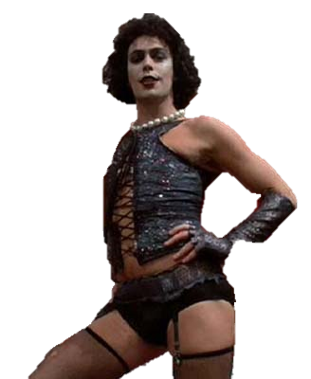
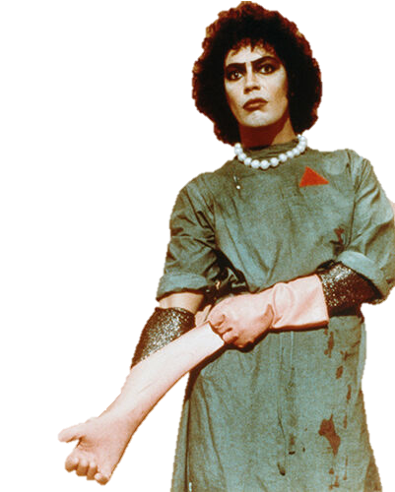
Dr. Frank-N-Furter : God or the Serpent?
As the Creator of Rocky, he holds the secret to life itself
Commits heinous acts throughout the film and encourages others to do so as well
The overarching higher power to the other inhabitants of the castle, who follow his every command with blind faith
Ultimately betrayed and put to death by one of his disciples
Perhaps Both.

Slide 6
“Give yourself over to absolute pleasure. Swim the warm waters of sins of the flesh - erotic nightmares beyond any measure, and sensual daydreams to treasure forever.”
Dr. Frank-N-Furter
“They have no sense of shame. They live for lustful pleasure and eagerly practice every kind of impurity.”
Ephesians 4:19 (NLT)
True Religion vs. False Religion

Slide 7
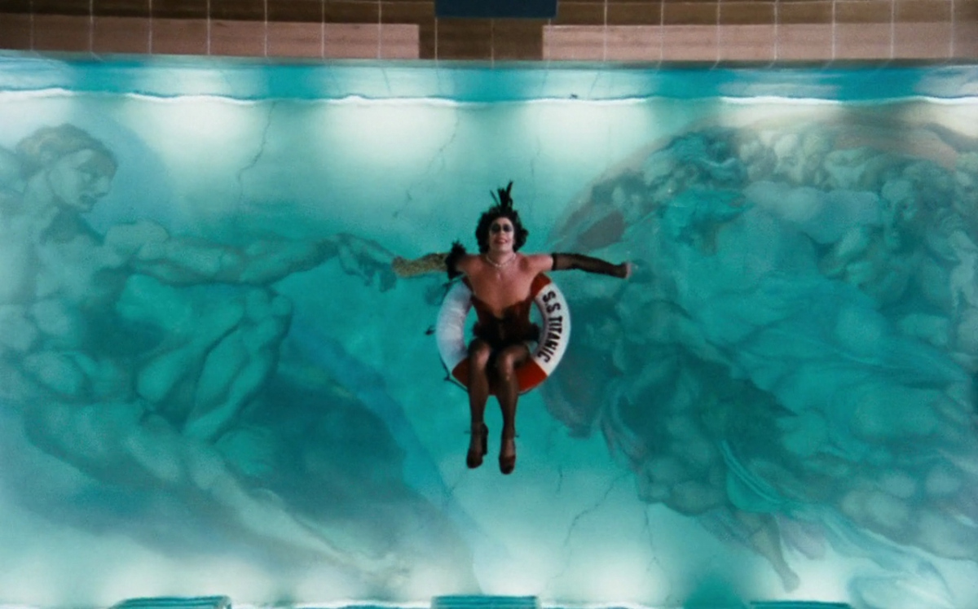
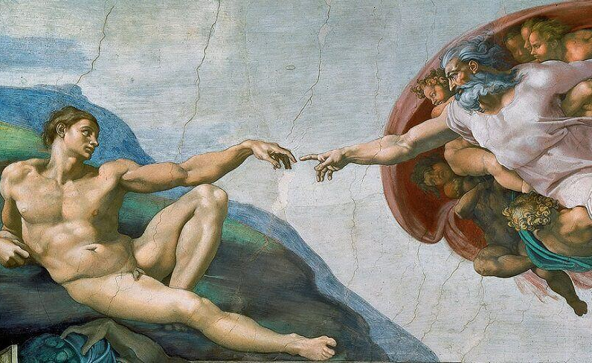

Slide 8
How is Rocky Horror Religion?
Acts as a modern retelling of the book of Genesis
(as found in the Jewish Bible and the Christian Old Testament)
References to the betrayal of Jesus
Contains religious imagery (The Creation of Adam by Michelangelo)
Unites people together
J.Z. Smith: Us vs. Them
True Religion vs. False Religion
McCutcheon: Emic vs. Etic
Narration of the Film from an outsider perspective

Slide 9
Sources
Six ways that 'The Rocky Horror Picture Show' is a religion (religionnews.com)
The Secret Jewish History of the Rocky Horror Picture Show (forward.com)
Rocky Horror, Hedwig and Religion: November 2010 (rockyhedwigreligion.blogspot.com)
The Rocky Horror Show: Queer Genesis – YouTube
Studying Religion: An Introduction, Russel T. McCutcheon
Religion, Religions, Religious, J.Z. Smith

